Slide 1
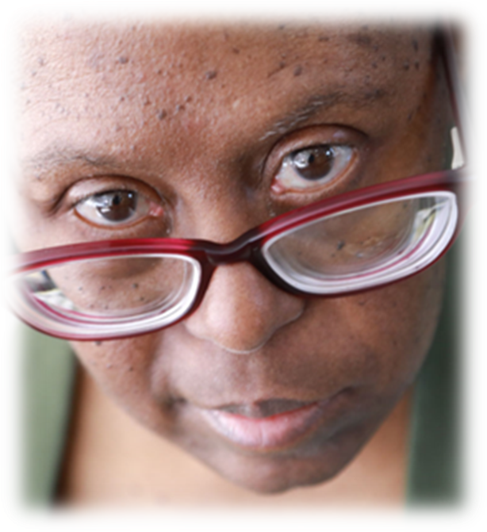
Aging Individuals with IDD and Quality of Life into Old Age
Barbara Coppens
Advocate Assistant
Disability Rights New Jersey
Seth M. Keller, MD
Co-President NTG
June 25, 2024

Slide 2
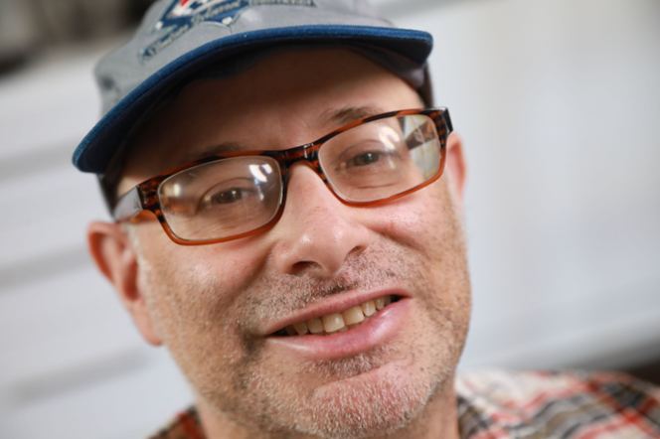
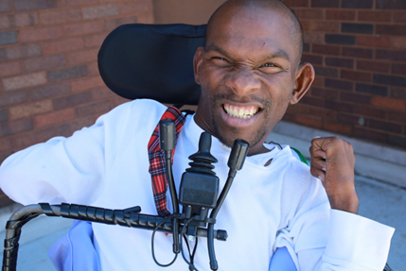
No Conflicts or Disclosures
Photos Courtesy of Rick Guidotti Positive Exposure

Slide 3
Introductions

Slide 4
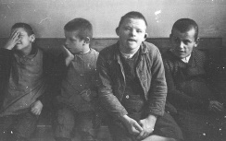
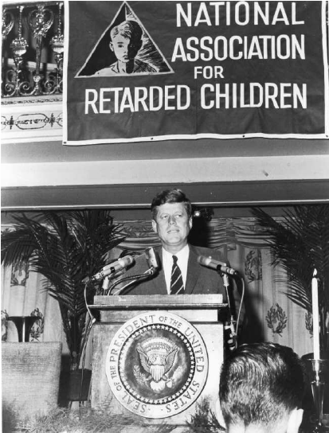
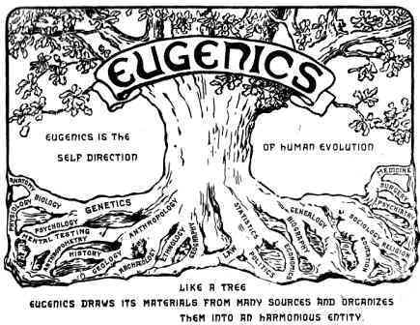
United States Life Expectancy
Approximately 6.5 million people in the United States have an intellectual disability (ID). 2019
Source: Carter & Jancar, 1983, Janicki, Dalton, Henderson & Davidson, 1999

Slide 5
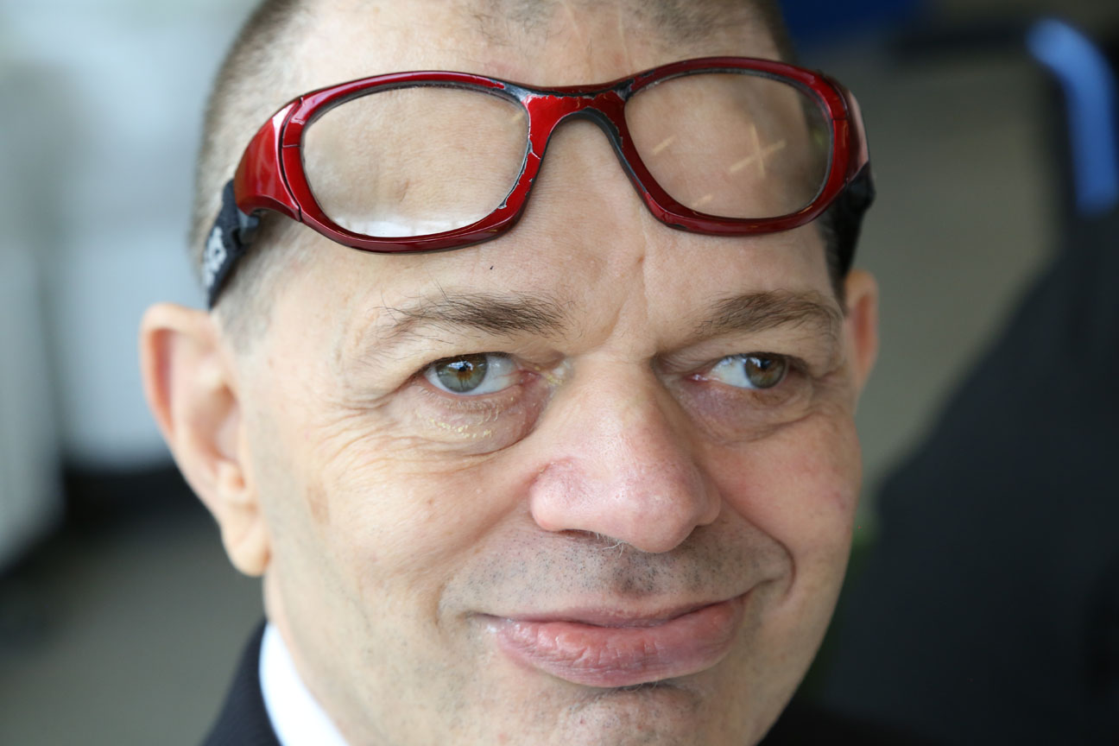
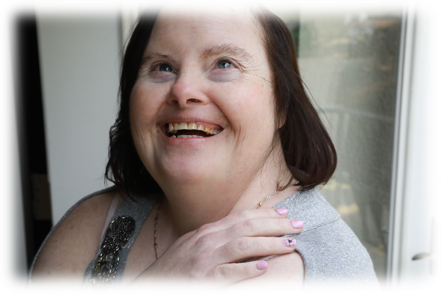
Aging and Intellectual and Developmental Disabilities
In 2002, an estimated 641,000 adults with IDD were older than 60.
In 2002 about 75% of all older adults with IDD were in the 40-60 year old age range.
The number of adults with IDD age 60 years and older is projected to nearly double from 641,860 in 2000 to 1.2 million by 2030 due to increasing life expectancy and the aging of the baby boomer generation

Slide 6
Expected Physical Changes of Aging
Osteopenia/Osteoporosis - normal aging-related bone loss
Sarcopenia - progressive loss of muscle mass
Presbyopia: the lens of the eye becomes stiffer and less flexible – affecting the ability to focus on close objects (accommodation)
Presbycusis – aging related change in the ability to detect higher pitches – more noticeable in those age 50+
Gustation (i.e. the sense of taste) decrements become more noticeable beyond 60+
Olfaction (i.e. the sense of smell) decrements become more noticeable after age 70+
Somatosensory System - Reduction in sensitivity to pain, touch, temperature, proprioception
Vestibular – Reduction in balance and coordination
Cognitive – Reduction in short term memory loss, attention, and retrieval
Homeostenosis -- Narrowing of reserve capacity

Slide 7
Successful Aging/Aging Well
Freedom from disability and disease
High cognitive and physical functioning
Social engagement
Taking action
Emotionally
Physically
Mentally
Spiritually
February 22, 2010

Slide 8
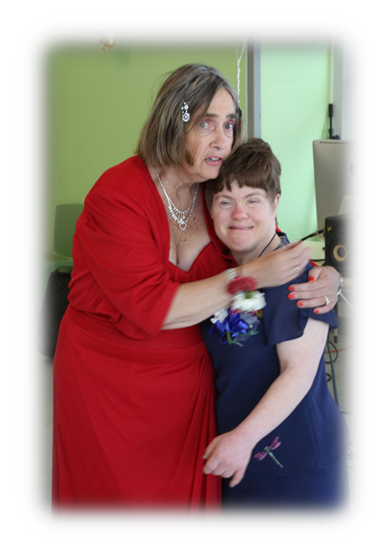
Potential Barriers and Roadblocks
Ageism
Denial
Self Efficiency
Unrealistic Goals
Myths and stereotypes

Slide 9
Potential Roadblocks affecting IDD & Aging
Aging related disorders are superimposed on pre-existing social, mental & physical challenges:
Diagnosis is more challenging; Diagnostic Overshadowing
Interventions may be more challenging
Expectations and focus has been on gains and not loss
Fewer health care providers have expertise in both aging & ID
Service delivery may be a challenge because of political issues between the aging & the ID care systems
Parents/sibling age with associated challenges
Persons with IDD may have more trouble dealing with normal age related changes because of their pre-existing disabilities, secondary conditions and associated medical problems.
Inherent biases and stereotypes

Slide 10
Aging and Decline Affects QOL
Small Change in Cognitive Capability could have profound impact on Independence
Approx. 15%
Dependent Living
Independent Living

Slide 11
DD Specific Aging and Health Complications
Down Syndrome
Cerebral Palsy
Autism
Sleep disturbances, depression, sensory loss
Obesity
Thyroid dysfunction, B12/folate deficiency
Sleep Apnea
Gait dysfunction
Seizure Disorder
Early onset Alzheimer’s Disease
Chronic Pain
Dysphagia, aspiration, Esophageal strictures, gastritis
Dental caries, erosion
Motor dysfunction, inc spasticity and spinal cord dysfunction
Osteoporosis
Worsening bladder/bowel dysfunction
Lifespan outcomes with Autism are unpredictable: some improve, some plateau, some lose skills
Restrictive behaviors such as ritualistic, compulsive or self injurious behaviors tend to become more infrequent with age
Seizures, accidental deaths (drowning, suffocation), earlier death from heart disease, aspiration pneumonia

Slide 12
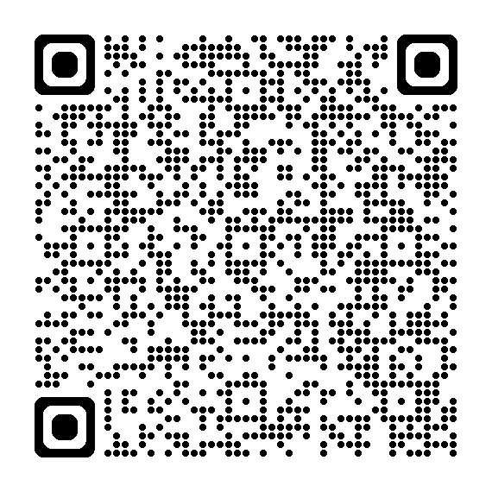
Relaying on the Healthcare system
Diagnostic Overshadowing
Polypharmacy
Provide appropriate and necessary supports
GUIDE Program

Slide 13
Aging and the Impact Upon the Caregivers
Mom, dad and siblings also getting older
May transition to different home
Friends also aging developing their own age related health issues
Community based supports adapting to age and its changes

Slide 14
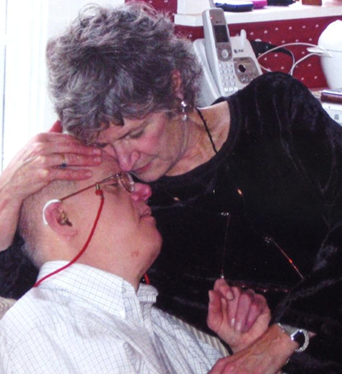
Impact on Families and Caregivers
Frequent issues experienced by families and caregivers include:
Denial
Anger / Frustration
Guilt
Loss and Grief
Letting Go
Financial Stress
Role Reversals
Social Isolation
Becoming patients themselves

Slide 15
Securing a positive future
Supportive decision making
Living will
POLST
Concerns for abuse and neglect
Retirement or not
Bucket List

Slide 16
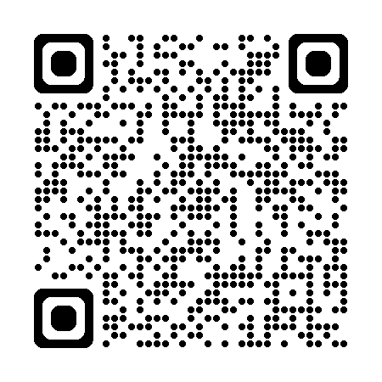

Slide 18
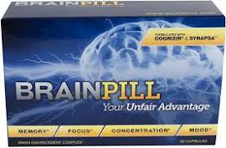
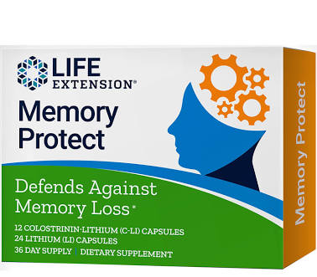
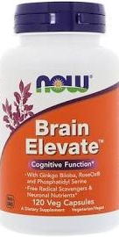
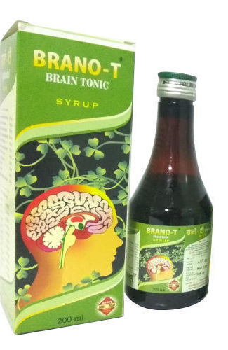

Slide 19
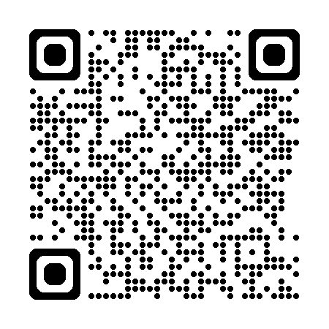
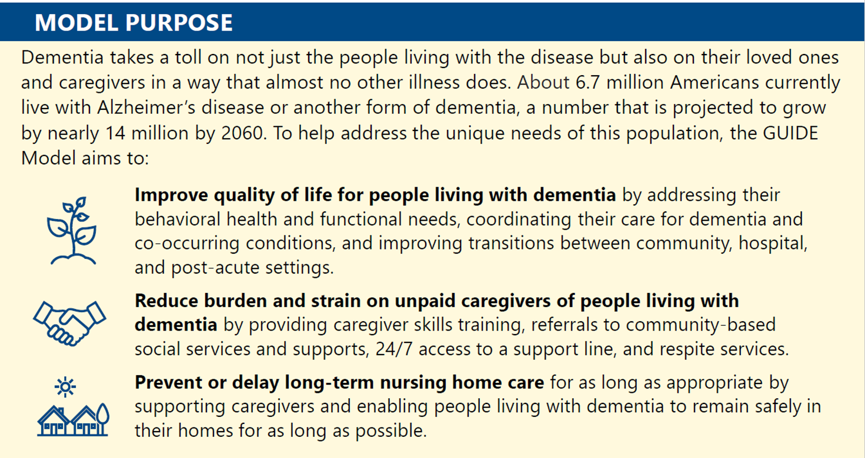
Guiding an Improved Dementia Experience (GUIDE) Model
CMS Alternative Payment Model Model Beneficiary Eligibility
Traditional Medicare Patients/Beneficiaries (Parts A & B)
Not enrolled in Advantage Plans, Special Needs Plans & PACE
Beneficiary has a diagnosis of dementia, as confirmed by clinician attestation
Community Dwelling (Not residing in long-term nursing home)
Excludes Hospice Patients
8 Year Program (July 2024 – July 2032)
To reduce disparities in access to dementia care services, the GUIDE Model incorporates policies to enhance health equity by ensuring that underserved communities have equal access to the model intervention
CMS will actively seek out the participation of eligible organizations that provide care to underserved communities for participation in the GUIDE Model.
https://www.cms.gov/priorities/innovation/innovation-models/guide

Slide 20
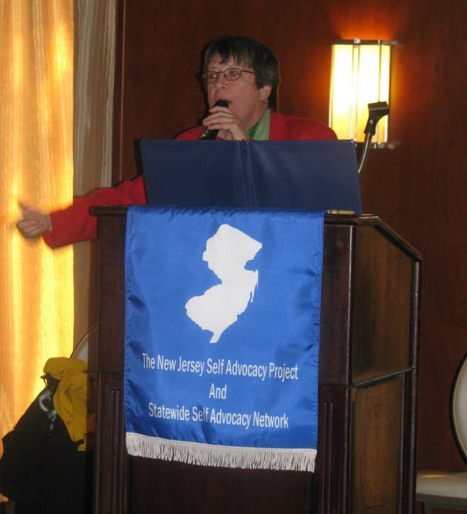
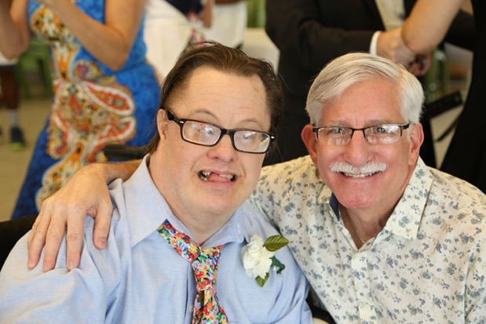
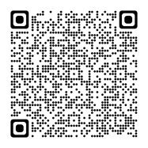
Thank you!
bcoppens@disabilityrightsnj.org
sethkeller@aol.com

