Slide 1
Workshop C: Providing Direct Care in the IDD Community: From Our Local Chapters

Slide 2
Pauline Park-Maxwell, APN DNP
Doctor of Nursing Practice and an Adult-Gerontology Nurse Practitioner at The Arc of Mercer.
20+-year career working with the intellectually and developmentally disabled population
Completing Psychiatric Mental Health Nurse Practitioner certification.

Slide 3
Annette Dunnah MSN, RN, CDDN, BC-NC
Senior Director of Health Services - The Arc of Monmouth
Certified Developmental Disabilities Nurse
Board Certified Nurse Coach
30+ years experience working with the I/DD community

Slide 4
Jessica Turro MSN, FNP-C
Nurse Practitioner at The Arc of Monmouth Primary Care Center
10+ years nursing experience
5 years primary care experience

Slide 5
Providing Health Care to Patients with Intellectual and Developmental Disability
American Association on Intellectual and Developmental Disabilities.
Health Disparities
Health disparities are preventable differences in the burden of disease, injury, violence, or opportunities to achieve optimal health experienced, by socially disadvantaged populations.
As being discussed today for individuals with intellectual developmental disabilities (IDD), are the faces of health disparities . People with IDD have a poorer health status than the general population.

Slide 6
Evidence for Providing Health Care to Patients with Intellectual and Developmental Disability
Journal of Applied Research in Intellectual Disabilities (2018)
Some individuals with intellectual, and or developmental disabilities (IDD) have communication difficulties. When the disability directly affect speech, hearing, or sight , they are more likely to have communication barriers.
Unless a communication barrier is obvious, it is best not to assume one exists unless the patient, a family member, or other caregiver tells you about the barrier. Even when a communication difficulty exists, the exact barrier and the best way to address it often varies.
it is important that healthcare workers are facilitated with opportunities to develop knowledge and skills to support lifestyle-related issues in everyday practice. Care-provider organizations can provide sufficient resources for providers to support health promotion,

Slide 7
Supporting Evidence for Providing Direct Health Care to Patients with Intellectual and Developmental Disability
COMMUNICATING EFFECTIVELY (Tyler and McDermott, 2021)
Health care providers should allow additional time to exchange information.
An assessment of language skills helps the provider to choose the level of language to use. Talking with someone with mild communication difficulty is very different from talking with a person with a moderate or severe communication difficulty.
Many people have stronger receptive (understanding) communication skills than expressive skills.
Conversely, a person’s expressive speech may sometimes give an impression of better comprehension than is the case, so check the patient’s understanding. Also incorporated by the assistance of the immediate health care staff

Slide 8
Supporting Evidence for Providing Direct Health Care to Patients with Intellectual and Developmental Disability
COMMUNICATING EFFECTIVELY (Tyler and McDermott, 2021)
Some people may be delayed in responding to questions; so much so that answers may seem to “come out of nowhere.” Give them time to process their thoughts and express themselves.
Some people may also have difficulty giving you an accurate picture of their feelings and symptoms because of limitations in interpreting internal cues (e.g., need to urinate, anxiety). As mentioned before, involving caregivers who know the patient well may help you to better understand his/her experiences. However, as much as possible, continue to focus your communication efforts on the patient. Never compromise their autonomy.
If you are in a busy area with many distractions, consider moving to a quieter location.

Slide 9
Supporting Evidence for Providing Direct Health Care to Patients with Intellectual and Developmental Disability
Journal of Applied Research in Intellectual Disabilities (2018)
It is imperative to increase health care provider’s awareness when providing direct care for patients with intellectual and developmental disabilities.
Providers should strive to enhance the patient’s participation in completing their health visit.
People with intellectual disability may understand what healthy behaviour is, but they often need support to integrate healthy behaviour into their daily routine . When health care providers are equipped to support healthy behaviour, and educated this population . Having this level of primary health care intervention will allow them to identify health problems early.
Developing effective communication will reduce behavioral interruptions when the most suitable approach to offering health care is implemented.

Slide 10
Supporting Evidence for Providing Direct Health Care to Patients with Intellectual and Developmental Disability
Journal of Applied Research in Intellectual Disabilities (2018)
Implementing holistic and comprehensive health care for individuals with IDD can be achieved by incorporating workforce awareness, making changes in health delivery perspective, and equipping staff with the tools for successfully achieving the goal of meeting the needs of this vulnerable population.

Slide 11
Helpful Resources
Primary care of the Adult with Intellectual and Developmental Disabilities. UpToDate. at https://www.uptodate.com/contents/primary-care-of-the-adult-with-intellectual-and-developmental-disabilities
Pre-visit telephone script developed by Tyler and McDermott (2021).
IDD Healthcare E-Toolkit at https://iddtoolkit.vkcsites.org/
Comparisons of self and proxy report on health-related factors in people with intellectual disability 2018, Journal of Applied Research in Intellectual Disabilities

Slide 12
Diagnostic Overshadowing
Definition: When signs and symptoms arising from physical or mental health problems are mis-attributed to the individual’s physical, developmental, or intellectual disability.
Can be detrimental to quality of care and can contribute to delays in diagnosis and treatment, unnecessary or unsafe care, and inequities of care.
Individuals with disabilities are at greater risk of diagnostic overshadowing
Most clinicians do not have training, experience and skills grounded in treating individuals with disabilities – this increases the risk for diagnostic overshadowing

Slide 13
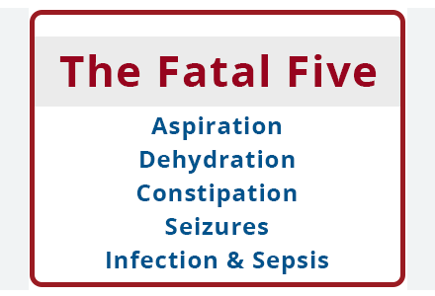
The Fatal Five
Diagnostic overshadowing impacts the Fatal Five
All behavior is communication - allow time for the person to express themselves.
Pay close attention to non-verbal communication.
Ask how the person communicates pain, fear, sadness etc …
Be aware of the physical setting and how it can be adjusted to make the person more comfortable

Slide 14
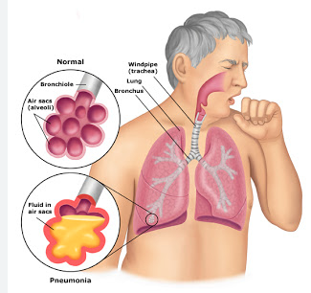
Fatal Five - Aspiration
Aspiration is often listed as a common cause of death in institutional settings, including large group care settings for people with IDD. ​
Aspiration pneumonia is a common discharge diagnosis following hospitalization.
Risk Factors for people with I/DD may include:
Decreased or absent gag reflex​
Weakness of the muscles that are used in chewing and swallowing
Poor positioning during meals​
Medication side effects that relax the muscles used for chewing and swallowing.​
Gastroesophageal Reflux Disease (GERD)​ - Rule out GERD with PICA behaviors
Eating too fast or having too much food in the mouth while eating

Slide 15
Fatal Five - Constipation
Neuromuscular degenerative disorders, such as cerebral palsy, may impair the central nervous system’s response for the need to elimination
People with muscle weakness, such as down syndrome, may lack the strength needed for adequate bowel function​
People with mobility issues can lack the activity level needed to help the bowels function properly
Poor swallowing skills may make it difficult to eat and drink adequate amounts of fiber and fluids.​
Medication side effects can contribute to constipation. Watch for constipation in persons who take antacids, anticonvulsants, antidepressants, tranquilizers, iron supplements, drugs for tremor, medication for urinary control or if the individual is using narcotics or other drugs for pain relief.
Poorly managed constipation can lead to bowel perforation and bowel obstruction, one of the most common preventable causes of mortality for people with I/DD​

Slide 16
Fatal Five - Dehydration
Higher rate of swallowing issues for people with I/DD compared to general population
Poor oral health can contribute
Communication limitations can be a barrier to adequate fluid intake

Slide 17
Fatal Five - Seizure Disorder
Individuals with IDD have a higher incidence of seizure disorders or epilepsy.
There can be significant morbidity or mortality due to issues such as respiratory suppression or aspiration
Life expectancy for people with active seizure disorders has been shown to be up to 10 years less than those without epilepsy.
Drug toxicity and medication side effects can further impact the health of people who take these medications.
Balancing adequate control of seizures and the risk of adverse drug reactions must always be at the forefront of the treatment plan.

Slide 18
Fatal Five - Infection/Sepsis
People with IDD are three times more likely to die from sepsis than the general population
People with IDD often have difficulty communicating when they're not feeling well, which can lead to sepsis going unnoticed.
Lack of access to healthcare providers with experience working with the population and lack of access to screenings may prevent diagnosing sepsis early.
Early detection and treatment of these conditions can improve quality of life, lower the risk of death, and lead to better health

Slide 19
Trauma and the I/DD Community
People with developmental disabilities suffer 2.5 to 10 times the abuse and neglect of their non-disabled peers.
More than 90% of adults with a developmental disability report that they’ve experienced sexual abuse.
In an institutional setting, the risk of sexual abuse is 2 to 4 times higher than in the community. The more severe the disability, the more likely abuse is to occur.
People with intellectual or developmental disabilities are also often more vulnerable to abuse and neglect because of a higher level of assistance required from caregivers. This sometimes includes help with invasive daily living functions.

Slide 20
Trauma Considerations for Medical Appointments
Medical appointments can be a trigger for people who have experienced boundary violations and sexual trauma
Many medical practitioners are not trauma informed
Include persons with I/DD to be partners in care. Communicate directly with the person and explain what the appointment will entail and what you will do. Provide verbal cues when touch will be involved
The person being supported may prefer a certain physician, gender etc.. accommodate these requests as much as possible

Slide 21
Clinical Considerations
Assess: What is the person usually like? Is the condition/ concern getting better or worse?
Manage chronic health issues so they do not become routine or invisible
Work with caregivers to gather useful data about treatments - (example BM charts,)
Work with residential settings to assure health and safety (do they have a nurse? Are there health protocols in place?)
Include information reported by parents/staff in your overall assessment of the situation

Slide 22
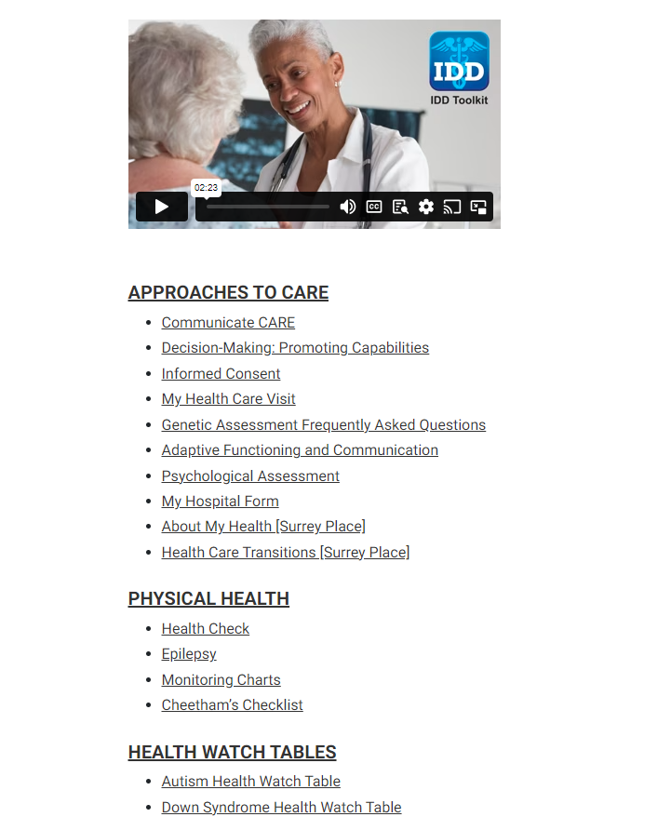
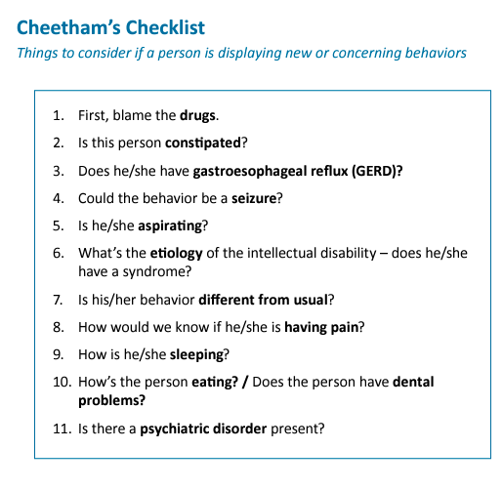
Primary Care Resource- I/DD toolkit
Provides healthcare providers with best practice tools, information regarding specific medical and behavioral concerns of adults with I/DD.
Designed to support primary care practices to care for adults transitioning from pediatric care.
https://iddtoolkit.vkcsites.org/

Slide 23
Primary Care Resources
Primary Care of Adults with Developmental Disabilities - College of Family Physicians of Canada
https://www.cfp.ca/content/60/7/e356.full
Surrey Place
Provides specialized clinical services to children and adults with intellectual and developmental disabilities in the Toronto Region. Surrey Place is affiliated with the University of Toronto and other academic institutions and is a teaching site for students in a variety of healthcare professions.
https://ddprimarycare.surreyplace.ca/guidelines/

Slide 24
Barriers to Care
Higher rates of
Poor dental health
Obesity
Diabetes, cardiovascular disease
Psychotropic medications
Mortality
Less likely to
Receive preventative screenings & vaccinations
Have adequate management of chronic conditions
Have access to quality healthcare
Have reliable transportation or support at medical appointments
Be socially connected
Be employed

Slide 25
Barriers to care
Lack of IDD curriculum requirements for healthcare professional students
Leads to less understanding of specific needs of the population
People report negative experiences within the healthcare system making them less likely to seek care
Often times, the ER is the 1st stop for patient
Need for more consistent primary care
Communication limitations
Sensory limitations
Bright lights in exam room, noisy or crowded waiting room, wait time for appointment
Cognitive limitations
Does the person understand the care instructions given to them?
IDD patients may also identify with other racial or minority groups that come with their own set of health disparities
Compounded effect

Slide 26
Case Study #1
58 year old male with history of autistic disorder, epilepsy, depression, glaucoma, and hearing loss
DSP staff noted patient to be having loose stool. Imodium was given off the agency’s OTC sheet.
Patient continued to have loose stool for 3-4 days
On day 5 of symptoms, a new staff member noted his stomach “looked like he was pregnant”. Patient was noted to be weak & sent to ER
Patient underwent emergency surgery for bowel obstruction secondary to incarcerated inguinal hernia.
He was hospitalized for 10 days due to bowel obstruction and hypokalemia needing replacement
No call was made to PCP until 911 was called.
Patient never once complained of pain

Slide 27
Case Study #2
62 year old male with history of autistic disorder, altherosclerotic heart disease, chronic constipation, hemorrhoids, impulse disorder, dementia, incontinence, and mobility impairment
Has had a general cognitive decline with unexplained weight loss over the past 6 months.
Followed by GI, but had trouble completing ordered colonoscopy due to poor prep
Presented to PCP office for hemorrhoids and constipation within 1 week of failed attempt
Patient was disimpacted in PCP office by provider
Sent for STAT CT scan which showed severe fecal impaction and indeterminate density in colon
Patient referred to ER - PCP to hospital provider handoff.
Group home and PCP advocated for GI consult in ER
Patient had prep done in the hospital and colonoscopy was performed

Slide 28
Coordination of Care
Patient’s rely on DSP staff or caregiver for compliance and quality of information exchanged at medical appointments
Many specialists due to multiple comorbidities
Important to have continued education for DSP staff
Pharmacology education & training
Warning signs to observe for at home
Wound care
Patient transfers
Limited RN oversight or assistance in group home

Slide 29
Quality of Hospital & ER Care
Higher rates of mortality
Study in England (April 2017–March 2019) noted the likelihood of experiencing harm in disability groups was up to 2.7-fold higher than in patients without developmental disability.
Patient safety incidents led to an excess length-of-stay in hospital of 3.6–15.4 days and an increased mortality risk of 1.4–15.0 percent.
Lack of communication on patient’s plan of care
Lack of quality discharge information or complete medication reconciliation
Difficulty obtaining complete records after discharge
Lack of “medical home” for patient’s to follow up with
Notes:
We examined the prevalence of five avoidable in-hospital patient safety incidents (adverse drug reactions, hospital-acquired infections, pressure ulcers, postoperative pulmonary embolism or deep vein thrombosis, and postoperative sepsis) for four developmental disability groups (people with intellectual disability, chromosomal abnormalities, pervasive developmental disorders, and congenital malformation syndrome) in the English National Health Service during the period April 2017–March 2019

Slide 30
Importance of Advocacy
According to the CDC, more than 1 in 4 people in the US live with some type of disability (28.7%)
1 in 4 adults with disabilities (18-44) do not have a usual healthcare provider
1 in 4 adults with disabilities (18-44) have an unmet healthcare need because of cost in the past years
1 in 6 adults with disabilities (45-64) did not have a routine check up in the past year
Need for more IDD specific healthcare training
Need for change surrounding stereotypes and stigmas surrounding disability
More research is needed into the health disparities of IDD population
Change is needed on multiple levels of US healthcare system to improve the quality of care for IDD population

Slide 31
References
Baumbusch, J., Phinney, A., & Baumbusch, S. (2014). Practising family medicine for adults with intellectual disabilities: Patient perspectives on helpful interactions. Canadian Family Physician, 60(7), e356–e361. https://www.cfp.ca/content/60/7/e356.full
CDC. (2023, January 5). Disability Impacts All of Us Infographic | CDC. Centers for Disease Control and Prevention.
https://www.cdc.gov/ncbddd/disabilityandhealth/infographic-disability-impacts-all.html#print
Friebel, R., & Maynou, L. (2022). Assessing The Dangers Of A Hospital Stay For Patients With Developmental Disability In England, 2017–19. Health Affairs,
41(10), 1486–1495. https://doi.org/10.1377/hlthaff.2022.00493
Helping People Live Better Lives. Helping People Live Better Lives. Health Disparities in Individuals with Intellectual and
Developmental Disabilities. (n.d.). https://dhhs.ne.gov/Documents/Henrichs.pdf
‌Primary Care Guidelines – DDPCP. (2018). Surreyplace.ca. https://ddprimarycare.surreyplace.ca/guidelines/
Addressing Trauma in individuals with I/DD https://www.relias.com/blog/addressing-trauma-in-individuals-with-idd
Fatal Five Overview for staff https://www.relias.com/blog/fatal-five-overview
Joint Commission Sentinel Alert. Diagnostic overshadowing among groups experiencing health disparities www.jointcommission.org/-/media/tjc/documents/resources/patient-safety-topics/sentinel-event/sea-65-diagnostic-overshadowing-6-16-22-final.p

