Slide 1
Catching Up with Connor
Section 1634 Disabled Adult Child (DAC)
Connor Griffin, MPH
Director, Health Care Advocacy Program
The Arc of New Jersey
healthcareadvocacy@arcnj.org
thearcnjhealthcareadvocacy.org

Slide 2
Section 1634 of the Social Security Act
Sec. 1634. [42 U.S.C. 1383c] (a) The Commissioner of Social Security may enter into an agreement with any State which wishes to do so under which the Commissioner will determine eligibility for medical assistance in the case of aged, blind, or disabled individuals under such State’s plan approved under title XIX.
(c) If any individual who has attained the age of 18 and is receiving benefits under this title on the basis of blindness or a disability which began before he or she attained the age of 22.
(1) becomes entitled, on or after the effective date of this subsection, to child’s insurance benefits which are payable under section 202(d) on the basis of such disability or to an increase in the amount of the child’s insurance benefits which are so payable, and
(2) ceases to be eligible for benefits under this title because of such child’s insurance benefits or because of the increase in such child’s insurance benefits,
Such individual shall be treated for purposes of title XIX as receiving benefits under this title so long as he or she would be eligible for benefits under this title in the absence of such child’s insurance benefits or such increase.[121]

Slide 3
Adults with a Disability that Began Prior to Age 22
An adult who has a disability that began before age 22 can be eligible for benefits if a parent is deceased or starts receiving Social Security retirement or disability benefits (SSDI).
It is considered a “child's benefit” because it is paid on a parent's Social Security earnings record.
It is not necessary that the DAC has ever worked.
Benefits are paid based on the parent's earnings record.
A DAC cannot have substantial earnings. The “Substantial Gainful Activity (SGA)” amount increases each year.
In 2024, this means working and earning more than $1,550 (or $2,590 if you’re blind) per month.

Slide 4
Who Qualifies as a DAC?
To qualify as a DAC, a person must:
Have been receiving Supplemental Security Income (SSI)
Be at least 18 years old
Have blindness or a disability that began prior to age 22
Have been receiving SSI based on blindness or disability; and
Have lost SSI due to receipt of Social Security benefits on a parent’s record because of the parent’s retirement, disability, or death.
Some individuals who receive a smaller SSDI amount from the parent will also receive a reduced SSI benefit, and Medicaid benefits would continue unaffected.

Slide 5
Disabled Adult Child (DAC)
When an individual begins receiving SSDI from a parent’s work record, the amount is often too high to receive SSI.
This often results in the termination of SSI and Medicaid.
The person can qualify for Medicaid again as a DAC.
Need to re-enroll with Medicaid as a DAC, and the monthly SSDI benefit amount is disregarded.
Remember, Medicaid is needed for DDD!
Must still remain under the monthly resource limit of $2,000.
DAC FAQs fact sheet

Slide 6
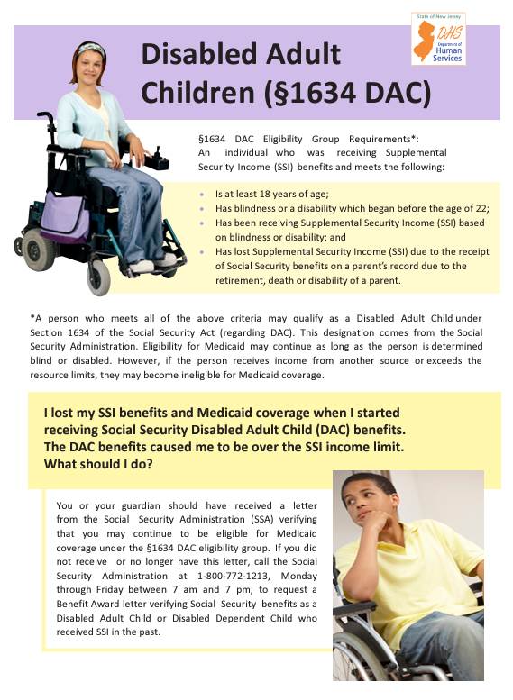
Disabled Adult Child (DAC)

Slide 7
Medicaid as a DAC
Review the Department of Human Services (DHS) flyer
You need to fill out an NJ FamilyCare Aged, Blind, Disabled (ABD) Request for Information (RFI) packet.
The RFI packet is the DAC Medicaid application.
Individuals enrolled with the Division of Developmental Disabilities (DDD) Supports Program or Community Care Program should receive the packet from DDD/their support coordinator.
Non-DDD individuals should receive a packet from their local County Board of Social Services
Contact the CBoSS if you do not receive one.
Please contact The Arc of NJ Health Care Advocacy program if there are any issues in enrolling with Medicaid as a DAC!

Slide 8
More Information
The Arc of NJ Health Care Advocacy Program
thearcnjhealthcareadvocacy.org
The Arc of NJ Fact Sheets - DAC and DAC FAQs
www.arcnj.org/programs/health-care-advocacy/resources.html
DHS Flyer on Section 1634 DAC
www.nj.gov/humanservices/ddd/assets/documents/individuals/dac-flyer.pdf
Subscribe to our email list at arcnj.org
Scroll to to the bottom of the page and click “Health care issues” then the subscribe button.
Still have questions? Email: healthcareadvocacy@arcnj.org

