Slide 1
Catching Up with Connor
Important SSI Updates
on September 30, 2024
Connor Griffin, MPH
Director, Health Care Advocacy Program
The Arc of New Jersey
healthcareadvocacy@arcnj.org
thearcnjhealthcareadvocacy.org

Slide 2
Supplemental Security Income (SSI)
Provides monthly payments to eligible individuals with little to no income or resources
SSI is for older adults 65+ as well as people of any age who are blind and/or disabled
Maximum monthly benefit of $974.25 for a single individual in NJ (2024)
Monthly resources/assets cannot exceed $2,000 for a single person
Excludes resources in an ABLE account or Special Needs Trust

Slide 3
SSI Updates Beginning on September 30th
Expanding the Definition of a “Public Assistance” Household
Removing Food from In-Kind Support and Maintenance (ISM) Calculations
Expanding SSI Rental Subsidy Policy

Slide 4
Key Definition: In-Kind Support and Maintenance (ISM)
ISM is defined by SSA as “unearned income received by SSI applicants and recipients in the form of food and/or shelter from anyone living within or outside their households.”
ISM is counted as income for the person when calculating his or her monthly SSI payment.
A person receiving ISM, for example, an adult child who lives at home with his or her parents and does not pay towards the household’s monthly food/shelter costs, can have their monthly SSI benefit reduced by up to 1/3rd.

Slide 5
Expanding the Definition of a “Public Assistance” Household
Currently, if a person receiving SSI lives in a home where every person receives a “public assistance” benefit, SSA does not evaluate if other members of the home are providing the SSI recipient with ISM
9/30: To include households where one or more residents receive Supplemental Nutrition Assistance Program (SNAP) benefits and households where not all residents receive public assistance.
Previously, all members of the household needed to receive a public assistance benefit.
This will help more people to qualify for SSI and increase some SSI payment amounts.
Read here

Slide 6
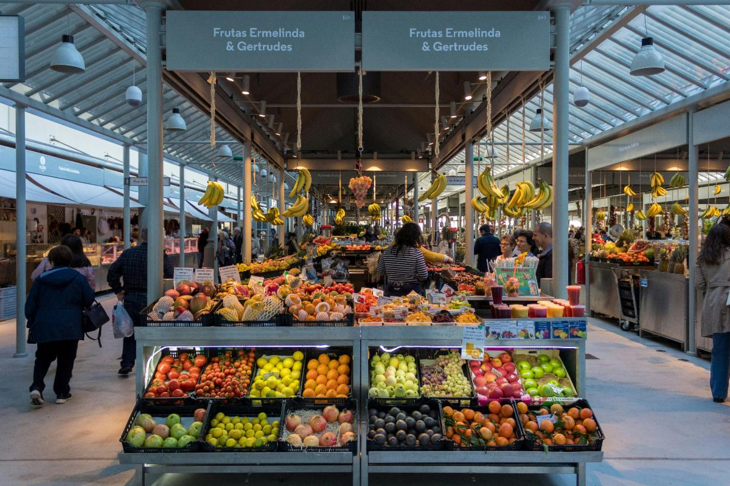
Removing Food from In-Kind Support and Maintenance (ISM) Calculations
9/30: SSI recipients will no longer have to report food/groceries, will not be penalized if receiving food assistance from family and friends, and see less month to month variability with their SSI benefits.
Food will not be calculated as part of ISM and not counted as “income.”
Many SSI recipients will see their benefit increase and no longer worry about reporting food/grocery expenditures.
Read here

Slide 7
Expanding SSI Rental Subsidy Policy
Currently, in all but 7 states, if the SSI recipient is a renter and their landlord is a parent or adult child, SSA determines if the recipient is being charged less than they would charge another person.
This can result in a reduction of the SSI benefit.
9/30: Now extends to all states that if a person pays rent equal to or greater than "Presumed Maximum Value," (PMV) SSA assumes the rent is under a business arrangement and will not reduce the SSI benefit.
The SSI recipient is not considered to be receiving ISM when the amount of monthly required rent for the property equals or exceeds PMV.
Read here

Slide 8
More Information
The Arc of NJ Health Care Advocacy Social Security Resources
thearcnjhealthcareadvocacy.org
The Arc of NJ Family Institute Social Security Go Bag
thearcfamilyinstitute.org
Social Security Administration Website
SSA.gov
Subscribe to our email list at arcnj.org
Scroll to to the bottom of the page and click “Health care issues” then the subscribe button.

