Slide 1
Catching Up with Connor
Medicaid & Social Security
Disability Determinations
Connor Griffin, MPH
Director, Health Care Advocacy Program
The Arc of New Jersey
healthcareadvocacy@arcnj.org
thearcnjhealthcareadvocacy.org

Slide 2
NJ FamilyCare/Medicaid
NJ FamilyCare = NJ Medicaid
2 main types of Medicaid:
NJ FamilyCare, covering children under 19, lower income adults, and pregnant women
Aged, Blind, or Disabled (ABD), covering people 65 and older, and people determined blind or disabled by Social Security or the state

Slide 3
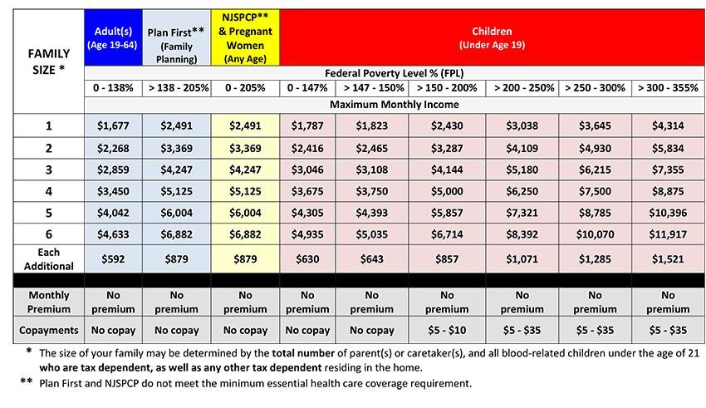
MAGI/ACA Medicaid
NJ FamilyCare, Affordable Care Act (ACA) expansion Medicaid, or “MAGI” (Modified Adjusted Gross Income) Medicaid
Eligibility is only income, not on an individual having a disability
Maximum gross income of $1,732/month for a single person (2024)
ABD Medicaid is usually a better option if an individual has a disability and is eligible

Slide 4
ABD Medicaid
Aged, Blind, Disabled (ABD) Medicaid
Eligibility is dependent upon a person being blind or having a disability
In addition to meeting financial eligibility criteria
If a person qualifies for Supplemental Security Income (SSI) in NJ, they automatically have ABD Medicaid.
Can apply for SSI on the Social Security website
https://www.ssa.gov/apply/ssi

Slide 5
Social Security Disability Determination
SSI application includes submitting information about a person’s disability
Someone is determined to meet Social Security’s definition of a disability in qualifying for SSI
Also can apply in the instance of SSDI (Social Security Disability Insurance)
Someone can qualify, if needed, for a different type of ABD Medicaid with this disability determination from Social Security

Slide 6
Medicaid Disability Determination
If a person has no history of SSI or SSDI, there is likely not an official disability determination from Social Security.
If a person qualifies for ACA/MAGI Medicaid, it is not needed.
BUT, if a person needs to qualify for ABD Medicaid, a disability determination is needed for approval
A Social Security/SSI application is not required, a disability determination is possible through the Division of Medical Assistance and Health Services (DMAHS) state Medical Review Team (MRT)

Slide 7
Medicaid Disability Determination
If there is no Social Security disability determination, ABD Medicaid will require a MRT review
Important to fill out a PA-5 and PA-6 form as part of the process for the MRT
If a person fills out the ABD Medicaid application, you will be asked to submit these forms
Also recommend submitting any medical records supporting his disability in order to have an MRT determination made.
IEPs, medical evaluations, assessments, medications, etc.
If approved by the MRT, the person is then assessed for an appropriate ABD Medicaid program.
Evaluate financial eligibility.

Slide 8
Apply for Medicaid
Online via the NJ FamilyCare website (usually easiest)
Apply here
In person at your local County Board of Social Services office
Find your local office
Print the application, fill in out, and mail it in
A pdf of the application
Call NJ FamilyCare 1-800-701-0710 (TTY: 711) for assistance

Slide 9
More Information
The Arc of New Jersey Health Care Advocacy Program
thearcnjhealthcareadvocacy.org
Subscribe to our email list at arcnj.org
Scroll to the bottom of the page and click “Health care issues” then the subscribe button.
NJ FamilyCare/Medicaid
https://njfamilycare.dhs.state.nj.us/
DMAHS NJ FamilyCare/ABD Medicaid
https://www.nj.gov/humanservices/dmahs/clients/medicaid/

