Slide 1
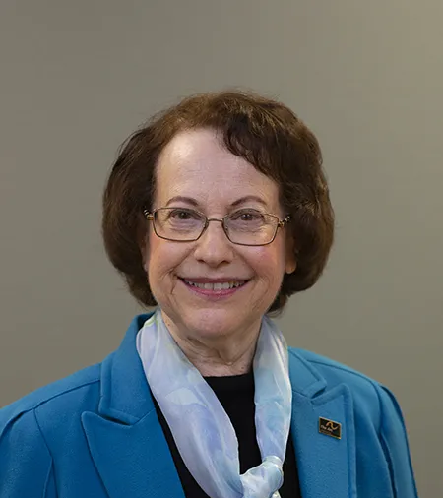
The individual with intellectual and developmental disabilities: why are their dental needs so different?
2024 Beverly Roberts
Memorial Healthcare Symposium
The Arc of New Jersey
October 15, 2024

Slide 2
Evan Spivack, DDS
Professor, pediatric dentistry
Director, Special Care Treatment Center
Rutgers School of Dental Medicine
*****
Attending dentist
Department of Dental Medicine
University Hospital
*****
spivacev@sdm.rutgers.edu

Slide 3
Financial disclosures
Conflicts of interest
Sponsorships

Slide 4
Special care dentistry: why should I care?

Slide 5
Who are our patients?
Intellectual and developmental disability
Dementia
Psychiatric disability
Traumatic brain injury
Stroke
Neuromuscular disorders

Slide 6
General dentistry

Slide 7
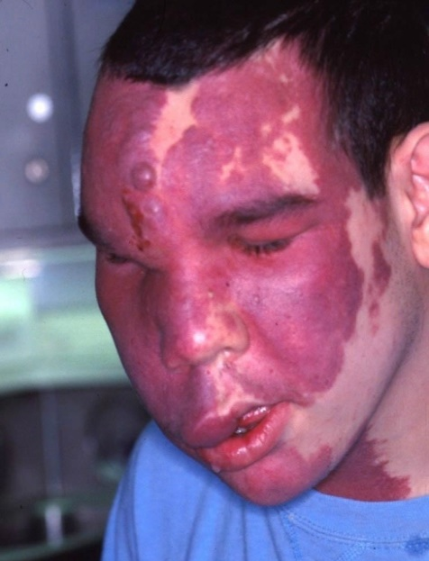
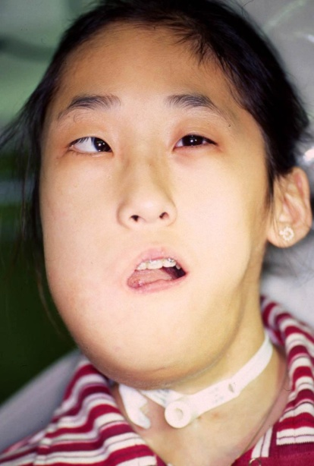
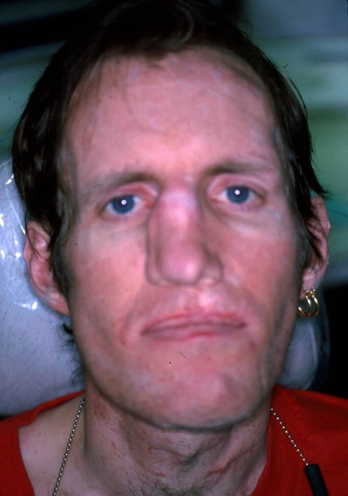
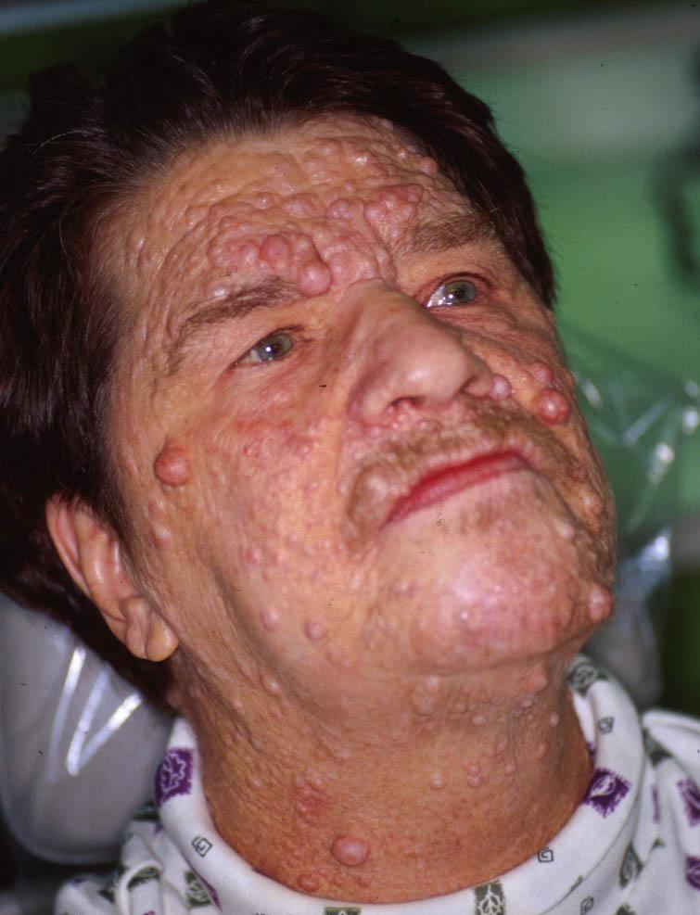
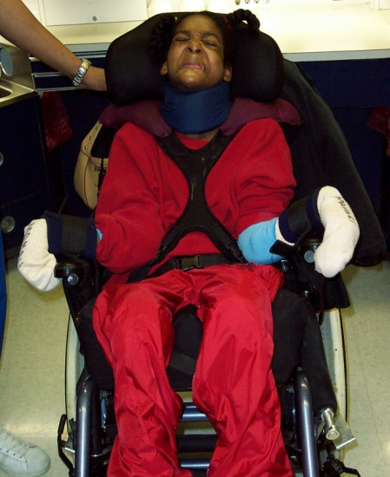
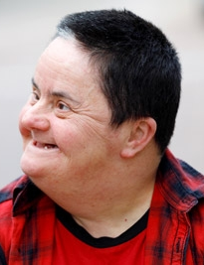
Special care dentistry

Slide 8
Disability in the community
26% of adults have some degree of disability (61 million individuals)
40% of adults over age 65
25% of females
33% of adults with disabilities have unmet healthcare needs

Slide 9
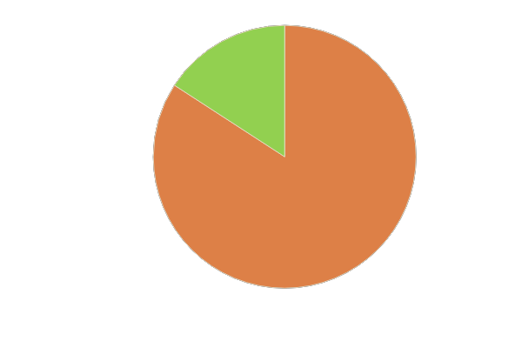
16% of US population has a developmental disability

Slide 10
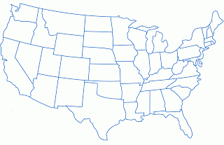
Autism in the U.S.
1 in 36*
*New Jersey: 1 in 34
CDC 2023

Slide 11
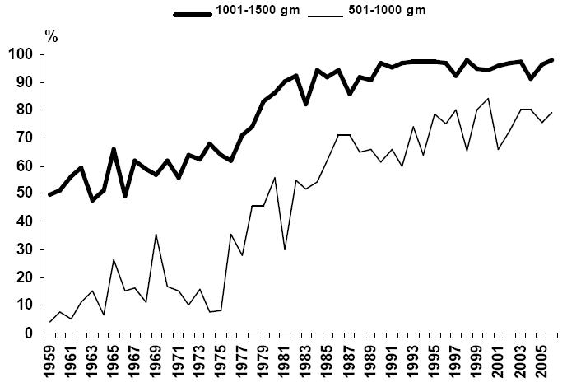
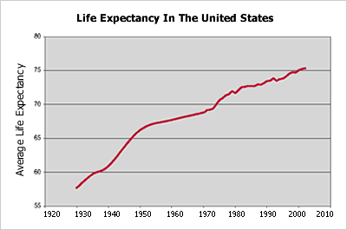
U.S. life expectancy

Slide 12
Mortality from disease
Those with disabilities are likely to suffer up to six times the mortality rate from preventable diseases compared to the general population
Alexander et al. Top Ger Rehab, 2008

Slide 13
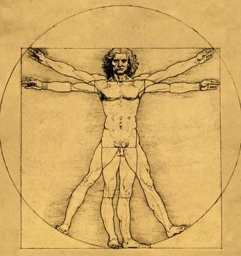
Oral health and systemic health
Association found with numerous systemic concerns
Diabetes
Respiratory concerns
Cardiac concerns
Neurologic concerns

Slide 14
Oral health and systemic health
Association found with numerous systemic concerns
Diabetes
Respiratory concerns
Cardiac concerns
Neurologic concerns
Periodontal disease
Glycemic control

Slide 15
Oral health and systemic health
Association found with numerous systemic concerns
Diabetes
Respiratory concerns
Cardiac concerns
Neurologic concerns
Periodontal pathogens
Aspiration
Pneumonia

Slide 16
Oral health and systemic health
Association found with numerous systemic concerns
Diabetes
Respiratory concerns
Cardiac concerns
Neurologic concerns
Periodontal pathogens
Inflammation
Endocarditis Heart attack Stroke

Slide 17
Oral health and systemic health
Association found with numerous systemic concerns
Diabetes
Respiratory concerns
Cardiac concerns
Neurologic concerns
Periodontal disease
Dementia/cognitive decline
Tooth loss

Slide 18
The need for dental care
1 out of 2 persons with a significant disability cannot find a professional resource to provide appropriate and necessary dental care
Oral health problems are the second leading health conditions that affect the quality of life in the disabled population
Adults with disabilities were less likely to have visited a dentist within the past year compared to people without disabilities

Slide 19
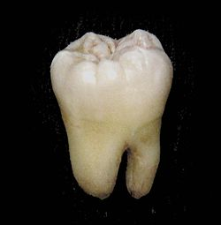
Oral health in the special needs community

Slide 20
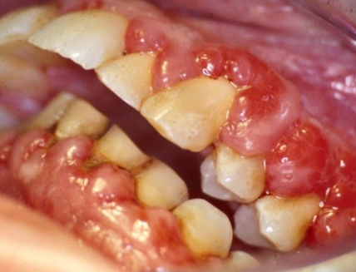
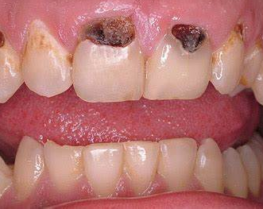
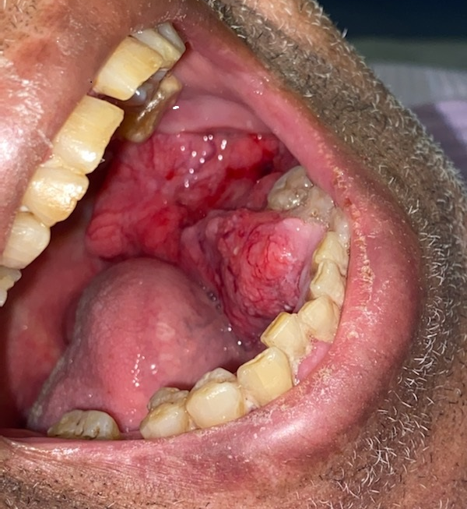
Common oral diseases
PERIODONTAL DISEASE DENTAL CARIES ORAL CANCER

Slide 21
CAREGIVER
HOUSING
BEHAVIOR
MEDICAL
CONCERNS
CULTURAL
ISSUES
SIDE
WALKS
DOORS
SUPPORT
NETWORK
DENTAL
COMPLEXITY
TRANSPORT
ORAL
HYGIENE
FINANCES
DIET
STAIRS
PHYSICAL
CONCERNS
COMMUNI
CATION

Slide 22
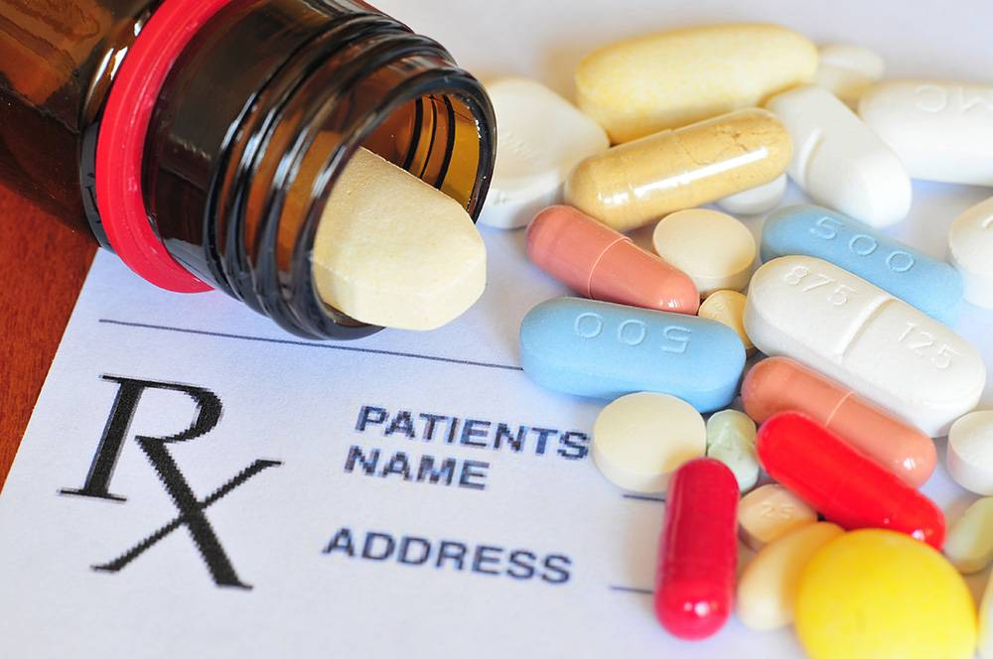
Special challenges: medications
Xerostomia
Gastric reflux
Excess sugars (liquids)
Gingival hypertrophy

Slide 23
Special challenges: medications
Xerostomia
Gastric reflux
Excess sugars (liquids)
Gingival hypertrophy

Slide 24
Special challenges: anatomy
Oral (mal)occlusion
Airway considerations
Enlarged tongue
Dental crowding/space considerations
Dental anatomy

Slide 25
Special challenges: anatomy
Oral (mal)occlusion
Airway considerations
Enlarged tongue
Dental crowding/space considerations
Dental anatomy

Slide 26
Special challenges: anatomy
Oral (mal)occlusion
Airway considerations
Enlarged tongue
Dental crowding/space considerations
Dental anatomy

Slide 27
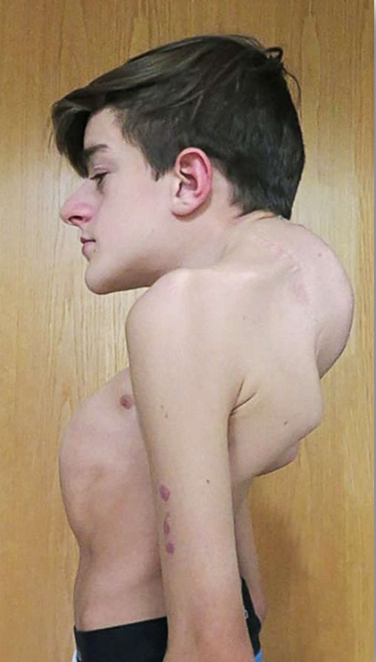
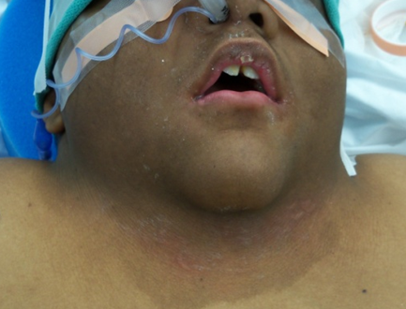
Special challenges: anatomy
Oral (mal)occlusion
Airway considerations
Enlarged tongue
Dental crowding/space considerations
Dental anatomy

Slide 28
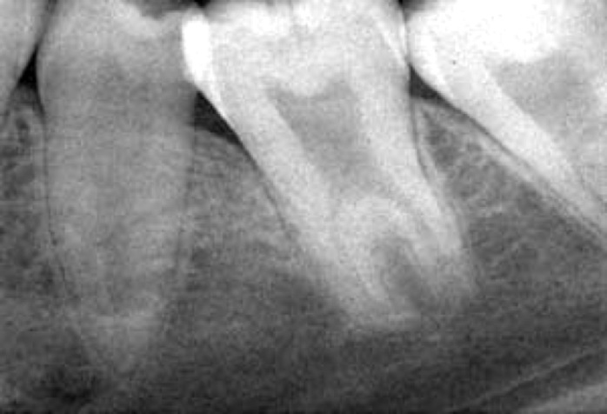
Special challenges: anatomy
Oral (mal)occlusion
Airway considerations
Enlarged tongue
Dental crowding/space considerations
Dental anatomy

Slide 29
Special challenges: dental status
Bruxism
GERD
Dental caries
Periodontal disease
Edentulism (full or partial)

Slide 30
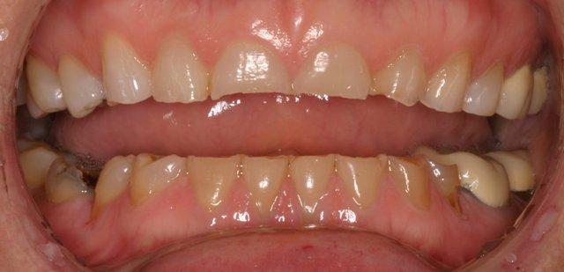
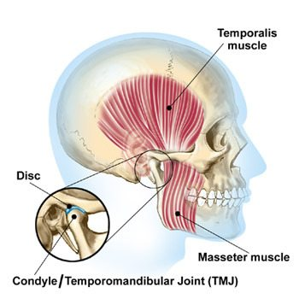
Special challenges: dental status
Bruxism
GERD
Dental caries
Periodontal disease
Edentulism (full or partial)

Slide 31
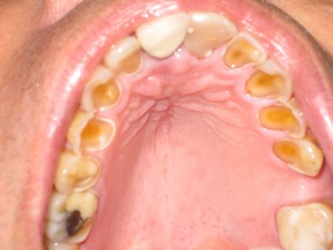
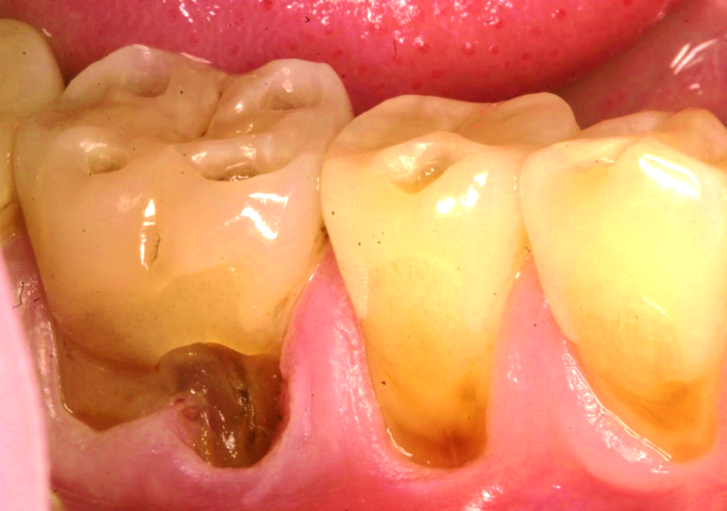
Special challenges: dental status
Bruxism
GERD
Dental caries
Periodontal disease
Edentulism (full or partial)

Slide 32
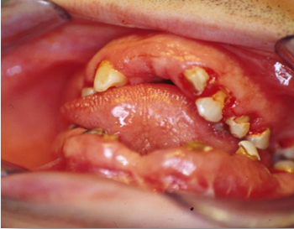
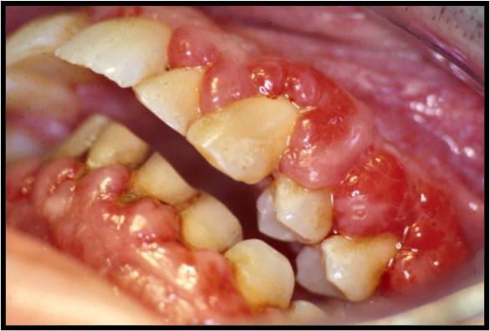
Special challenges: dental status
Bruxism
GERD
Dental caries
Periodontal disease
Edentulism (full or partial)

Slide 33
Special challenges: communication/cognition
Medical/dental history review
Consent to treatment
Post-operative instructions and oral care recommendation
Ability to cooperate for care
Ability to perform/tolerate oral home care

Slide 34
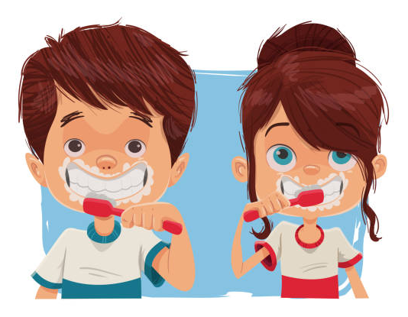
Special challenges: physical and intellectual disability
Can the patients brush their own teeth (effectively)?
Who is brushing the teeth?
Will the patient permit regular professional intervention?

Slide 35
Special challenges: pain
Many patients are nonverbal or have limited verbal ability
Common complaints:
“He isn’t eating”
“She has been holding the side of her face”
“He has lost a lot of weight”
“She grimaces when she eats”
“He isn’t eating the foods he used to eat”

Slide 36
Special challenges: pain
The basics…
Can the pain be localized?
How long have you suspected pain?
Is the pain constant or episodic?
Is the pain spontaneous?
Has there been any swelling or bleeding?
Is there pain with tooth brushing?
Does the pain respond to analgesics?

Slide 37
Special challenges: pain
The basics of function:
Beyond the basics:
Ask about function…
Is there pain on eating and drinking?
What are his favorite foods?
Is there pain with soft and hard foods?
Is there pain with sweets?
Is he pushing away foods?
Has the pace of eating changed?
Is the food being chewed or swallowed?
Are there non-routine signs of pain?
Groaning, moaning, shouting
Hitting face
Other self-injurious behaviors
Hyperorality
Aggressiveness
Passivity
Increased oral defensiveness/resistance

Slide 38
The first visit: setting the stage
Pre-appointment questionnaire: who is the patient?
Medical
Behavioral/sensory
Don’t leave home without it
Medical and dental history
Medications and allergies

Slide 39
What really concerns us: respiratory
Especially significant in:
I/DD (CP, DS, others)
Traumatic brain injury
Complex geriatrics
Why we care:
Sedative use
Intraoperative aspiration

Slide 40
What do we do to maintain oral health?
Oral home care
Tooth brushing, flossing, mouth rinsing
Diet control
Eating, drinking
Professional intervention
Regular evaluations, needed interventions

Slide 41
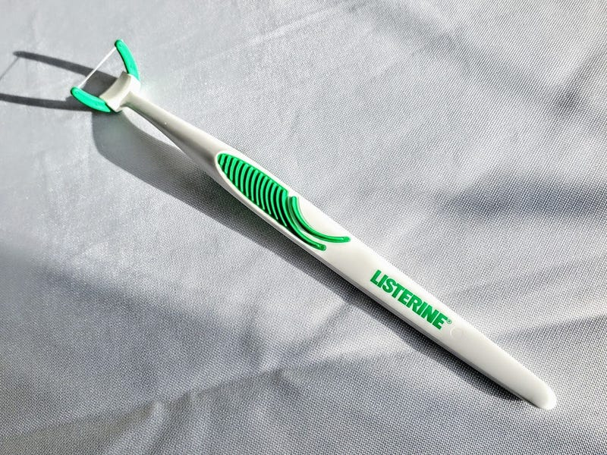
Oral health care tips
Toothbrush: whatever works!
Toothpaste: fluoride
Flossing: Listerine Access Flosser
Oral rinse
Use as swab if necessary
Encourage water after all oral intake

Slide 42
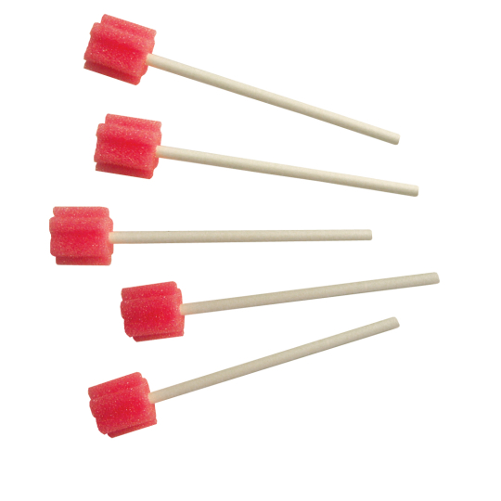
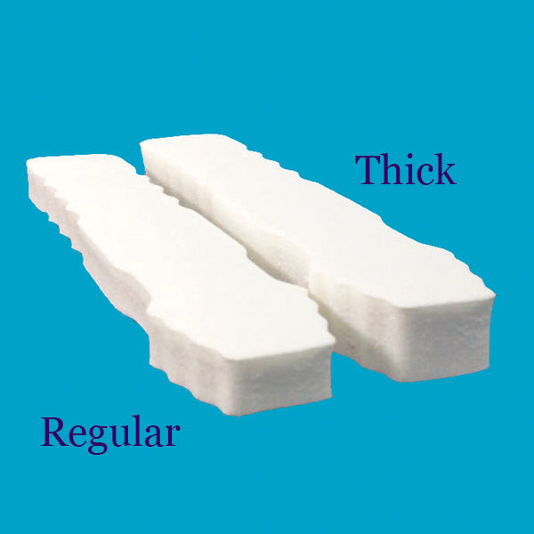
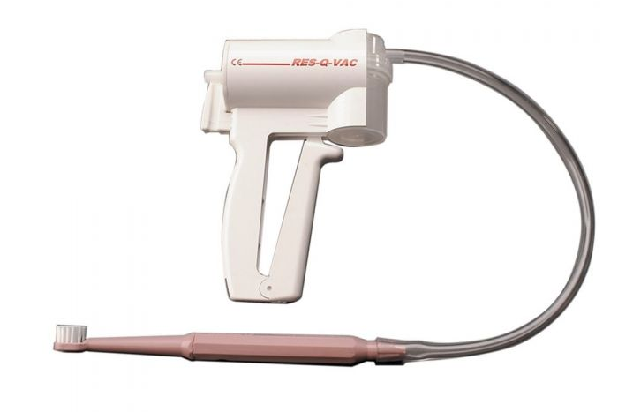
Take-home advice
Toothettes
Open Wide mouth props
Plak-Vac/Res-Q-Vac

Slide 43
Professional intervention
Frequent recall evaluations
Increased frequency of radiographs
Consider PAN
Avoid watch and wait
Keep referral sources available
Fluoride supplementation and SDF
Watch
and
Wait

Slide 44
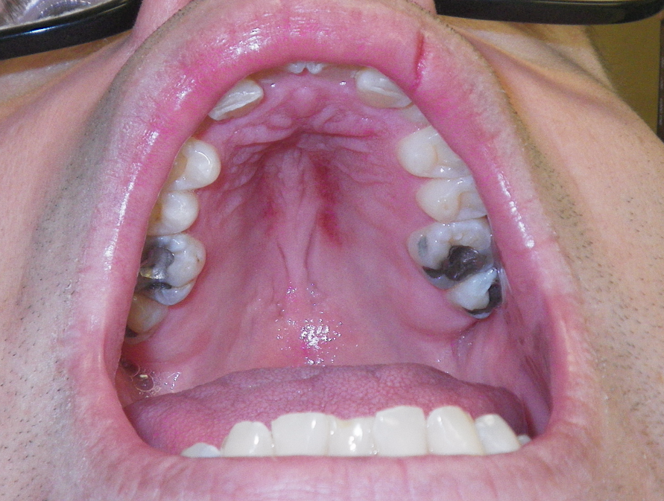
Physical and sexual abuse
Up to seven times those for people without disabilities.
Recent study: 34% of individuals with I/DD
Number is likely highly underestimated
Very small percentage reported, even fewer prosecuted

Slide 45
The challenge to dentistry
Patient complexity
Education
Cost
NJ.com 2012

Slide 46
Thank you for your attention! What questions do you have?
spivacev@sdm.rutgers.edu

