Slide 1
Aging Individuals with IDD and Dementia
October 15, 2024
Seth M. Keller, MD, FAAN
Co-President NTG Past President AADMD
Founder Adult IDD Section AAN

Slide 2
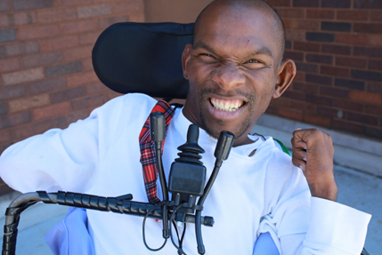
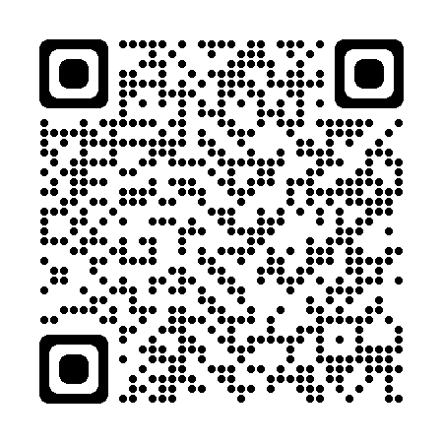
No Conflicts or Disclosures
Photos Courtesy of Rick Guidotti Positive Exposure

Slide 3
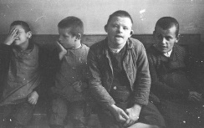
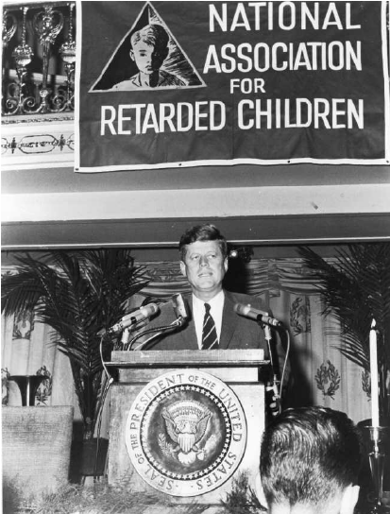
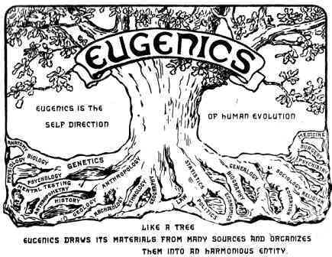
United States Life Expectancy
Approximately 6.5 million people in the United States have an intellectual disability (ID). 2019
Source: Carter & Jancar, 1983, Janicki, Dalton, Henderson & Davidson, 1999

Slide 4
Aging and Intellectual and Developmental Disabilities
In 2002, an estimated 641,000 adults with ID were older than 60.
In 2002 about 75% of all older adults with ID were in the 40-60 year old age range.
The number of adults with ID age 60 years and older is projected to nearly double from 641,860 in 2000 to 1.2 million by 2030 due to increasing life expectancy and the aging of the baby boomer generation

Slide 5
Expected Physical Changes of Aging
Osteopenia/Osteoporosis - normal aging-related bone loss
Sarcopenia - progressive loss of muscle mass
Presbyopia: the lens of the eye becomes stiffer and less flexible – affecting the ability to focus on close objects (accommodation)
Presbycusis – aging related change in the ability to detect higher pitches – more noticeable in those age 50+
Gustation (i.e. the sense of taste) decrements become more noticeable beyond 60+
Olfaction (i.e. the sense of smell) decrements become more noticeable after age 70+
Somatosensory System - Reduction in sensitivity to pain, touch, temperature, proprioception
Vestibular – Reduction in balance and coordination
Cognitive – Reduction in short term memory loss, attention, and retrieval
Homeostenosis -- Narrowing of reserve capacity

Slide 6
Aging and Decline Affects ADL’s
Small Change in Cognitive Capability could have profound impact on Independence
~15%
Dependent Living
Independent Living

Slide 7
Functional decline is the decrement in physical and/or cognitive functioning and occurs when a person is unable to engage in activities of daily living
Cognitive
Sensory
Neuromotor
Psychiatric
General
Medical
Dementia
Hearing
Impairment
Myelopathy
Depression/Anxiety
Cardiac/Pulmonary
Stroke
Visual
Impairment
Radiculopathy
Schizophrenia
Endocrine
Head Injury
Peripheral
Neuropathy
Neuropathy
Bipolar Dis
Musculoskeletal
Seizures
Vestibular
Spasticity
SIB
ADR
Myopathy
Drugs/Alcohol
Parkinsonism
Sleep Apnea

Slide 8
DD Specific Aging and Health Complications
Down Syndrome
Cerebral Palsy
Autism
Sleep disturbances, depression, sensory loss
Obesity
Thyroid dysfunction, B12/folate deficiency
Sleep Apnea
Gait dysfunction
Seizure Disorder
Early onset Alzheimer’s Disease
Chronic Pain
Dysphagia, aspiration, Esophageal strictures, gastritis
Dental caries, erosion
Motor dysfunction, inc spasticity and spinal cord dysfunction
Osteoporosis
Worsening bladder/bowel dysfunction
Lifespan outcomes with Autism are unpredictable: some improve, some plateau, some lose skills
Restrictive behaviors such as ritualistic, compulsive or self injurious behaviors tend to become more infrequent with age
Seizures, accidental deaths (drowning, suffocation), earlier death from heart disease, aspiration pneumonia

Slide 9
Cognitive Changes with Aging
Normal changes = more forgetful & slower to learn
MCI – Mild Cognitive Impairment =
Immediate recall, word finding, or complex problem solving problems (½ of these folks will develop dementia in 5 yrs)
Dementia = Chronic thinking problems in > 2 areas
Delirium =Rapid changes in thinking & alertness
Depression = chronic unless treated, poor quality , I “don’t know”, “I just can’t” responses, no pleasure
can look like agitation & confusion

Slide 10
A term used to describe a group of symptoms affecting memory, thinking and social abilities. In people who have dementia, the symptoms interfere with their daily lives.
DEMENTIA
(Neurocognitive Disorders)
Alzheimer’s
Disease
Early - Young Onset
Late Onset (LOAD)
Vascular
Dementias
(Multi-stroke)
Lewy Body Dementia
Other Dementias
Genetic syndromes
Metabolic abnormalities
Long term alcohol usage
Drugs/toxin exposure
White matter diseases
Chronic Traumatic Encephalopathy (CTE)
Depression or other mental health conditions
Infections; Syphilis
Multiple Sclerosis
Normal Pressure Hydrocephalus (NPH)
Parkinson’s
Dementia
Fronto-
Temporal Lobe Dementias

Slide 11
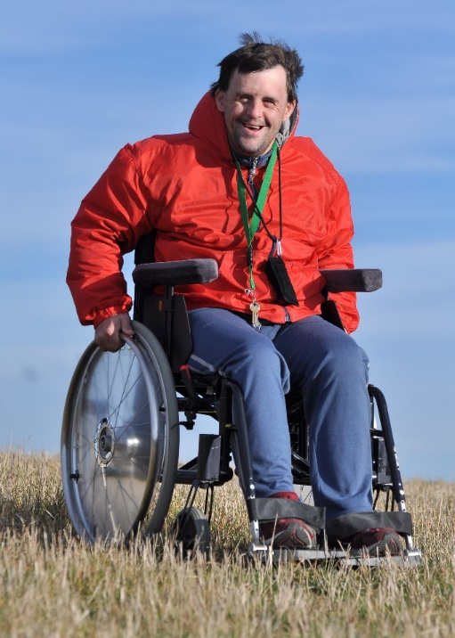
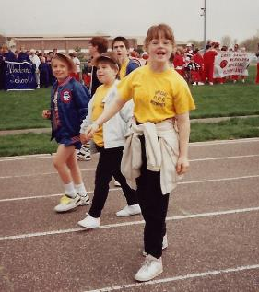
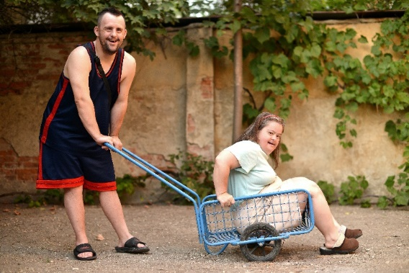
When Change Occurs
Normative or a sign of disease
Life Stories
Health Co-morbidities
Psychosocial changes
Regression
Dementia/Alzheimer’s disease
Biases/stereotypes/Diagnostic Over Shadowing

Slide 12
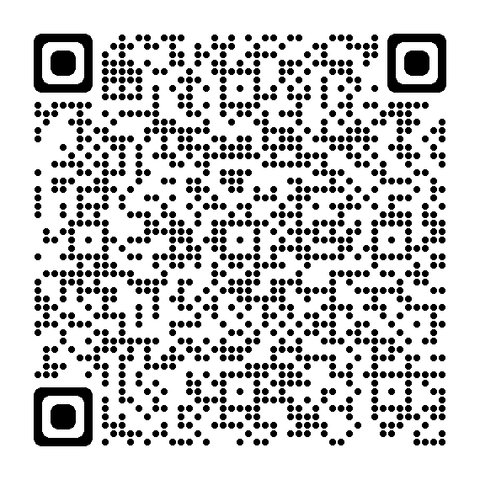
Diagnostic Overshadowing
Attribution of symptoms to a pre-existing
condition rather than a potential co-morbid condition
Can be detrimental to quality of care and can contribute to delays in diagnosis and treatment, unnecessary or unsafe care and inequities of care.
Contributes to health disparities and is of particular concern in groups experiencing health disparities, such as individuals with disabilities.
Speed, stress and lack of training contribute to diagnostic overshadowing.
Most clinicians do not have training, experience and skills grounded in treating individuals with disabilities – again putting
these individuals at increased risk for diagnostic overshadowing.

Slide 13
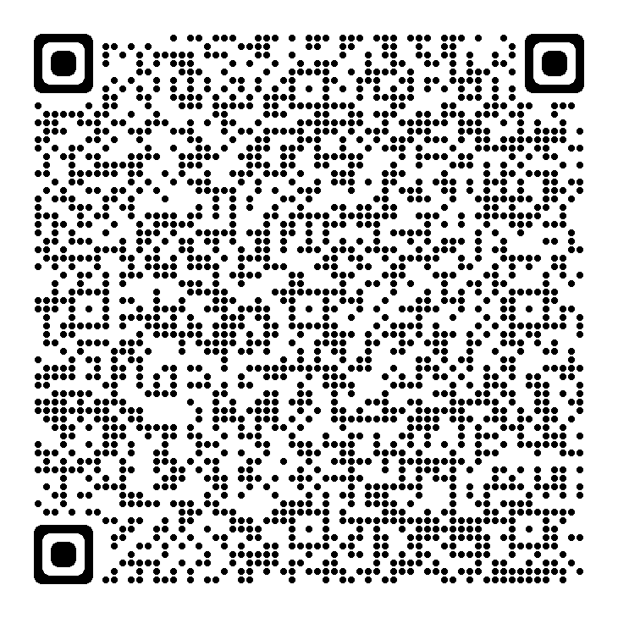
Neuroatypicals is a term used to describe people of atypical developmental, intellectual and cognitive abilities.
Because of these differences, they may experience health and social disparities in their care and supports including being able to access quality services.
Their aging profile of change and possible dementia trajectory and presentation may diverge from neuroatypicals.
Impacts the Healthcare Provider Annual Wellness Visit exam
Examining Adults with Neuroatypical Conditions for MCI/Dementia During Cognitive Impairment Assessments: Report of the Neuroatypical Conditions Expert Consultative Panel (the-ntg.org)

Slide 14
Dementia Questionnaire for People with Learning Disabilities (DLD) 2006
Gedye Dementia Scale for Down Syndrome (DSDS)2009
Dyspraxia Scale for Adults with Down Syndrome, 2009
Dementia Screening Questionnaire for Individuals with Intellectual Disabilities (DSQIID) 2007
Cambridge Examination for Mental Disorders of Older People with DS and ID (CAMDEX-DS) 1986
Test for Severe Impairment (TSI) 1999
Cued Recall Test: Detection of Memory Impairment 2022
Adaptive Behavioral Dementia Questionnaire (ABDQ) 2004
NTG-Early Detection Screen for Dementia (NTG-EDSD) 2012
Rapid Assessment for Developmental Disabilities (RADD) 2021
Paiva AF, Nolan A, Thumser C, Santos FH. Screening of Cognitive Changes in Adults with Intellectual Disabilities: A Systematic Review. Brain Sci. 2020 Nov 12;10(11):848
https://link.springer.com/book/10.1007/978-3-319-61720-6 (2018)
Fleming V, Hom CL, Clare ICH ,et al, Cognitive outcome measures for tracking Alzheimer's disease in Down syndrome. Int Rev Res Dev Disabil. 2022;62:227-263

Slide 15
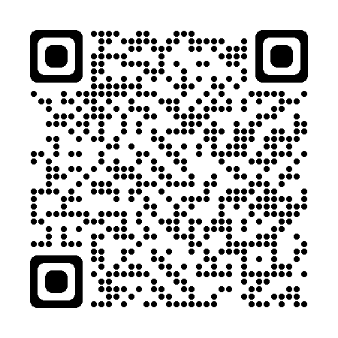
NTG-Early Detection Screen for Dementia’ (NTG-EDSD)
Usable by support staff and caregivers to note presence of key behaviors associated with dementia
Picks up on health status, ADLs, behavior and function, memory, self-reported problems
Available in multiple languages
Use: to provide information to physician or diagnostician on function and to begin the conversation leading to possible assessment/diagnosis
NTG-EDSD (the-ntg.org)

Slide 16
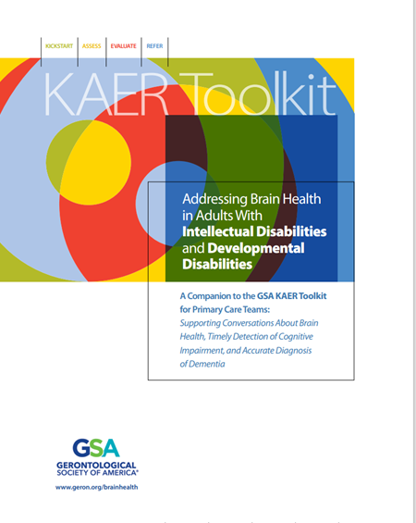
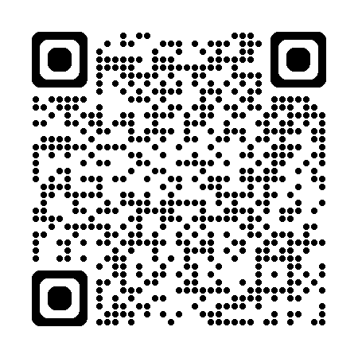
Focuses on issues relevant to intellectual disability and dementia, providing guidance for health workers, support personnel, and caregivers.
It includes specific information, paralleling that of the main Toolkit, on screening, assessment, and diagnosing dementia, resources for clinicians and caregivers, and information on brain health and risk reduction.

Slide 17
Alzheimer’s Disease in Down Syndrome
Women with Down’s syndrome are more at risk of developing Alzheimer’s disease than men in the 40 to 65 age group
People with Down’s syndrome who develop Alzheimer’s disease live, on average, 4-10 years from first symptoms; median 7 years
Rapid decline can occur
Sensory impairments (vision: 93.3%; hearing: 61.3%) were evident in adults with dementia
Late onset seizures were evident in 73.9%; with epilepsy dx at mean age of 55.4, and interval of about ½ year following dx of dementia.
Percentage of people with Down syndrome who develop dementia at different ages:
30’s | 2%
40’s | 10-15%
50’s | 20-50%
60’s | 60-90%
McCarron et al., (2017). A prospective 20-year longitudinal follow-up of dementia in persons with Down syndrome
Journal of Intellectual Disability Research Sep;61(9):843-852

Slide 18
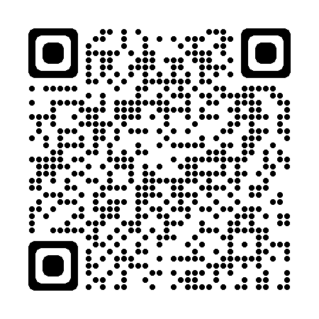
Mapping of Alzheimer’s biomarkers (blue), clinical Alzheimer’s disease status (green), cognitive and functional declines (orange) and chronological age in the progression of Alzheimer’s disease in Down syndrome
Fleming V, Hom CL, Clare ICH, Hurd-Thomas SL, Krinsky-McHale S, Handen B, Hartley SL. Cognitive outcome measures for tracking Alzheimer's disease in Down syndrome. Int Rev Res Dev Disabil. 2022;62:227-263.

Slide 19
Dementia in others with IDD, without DS
Autism
Cerebral Palsy
Spina Bifida
Parkinson’s disease
Non specific forms of IDD

Slide 20
Caring
“Caring” with empathy and sensitivity
Cognitive therapeutics
Behavioral care and supports
Health and wellness
Concomitant health complications; seizures, sleep apnea, falls, oral healthcare, etc.
Anticipating progression and its various needs
Concerns for abuse and neglect
Financial and legal supports
Palliative and end stage supports
Research opportunities

Slide 21
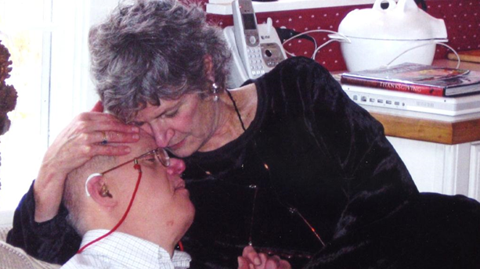
Impact on Families and Caregivers
Frequent issues experienced by families and caregivers include:
Denial
Anger / Frustration
Guilt
Loss and Grief
Letting Go
Financial Stress
Role Reversals
Social Isolation
Becoming patients themselves

Slide 22
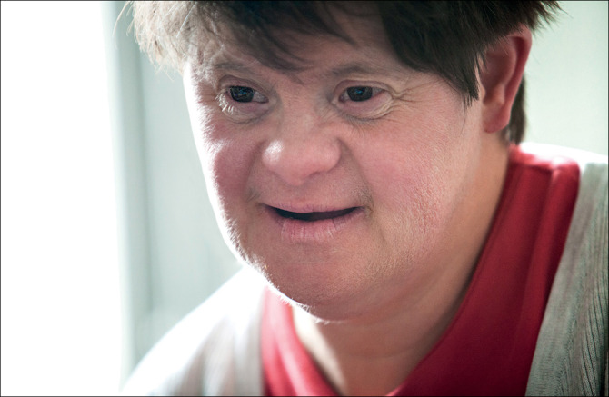
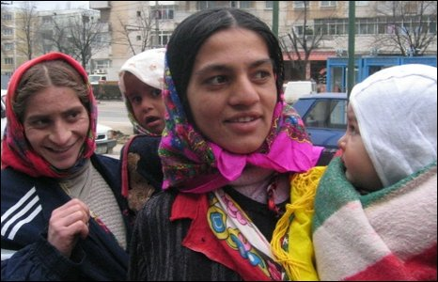
Social Determinants of Health
Lives in rural area , inner city, geographic isolation
Geopolitical uncertainties
Lack of transportation
Environmental and physical barriers
Poor or wealthy
Lives with aging parent
Lives in group home, high staff turn over, other challenging clients
Lack of access to wellness and health promotion activities
Poor prescription coverage for medications, testing and associated aides
Lack of access to medical, social, behavioral IDD/DS AD experts
Language and communication barriers
Minority, refugees
Notes:
Developing general theories in aging is difficult because of individual differences, it is a very diverse and complex process.
Furthermore, there is no current theory of aging that fully explains every physiological mechanism that occurs in the aging process.

Slide 23
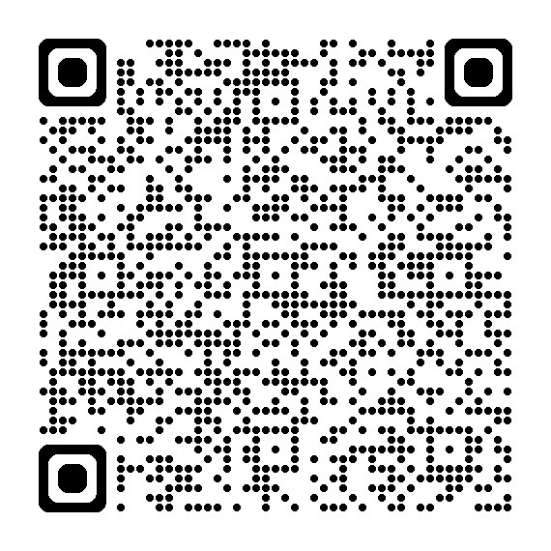
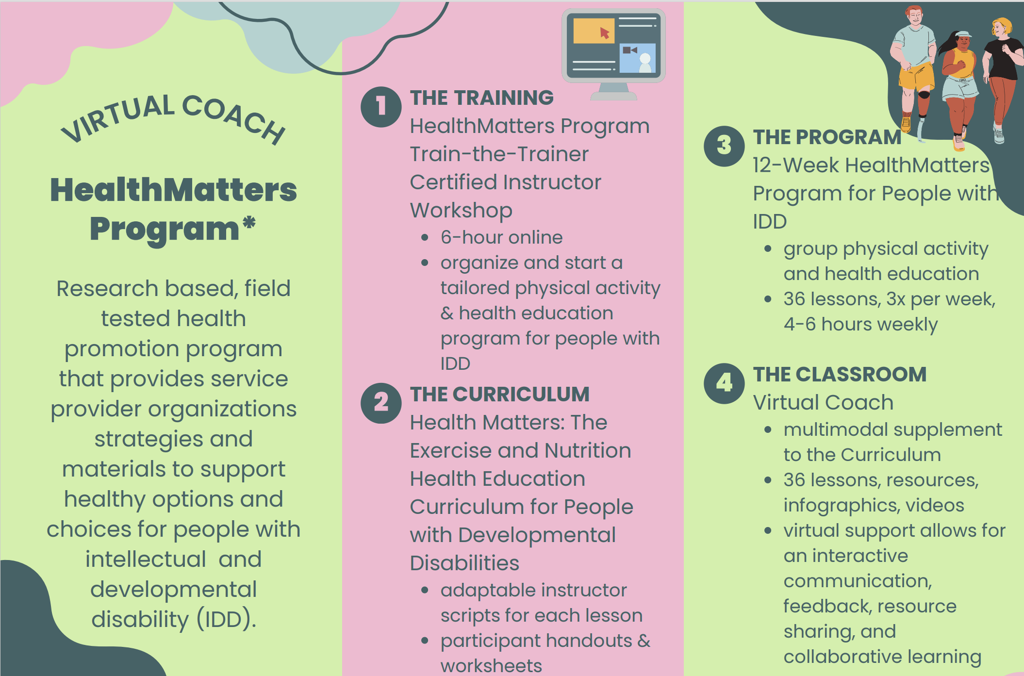
National Healthy Brain Initiative for People with Intellectual and Developmental Disabilities

Slide 24
Behavioral and Psychological Symptoms of Dementia (BPSD)
Depression—40%
Delusions—63%
Hallucinations—4-41%
Aggression—31-42%
Apathy
Pseudobulbar Affect
Sleep disturbance (day/night reversal)
Hoarding
Shadowing
Disinhibition (stripping)
Sexually inappropriate behavior
Sundowning
Wandering
Associated with worse prognosis
More rapid cognitive decline
Increased caregiver burden
Leads to earlier admission to institutional care
Increased healthcare costs

Slide 25
Common Triggers
Physical
Acute illness/infection, medications, pain, poor vision, hearing, poor sleep
Cognitive
Inability to understand, express oneself, lack of insight, misinterpretation of environment, difficult to problem solve
Emotional
Fear, anxiety, depression, frustration, apathy, boredom
Environmental
Changes in caregiver, confrontational approach, tasks that exceed abilities, change in routine, over/understimulation, lack of visual cues
Notes:
25

Slide 26
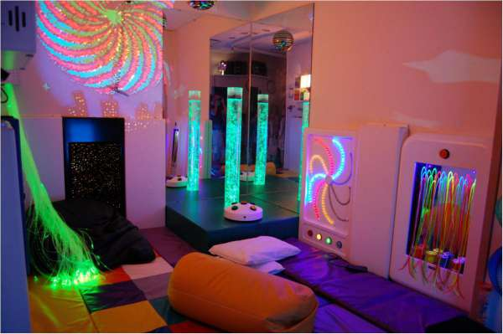
Nonpharmacological Approaches
Familiar environment—avoid frequent moves
Soft lighting
Calm colors
Places to walk
Access to outdoor spaces
Home-like environment
Low stimuli—minimize background noise
Time out space
Reminiscing
Individualized Care Planning
Careful analysis of care interactions
Meaningful activity
Art/Music Therapy
Exercise/Movement
Snoezelen® (multisensory stimulation program)
Aromatherapy
Yoga

Slide 27
Questions to be Answered in Evaluating Medication Use
What is the target problem being treated?
Is the drug necessary?
Are nonpharmacologic therapies available?
Is this the lowest practical dose?
Does this drug have adverse effects that are more likely to occur in an older patient?
By what criteria, and at what time, will the effects of therapy be assessed?
Safety of the medication
Drug use in the nursing home
Avorn J, Gurwitz JH. Ann Intern Med. 1995 Aug 1;123(3):195-204

Slide 28
Managing BPSD: Pharmacologic Interventions
Drug class | Chemical name | Dosage range (mg) | Side effects of class
Antipsychotics | Aripiprazole* Haloperidol Risperidone* Quetiapine* Olanzapine* | 2.5-15 0.5-5 0.25-2 25-200 2.5-15 | Sedation, EPS, NMS, metabolic syndrome, QTc prolongations, increased risk of CVE and mortality
Antidepressants | Fluoxetine Citalopram Paroxetine Sertraline Trazadone | 10-80 10-60 10-50 25-200 25-200 | Anxiety, headaches, sedation, GI symptoms, sexual dysfunction
Mood stabilizers | Carbamazepine Divalproex sodium Oxcarbazepine | 100-400 250-1000 300-600 | Sedation, gait and balance issues, falls, liver dysfunction, hyperammonemia, thrombocytopenia
Adapted from Tampi et al. Clin Geriatr. 2011;19:31-32.
PBA: Dextromethorphan/Quiidine (Nuedexta ) 20/10 mg Hepatotoxicity, QTc prolongation, thrombocytopenia
Rexulti (brexpiprazole) oral tablets for the treatment of agitation associated with dementia due to Alzheimer’s disease.
Notes:
When nonpharmacological interventions fail or the BPSD endangers the safety of the patient or others, pharmacological treatment may be needed.
The FDA has not approved any medication for the treatment of BPSD.
The antipsychotics, especially the second generation agents, are the most commonly prescribed medications for BPSD.
They have demonstrated modest benefits in senior patients with dementia, which should be weighed against their considerable risks of adverse events, including heart failure and sudden death.
The cognitive enhancers (cholinesterase inhibitors and memantine) have been shown to improve neuropsychiatric and functional outcomes.
Other alternatives to treat BPSD are antidepressants and mood stabilizers (anticonvulsants).
Antidepressants are generally well tolerated in persons with dementia [Henry et al. Am J Alzheimers Dis Other Demen.2011.26.169], but evidence is variable.
Mood stabilizers may be effective in some patients, but their side effects often limit use. [Konovalov et al.IntPsychogeriatr.2008.20.293.]

Slide 29
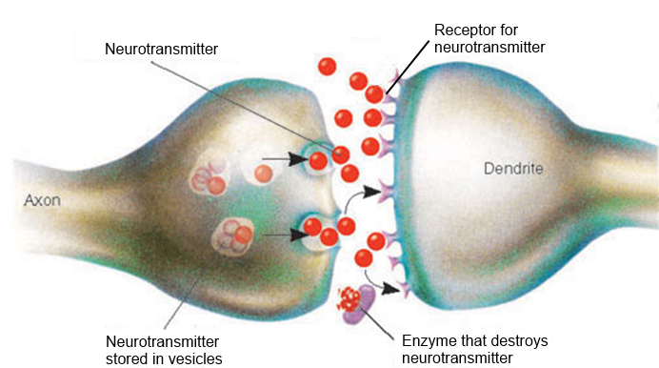
Therapeutic Approaches to help Alzheimer's Disease and Cognitive Impairment
Synapse
Namenda (Memantine)
Aricept (Donepezil)
Razadyne (Galantamine)
Exelon (Rivastigmine)
Aduhelm (Aducanumab)
Leqembi
(Lecanemab)
Kisunla (Donanemab)
Baseline
One Year

Slide 30
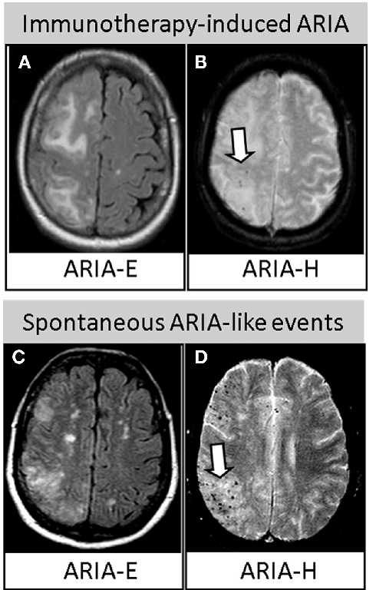
Amyloid-Imaging Related Abnormalities (ARIA)
ARIA-Edema (ARIA-E): vasogenic edema or sulcal effusion
ARAI-Hemorrhage (ARIA-H): brain microhemorrhages or localized superficial siderosis
May result from increased cerebrovascular permeability as a consequence of antibody binding to deposited amyloid-beta

Slide 31
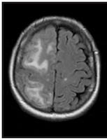
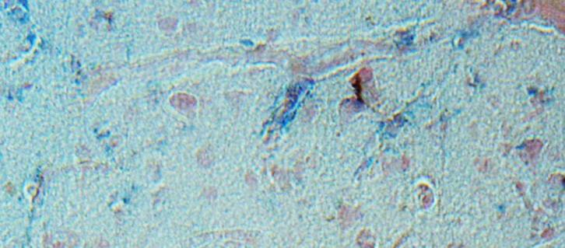
Lots of beta-amyloid on blood vessels in the brains of people with Down syndrome when they get older – and this may be more extensive than in people with Alzheimer disease without Down syndrome
Clinical trials in adults with Down syndrome with antiamyloid therapeutics are needed to establish safety.
What is the safety profile of antiamyloids in people with Down syndrome?

Slide 32
https://www.reuters.com/business/healthcare-pharmaceuticals/down-syndrome-families-fight-access-alzheimers-trials-treatments-2023-10-10/
https://helenjournal.org/september-2023/equitable-access-to-alzheimers-disease-therapeutics-for-adults-with-down-syndrome

Slide 33
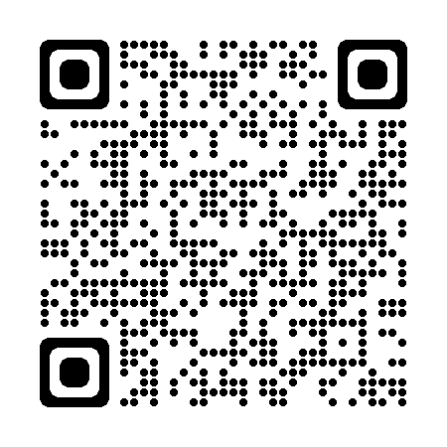
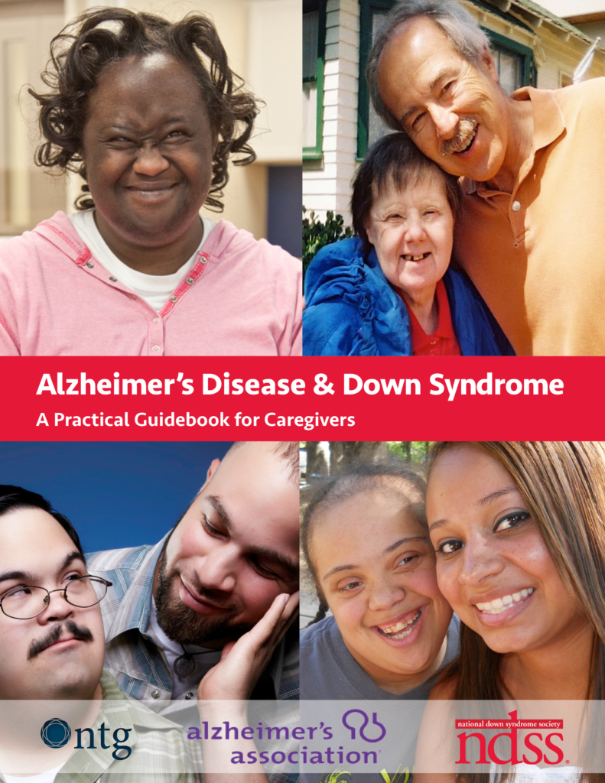
Person/Family Centered Resources
http://www.ndss.org/wp-content/uploads/2017/11/NDSS_Guidebook_FINAL.pdf
www.learningdisabilityanddementia.org/jennys-diary.html
http://www.sevenhills.org/uploads/SHRI-IDD-ADRD-Resource-Guide.pdf
http://www.ndss.org/wp-content/uploads/2017/11/Aging-and-Down-Syndrome.pdf

Slide 34
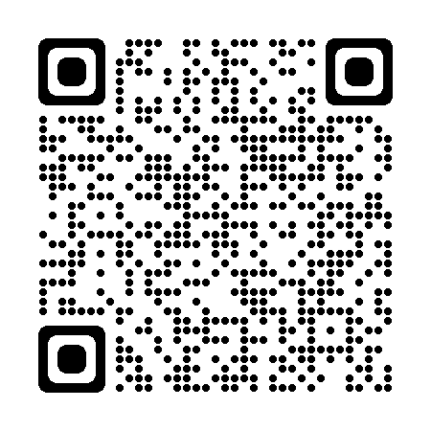
Alzheimer's Biomarkers Consortium of Down Syndrome (ABC-DS)
Recruitment
The NiAD sites will recruit 180 adults with DS (10% with dementia) and 40 sibling controls, age 25 years and older. The ADDS sites will recruit 225-300 adults with DS, 40 years and older.
https://www.nia.nih.gov/research/abc-ds

Slide 35
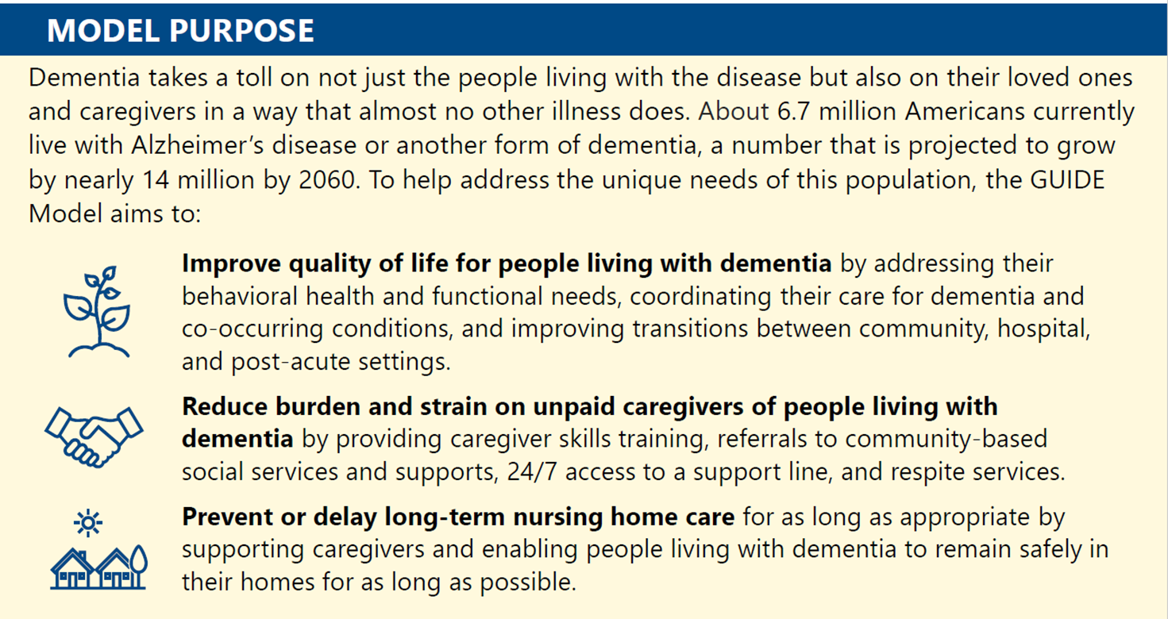
Guiding an Improved Dementia Experience (GUIDE) Model
CMS Alternative Payment Model Beneficiary Eligibility
Traditional Medicare Patients/Beneficiaries (Parts A & B)
Not enrolled in Advantage Plans, Special Needs Plans & PACE
Beneficiary has a diagnosis of dementia, as confirmed by clinician attestation
Community Dwelling (Not residing in long-term nursing home)
Excludes Hospice Patients
8 Year Program (July 2024 – July 2032)
To reduce disparities in access to dementia care services, the GUIDE Model incorporates policies to enhance health equity by ensuring that underserved communities have equal access to the model intervention
CMS will actively seek out the participation of eligible organizations that provide care to underserved communities for participation in the GUIDE Model.
https://www.cms.gov/priorities/innovation/innovation-models/guide

Slide 36
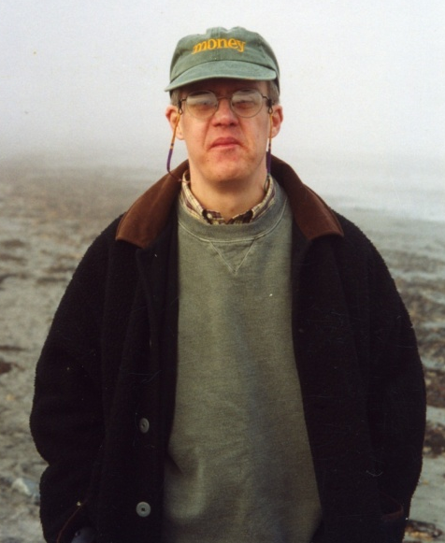
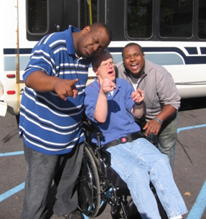
Who do you see?

Slide 37
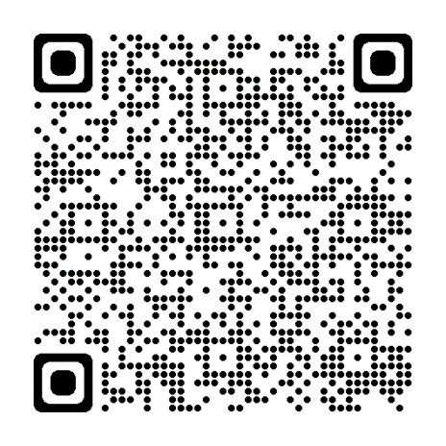
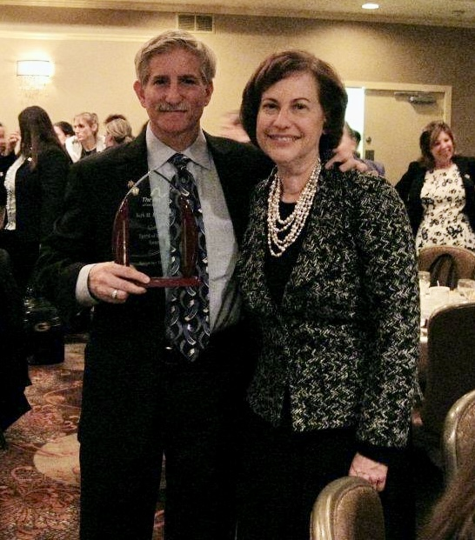
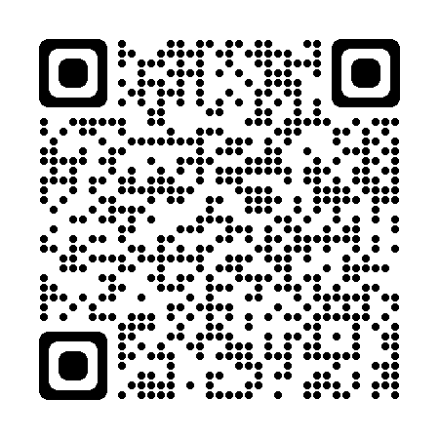
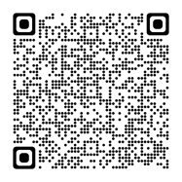
Thank you!
sethkeller@aol.com

