Slide 1
Catching Up with Connor
SSDI and Medicaid through DDD
Connor Griffin, MPH
Director, Health Care Advocacy Program
The Arc of New Jersey
healthcareadvocacy@arcnj.org
thearcnjhealthcareadvocacy.org

Slide 2
NJ FamilyCare/Medicaid
NJ FamilyCare = NJ Medicaid
2 primary programs:
NJ FamilyCare, covering children under 19, adults, and pregnant women
Aged, Blind, or Disabled (ABD), covering people 65 and older, and people determined blind or disabled
Most individuals with IDD have ABD Medicaid
Medicaid is required to receive Division of Developmental Disabilities (DDD) services at age 21

Slide 3
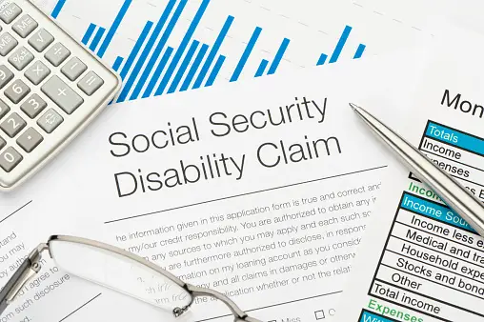
Social Security Disability Insurance (SSDI)
SSDI, SSD, or “Disability” provides monthly payments to people who have a disability that stops or limits their ability to work
You may qualify if you have a disability or blindness and enough work history OR
Many people with a disability qualify for SSDI based on a parent’s retirement, disability, or passing away.

Slide 4
SSDI Benefits
The person with a disability becomes eligible for SSDI based upon the parent's work record
When a parent retires or becomes disabled, and starts receiving Social Security benefits, the person will need to apply to Social Security to receive SSDI
Usually equal to 50% of the parent’s benefit amount
In cases where a parent passes away, the Social Security benefit is referred to as a Survivor’s benefit
Usually equal to 75% of the deceased parent’s benefit amount

Slide 5
SSDI and Medicaid
Some school-age individuals receive SSDI, prior to turning 18 or applying for SSI, oftentimes because a parent retired.
The person now has too much income to qualify for SSI and most Medicaid programs
But, the person may qualify for an exception to DDD’s Medicaid pre-enrollment requirement, through the DDD Waiver Unit
Afforded the opportunity to apply for Medicaid upon turning 21, given they are otherwise eligible for DDD services
The DDD Medicaid Eligibility Helpdesk facilitates this process
DDD.MediEligHelpdesk@dhs.nj.gov

Slide 6
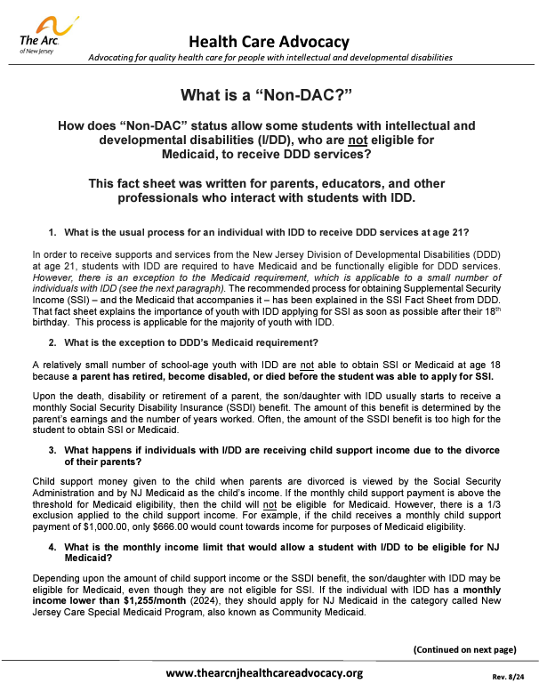
Non-DAC Fact Sheet
These individuals are sometimes referred to as “Non-DACs”
2024 income below $2,829/month
Resources must be under $2,000
Non-DAC fact sheet

Slide 7
How to Apply
For SSDI:
Online via the SSA website:
SSA.gov
Call or visit your local SSA office in person
ssa.gov/locator
Questions? You can call Social Security at 1-800-772-1213
For Non-DAC:
If you cannot get Medicaid because of high SSDI income and need Non-DAC status, please fill out the Medicaid Eligibility Problem Form
www.arcnj.org/programs/health-care-advocacy/problem_forms.html

Slide 8
More Information
The Arc of NJ Health Care Advocacy Social Security Resources
Social Security Resources
The Arc of NJ Fact Sheets on DAC and Non-DAC
Fact Sheets & Flyers
The Arc of NJ Family Institute Social Security Go Bag
Social Security Go Bag
Social Security Administration Website
SSA.gov
Subscribe to our email list at arcnj.org
Scroll to to the bottom of the page and click “Health care issues” then the subscribe button.

