Slide 1
Catching Up with Connor
An Overview of NJ FamilyCare/Medicaid Part 2
Connor Griffin, MPH
Director, Health Care Advocacy Program
The Arc of New Jersey
healthcareadvocacy@arcnj.org
thearcnjhealthcareadvocacy.org

Slide 2
NJ FamilyCare/Medicaid
NJ FamilyCare = NJ Medicaid
2 primary programs:
NJ FamilyCare, covering children under 19, adults, and pregnant women
Aged, Blind, or Disabled (ABD), covering people 65 and older, and people determined blind or disabled by Social Security or the state
Most individuals with IDD have ABD Medicaid
Medicaid is required to receive Division of Developmental Disabilities (DDD) services at age 21

Slide 3
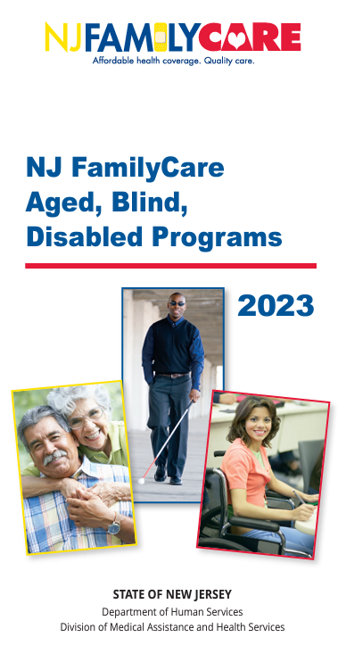
ABD Medicaid
ABD Medicaid Programs:
Supplemental Security Income (SSI) Medicaid
Medicaid Only
New Jersey Care … Special Medicaid Programs
NJ WorkAbility
Managed Long Term Services and Supports (MLTSS)
Multiple ABD programs, but only one application
See the online brochure

Slide 4
New Jersey Care … Special Medicaid Programs
Individuals with gross monthly income equal to or below 100% of the federal poverty level (FPL)
$1,255/month for an individual (2024)

Slide 5
NJ WorkAbility
Full Medicaid coverage to working individuals with disabilities whose income or assets would make them ineligible
No unearned income limit
No earned income limit
There are tiered premiums for higher income individuals with countable income over 250% of the FPL
No asset limit
Speak with a highly trained Community Resource Specialist at 1-888-285-3036
DDS NJ WorkAbility

Slide 6
MLTSS
Additional services and supports for clinically eligible individuals, who need a higher level of care
Clinical eligibility is determined through assistance with 3 or more activities of daily living (ADLs) such as dressing, bathing, eating, and mobility assistance
Require skilled nursing care, 24/7
Higher income limit of $2,742/month

Slide 7
Medicaid MCOs
Medicaid in NJ is administered through 5 participating managed care organizations (MCOs):
Aetna Better Health of New Jersey
Horizon NJ Health
Fidelis Care
UnitedHealthcare Community Plan
Wellpoint (formerly Amerigroup New Jersey)
Greater access to providers and coordination of care

Slide 8
How to Apply
Online via the NJ FamilyCare website (preferred)
Apply here
In person at your local County Board of Social Services office
Find your local office
Print the application, fill in out, and mail it in
A pdf of the application
Call 1-800-701-0710 (TTY: 711) for assistance

Slide 9
More Information
The Arc of New Jersey Health Care Advocacy Program
thearcnjhealthcareadvocacy.org
Subscribe to our email list at arcnj.org
Scroll to the bottom of the page and click “Health care issues” then the subscribe button.
NJ FamilyCare/Medicaid
DMAHS NJ FamilyCare/Medicaid ABD

