Slide 1
Co-occurring IDD and Mental Health Issues
Health Care Advocacy 2024 Webinar series Webinar # 3
Presenter: lucy Esralew PhD

Slide 2
Disclaimer
The contents of this presentation reflect the training and experience of the presenter and do not reflect any position of the agencies or organizations with which the presenter is affiliated.
This presentation reflects a non-medical perspective on co-occurring IDD and mental health issues.
This webinar is intended to provide considerations about mental health issues and does not take the place of individualized mental health services and consultation.

Slide 3
Objectives for Today’s Webinar
Overview
Overview of Dual Diagnosis (MI/DD)
Consider
Consider various challenges associated with dual diagnosis
Provide
Provide considerations about supporting individuals with dual diagnosis (MI/DD)

Slide 4
Language considerations
Throughout this presentation you will hear various terms used. The presenter is aware that others may choose to use different language to refer to the same situations
Person first language
individuals with intellectual and/or developmental disorders(IDD)
Individuals with mental health concerns
Individuals who meet criteria for depression, bipolar disorder, anxiety, or other mental health disorders
Dual Diagnosis (MI/DD) referring to individuals with intellectual disability and/or developmental disorders who also meet criteria for co-occurring mental health concerns

Slide 5
Myth or Fact?
Most individuals with developmental disabilities also carry mental health diagnoses.

Slide 6
Myth or Fact?
Individuals with Developmental Disabilities cannot benefit from psychotherapy.

Slide 7
Myth or Fact?
MOST BEHAVIORAL CHALLENGES EXPERIENCED BY INDIVIDUALS WITH INTELLECTUAL DISABILITY ARE CAUSED BY THEIR MENTAL HEALTH CONDITIONS.

Slide 8
Dual Diagnosis (MI/DD)

Slide 9
Dual Diagnosis (MI/DD)
The co-occurrence of an intellectual and/ or developmental disability and mental health concerns
Examples include:
An individual with Cerebral Palsy and Bipolar I Disorder
An individual on the autism spectrum with Obsessive-Compulsive Disorder
An individual with Down Syndrome and depression and/or dementia

Slide 10
Mental Health Concerns Among Individuals with IDD
Controversy as to whether developmentally disabled adults are more prone to psychiatric illness than the general population:
Individuals with IDD experience the same range of mental health problems that can be found in the general population
Depending upon contraindications, individuals with IDD are treated with the same types of medication as is the general population relevant to their diagnosis
NADD estimates that the prevalence of individuals who have mental health needs and have an intellectual and/or developmental disorder is somewhere between 30 and 40%
The National Core Indicators (NCI) identified a rate of 55% of people with IDD who have a co-occurring psychiatric disorder (National Core Indicators, 2016) based on a review of patient charts from 30 states in the USA (N=13,466)
Notes:
Get link for the NCI and add to slide

Slide 11
Individuals with Dual Diagnosis
Individuals with both I/DD and mental health needs have excess disability
Individuals with MI/DD are more likely to present as more behaviorally disordered than their peers without intellectual or developmental disabilities
Regarding MH disorders: individuals with IDD are more likely to be undiagnosed, misdiagnosed, undertreated or mistakenly treated because of clinical biases and lack of trained professionals to provide services to individuals
Notes:
Important to point out that this tendency has led to under-recognition of dual diagnosis

Slide 12
Therapeutic Disdain
Clinicians cite feeling inadequate or intimidated in working with individuals with intellectual disabilities
Perception among clinicians that those with intellectual disabilities cannot benefit from psychotherapy
Leads to lessened confidence in thinking about psychotherapeutic approaches despite evidence that suggest that many people with intellectual disabilities have or can be taught the necessary skills for therapies such as CBT

Slide 13
Diagnostic Overshadowing
A term introduced by Dr. Steven Reiss and his colleagues (Reiss & Szyszko, 1983) to describe the tendency to over attribute problems experienced by persons with IDD to their intellectual or developmental disorder, thereby missing other possible causes of distress or missing treatable conditions.
It is a form of biased thinking that can affect clinical decision-making and lead the person with IDD to be less thoroughly assessed than their typically developing peers.
Notes:
Nee
Dr. Steven Reiss and his colleagues (Reiss & Szyszko, 1983) introduced the term “diagnostic overshadowing” to describe the tendency of medical and mental health practitioners to over attribute problems experienced by persons with IDD to their intellectual or developmental disorder, thereby missing other possible causes of distress or missing treatable conditions.
It is a form of biased thinking that can affect clinical decision-making and lead the person with IDD to be less thoroughly assessed than their typically developing peers.
d to add Reiss’s material as a citation in the reference list

Slide 14
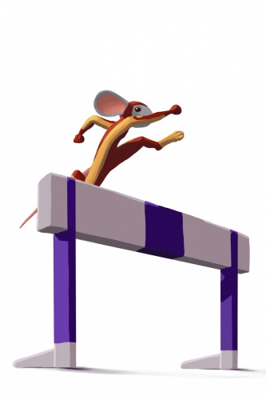
Assessment Challenges
Diagnostic Overshadowing by clinicians conducting assessment
Cognitive Distortion that may lead the person with IDD to be seen as having more significant mental health needs
Response Bias
Limited linguistic competency
Need for emotional education/ poor differentiation of mood states and thinking problems
Limited coping skills

Slide 15
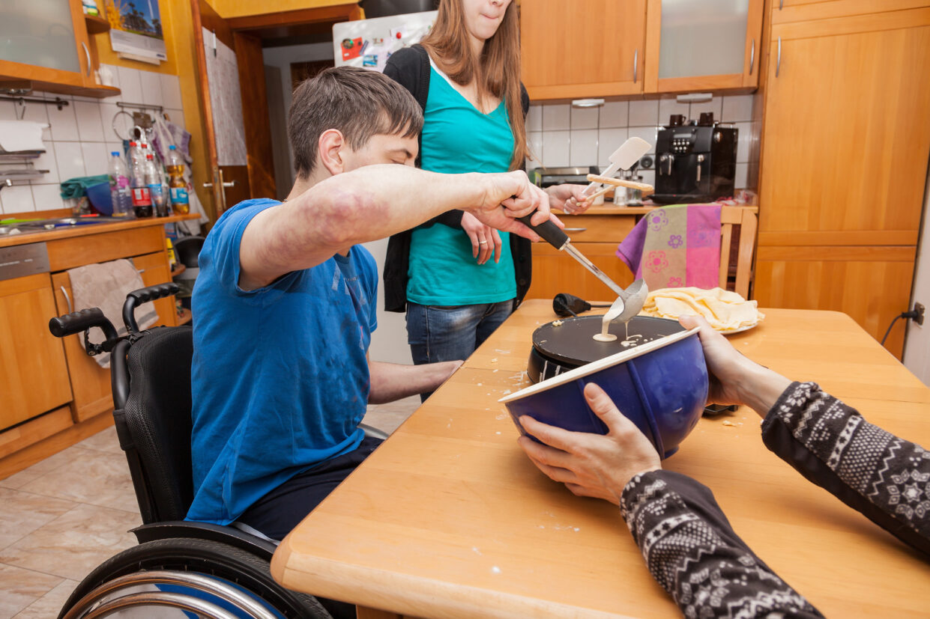
Excess Disability
Some common reasons for referral to a psychiatrist or psychologist include self-injury, aggressive behavior, impulsivity, hyperactivity
Most people are referred to psychiatric or mental health services for behavior not because of depression, anxiety or a mental health need
However, mental health concerns affect quality of life, relationships, ability to work and live independently apart from the challenges posed by a person’s intellectual or developmental disability

Slide 16
Trauma and individuals with IDD
Trauma may be unrecognized and undertreated in individuals with IDD
Many factors influence the clinical presentation of trauma: gender, age at the time of the traumatic experience, type of event/source of trauma, frequency and persistence of abuse or neglect, genetic risk factors, temperament, intensity of physiological response, co-occurring conditions, degree of cognitive capacity, problem solving abilities, communication skills, adaptive skills, social supports, and treatment
Both larger traumas and smaller traumas (i.e. bullying, isolation, exclusion) are risk factors that lower threshold for persistent PTSD
Trauma may be misdiagnosed as ADHD, Oppositional Defiant Disorder (ODD), OCD, Intermittent Explosive Disorder, Psychosis, Bipolar Disorder, Borderline Personality Disorder and other conditions

Slide 17
Psychotherapy with Individuals with IDD
General Considerations
Notes:
EBSHs and CCHs have Individual Behavior Support Teams (IBST) that are required to ensure consumers receive consultation services to meet individual needs. Psychotherapies may be an additional consultation service for IBSTs to discuss and consider
The following information applies to youth and adults served within the EBSH/ CCH settings

Slide 18
Getting Started
A mental health assessment should be conducted to inform the selection of a psychological intervention:
Tailor the intervention to the individual’s preferences, level of understanding, strengths and needs
Consider any physical, cognitive, sensory or communication challenges
Consider which format is most suitable (face-to-face, remote by phone or computer, individual or group)

Slide 19
Collaboration occurs among self-advocates, family, staff, and the mental health provider
Develop and agree upon the intervention goals
Agree upon the structure, frequency, duration, timing, place and mode of delivery of psychotherapy
How will the person get to appointments; consider transportation or escort to in-person sessions
Agree about the role(s) of the person served, support staff and family members in between session such as collection of data, support for homework assignment, providing reminders and supporting practice of new skills

Slide 20
Visiting the Medical Provider
This presentation does not cover the medical management of mental health conditions
The first step when someone is displaying signs of behavior changes or verbalizing distress that are unusual to them (not their baseline) is to bring the person to their PCP to rule out medical conditions that may be contributing to current problems
If there are no physical conditions and the provider is suspects the likelihood of a mental health issue, seek a mental health work-up (psychiatrist, APN, psychologist, LCSW)
If medications are indicated for treatment, these can be prescribed by a PCP, Psychiatrist or Advanced Nurse Practitioner
It is preferable to have the person consult with a psychiatrist or APN who has a background in prescribing for individuals with IDD who have co-occurring mental health conditions

Slide 21
Locating a Provider
Psychotherapy is usually provided by the following licensed professionals:
Psychologists (PhD, PsyD, EdD), Masters level Social Workers (LCSW), Licensed Professional Counselors (LPC)
Occasionally Psychiatrists (MD) or Nurse Practitioners (APNs) may provide psychotherapy along with medication management
County Mental Health, insurance panels and local professional organizations may be sources for referrals to providers

Slide 22
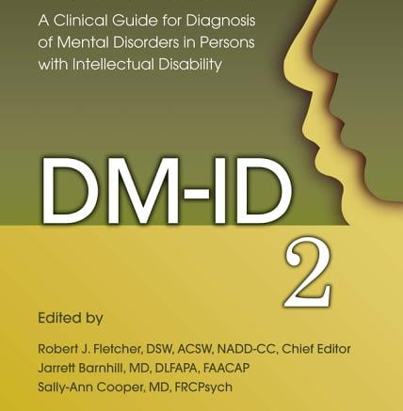
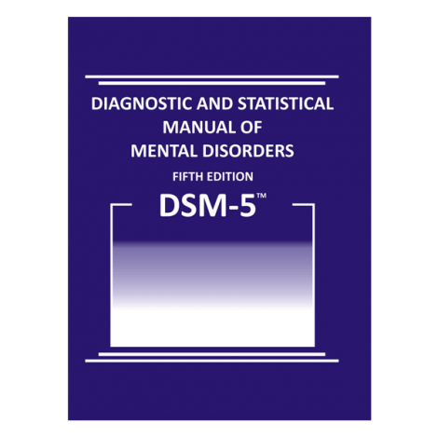
DSM-5, DM-ID-2& ICD-11
Three manuals used for the diagnosis of mental health disorders
DM-ID-2 was especially designed for individuals with IDD
Many insurance companies now use the International Classification of Diseases ICD-11

Slide 23
DSM and ICD Equivalents
The criteria for mental health disorders listed in the DSM-5 and ICD-11 may need to be adjusted to the psychiatric presentation of individuals with IDD
S/S of mental health disorders or mental illness may include behavioral presentation (aggression, property destruction, self-injurious behavior) not typically seen in individuals with mental health concerns who are not intellectually disabled
The DSM-5 has a companion volume for individuals with dual diagnosis (MI/DD): DM-ID 2

Slide 24
Depression
Sad
Sleep and appetite disturbance
Loss of interest in previous preferred activities
Thoughts about death or self-harm
Tendency to self-isolate
Lessened productivity at work
Increased irritability

Slide 25
Anxiety
Excessive worry
Physiological discomfort
Fear
Avoidance of stressors
Sleep disturbance

Slide 26
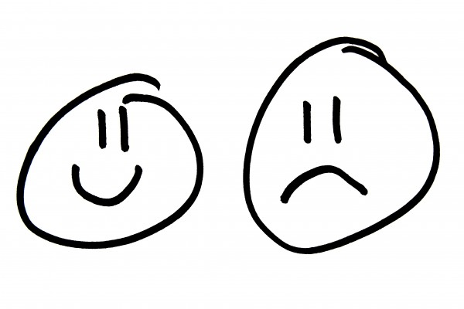
Bipolar Disorder
Cyclic mood disorder characterized by depressed and manic phases
Bipolar I disorder may be associated with psychotic features
Bipolar II disorder may include hypomanic episodes and not full-blown mania
Disturbance in sleep, appetite and energy level prominent in active phases

Slide 27
Thought Disorder
Problems with reality-based thinking
Hallucinations, most likely auditory
Delusions: grandeur, persecution, etc.
Poor reality testing
Schizophrenia, Schizoaffective Disorder, Psychotic Disorder, NOS
Schizophrenia and other thought disorders (psychosis) are not frequently occurring problems among individuals with IDD
Concern regarding misdiagnosis and effects associated with the long-term use of psychoactive medication

Slide 28
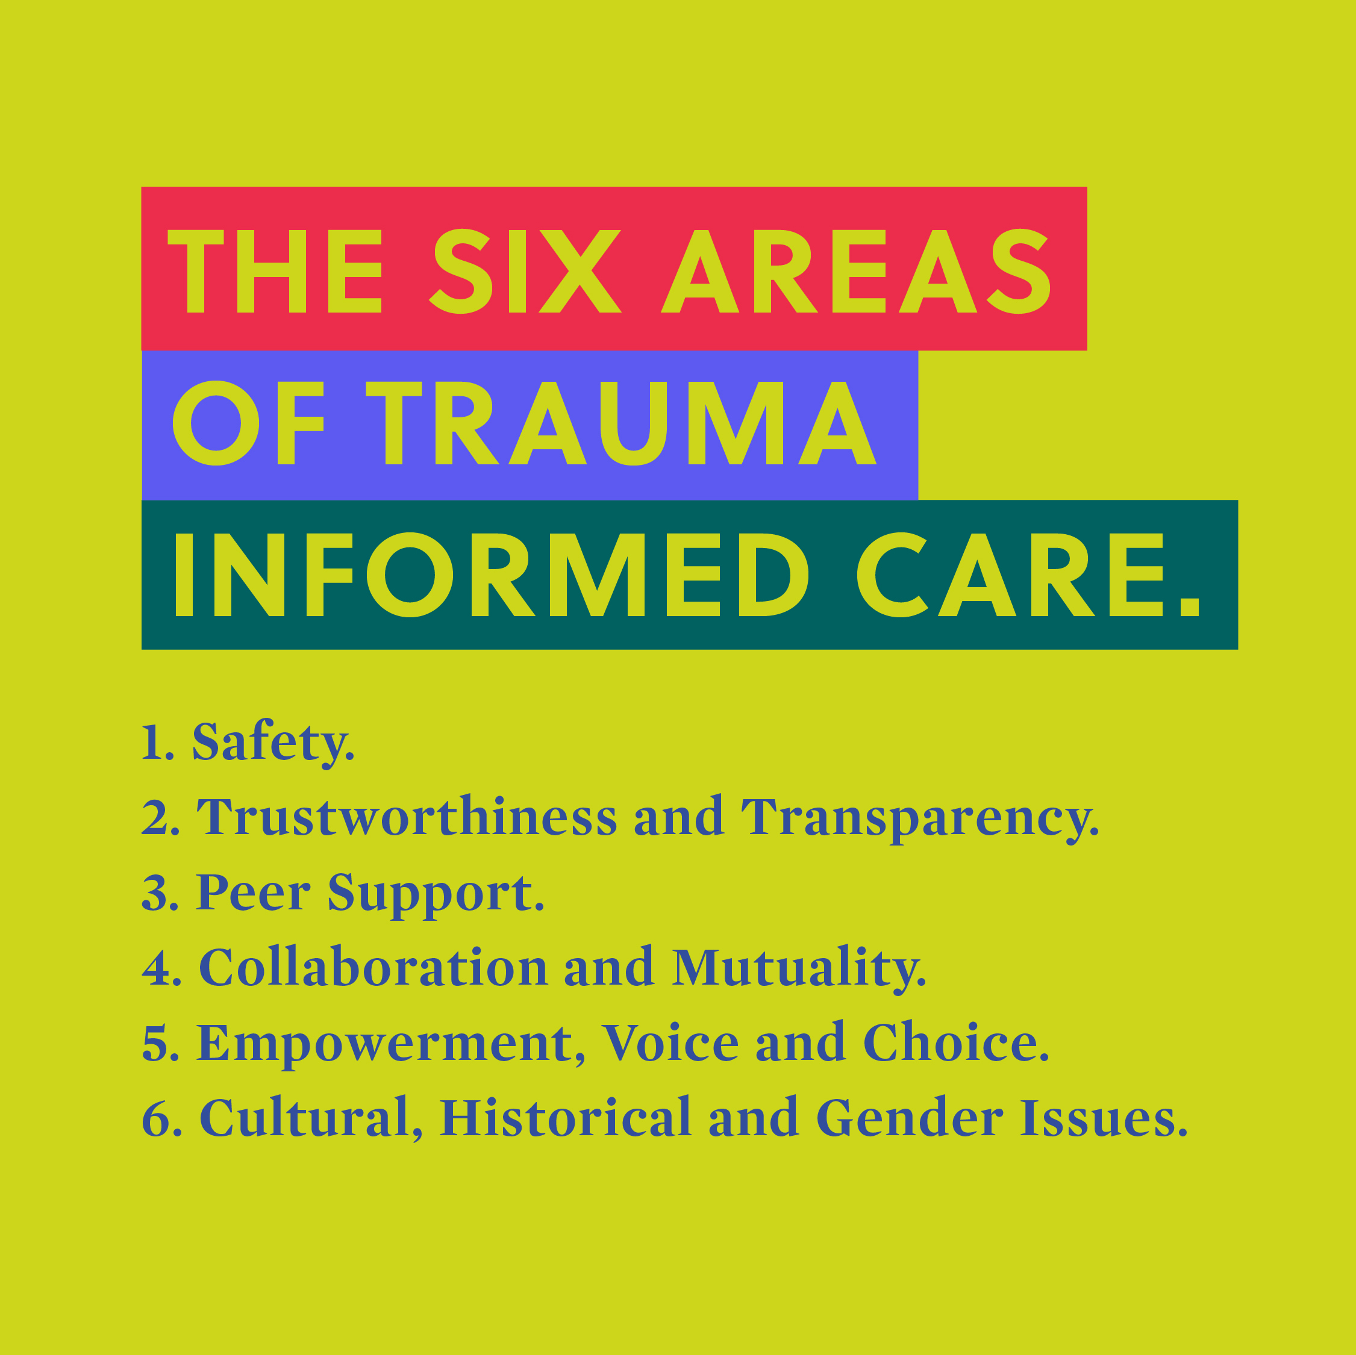
Recognizing Trauma
Individuals with disabilities are more likely to be victims of crime, abuse or neglect than individuals without disabilities
Individuals with disabilities are more likely to be sexually abused than those without disabilities

Slide 29
Trauma-Informed Therapies for Individuals with IDD
People affected by trauma can feel physically and emotionally unsafe or mistrustful in their relationships
Promising interventions for individuals with IDD and trauma exposure include:
Eye Movement Desensitization and Reprocessing (EMDR)
Positive Identify Development (Karyn Harvey, PhD)
Adapted Trauma-Focused Cognitive Behavior Therapy (Brian Tallant, LPC)

Slide 30
Psychotherapeutic Approaches
Common Approaches taken with individuals with IDD and mental health concerns

Slide 31
Who Can Benefit From Psychotherapy?
Psychotherapy is a non-medical treatment for individuals who are depressed, anxious, have mood disorders, personality style issues and/or have been trauma exposed.
Individuals who are most likely to benefit from this form of treatment are verbal, motivated to change, and are capable to follow through on skills learned within sessions.

Slide 32
Instructional Support for Adapting Psychotherapy for Individuals with IDD
Utilize concrete language and approaches
Include multimodal teaching strategies
Chunk information, providing visual organizers for planning, providing breaks to help with sustaining attention, and using visual reminders to recall information.
Involve caregivers
Use activities and illustrations to make abstract topics more easily understood
Plan for shorter, more frequent therapy sessions or a longer course of treatment
Use of positive behavior supports can enhance participation and skills practice in sessions
Incorporate the person’s special interests in content and use them to reinforce skills practice
Use positive behavior support strategies to redirect challenging behavior and encourage other expected behaviors during the session
Use environmental supports such as visual schedules, checklists, and timers to create appropriate structure and routine during the session.

Slide 33
Adaptations to Therapy: Behavioral Skills
Understand differences between developmental and chronological ages
Speak slowly and clearly
Introduce tasks, information, and skills one at a time and avoid compound statements
Allow time for practicing skills, which may take time before competency is met
Utilize caregivers in treatment to assist with coaching and skills practice outside session
Use reinforcement and motivating factors to encourage participation
Avoid assumptions in comprehension. The individual may say “yes” or nod even when they don’t what is being said
Utilize repetition in unique and creative ways
Increase support providers education about behavioral issues as well IDD
Use concrete examples to teach therapeutic tools
Tailor teaching strategies to the person’s developmental level
Incorporate skill building/lessons into developmentally appropriate, regular activities and routines

Slide 34
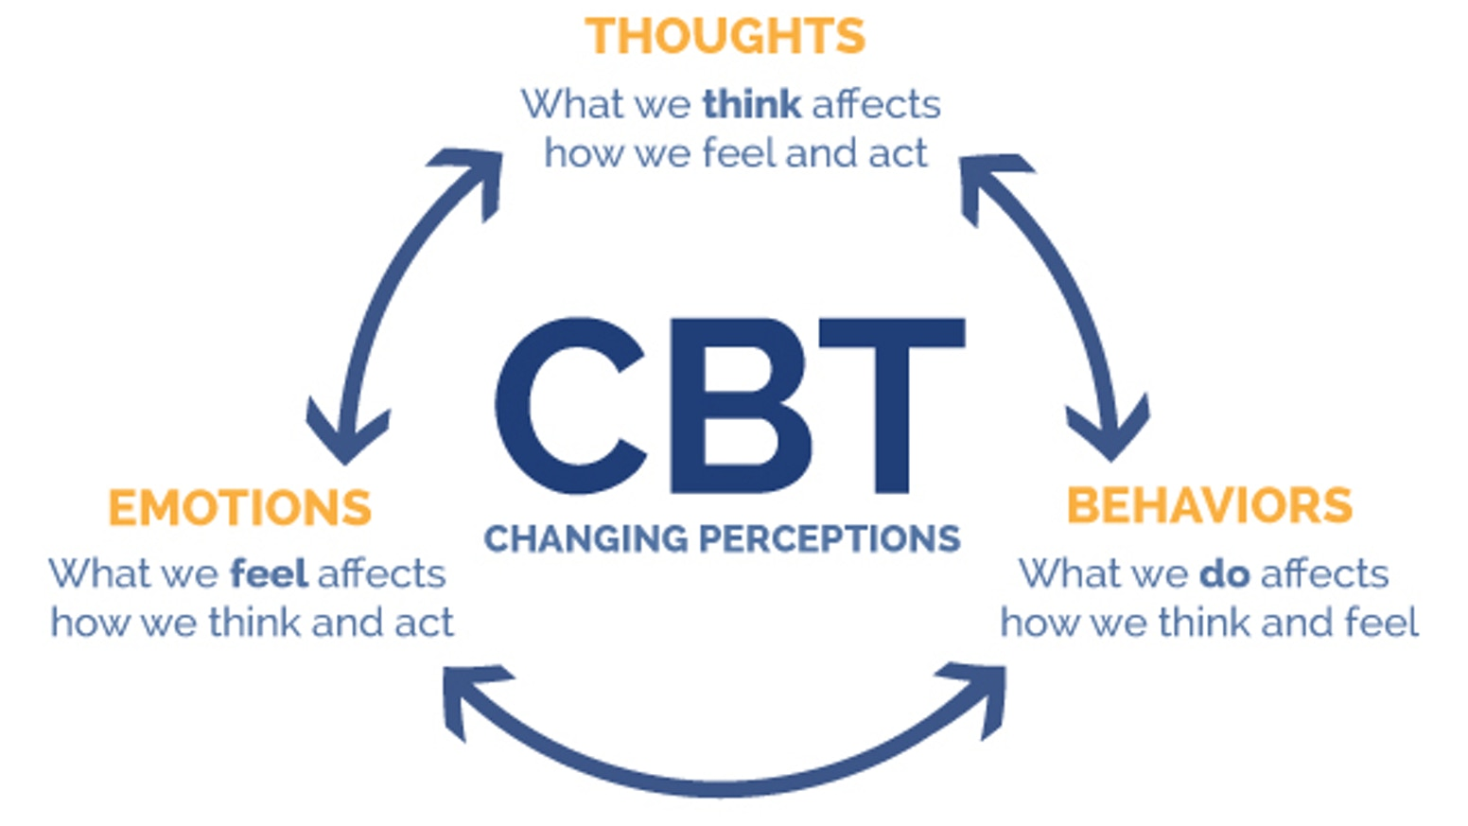
Cognitive Behavior Therapy (CBT)
CBT is an evidence-based therapy for anxiety, depression, insomnia
Notes:
Sometimes the relationships among thoughts, feelings and behaviors in CBT are represented by a triangle. I have included a different way to show that there are arrow connecting each of these domains. Although CBT has been applied to a range of mental health concerns. These are the areas in which there is the most robust evidence to support its use with youth and adults.

Slide 35
Cognitive Behavior Therapy (CBT)
By monitoring and recording thoughts associated with emotional upset, an individual can learn that the way you think can contribute to emotional problems such as depression and anxiety.
The individual in CBT can learn to reduce their emotional problems by:
Identifying distortions in their thinking
Seeing thoughts as ideas about what is going on rather than as facts
“Standing back” from one’s thinking to consider situations from different viewpoints
Notes:
CBT provides skills so that the person can more realistically think about their situation.

Slide 36
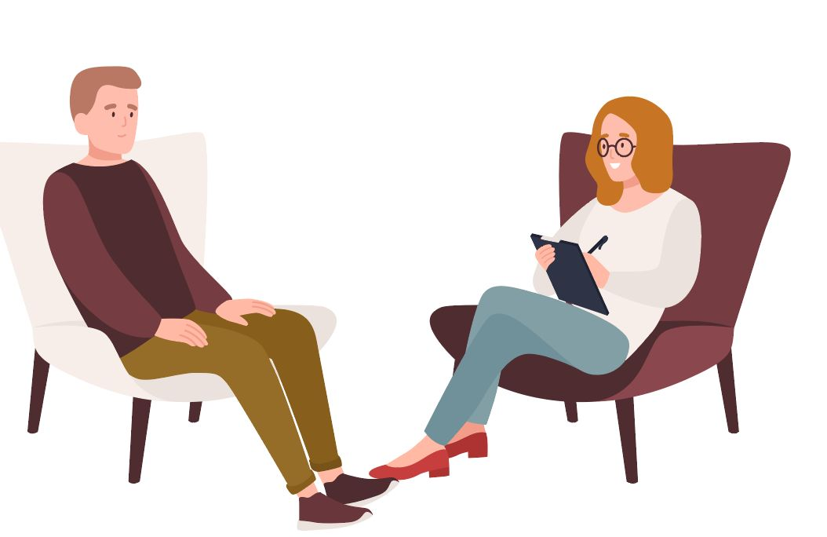
Cognitive Behavior Therapy is:
Time limited (10-15 sessions- although individuals with IDD may need longer time in treatment)
Evidence based
Collaborative
Skills oriented (self-management/coping skills)
Refers to a group of therapies including Exposure Response Prevention (ERP), Prolonged Exposure Therapy (PET) and Dialectic Behavior Therapy (DBT)

Slide 37
Cognitive Behavior Therapy (CBT) Who Can benefit From CBT?
In the general population, CBT has been found effective to treat a range of psychological and emotional problems.
For individuals with IDD, CBT has been found help in the treatment of depression, anger issues particularly among those with Mild Intellectual Disability
CBT works best when a person has sufficient verbal skills, is motivated to change their ineffective behaviors and can follow through on skills learned in session through homework and generalization of skills

Slide 38
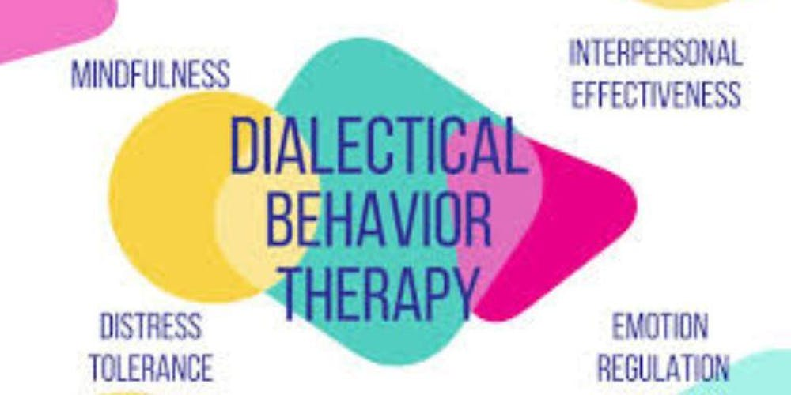
Dialectical Behavior Therapy (DBT)
Dialectical behavior therapy (DBT) is evidence-based therapy that is effective in treating multiple conditions: borderline personality disorder, substance abuse, eating disorders, ADHD, depression, anxiety, and PTSD (Behavioral Tech, 2019)
DBT focuses on helping someone cope with stress, manage emotions, and improve relationships with others by changing their behavior
Clients can learn a variety of helpful skills including learning to accept their emotional states, emotional regulation, problem solving, ways to change their thinking and ways to be more helpful.

Slide 39
Acceptance and Commitment Therapy (ACT)
Acceptance and Commitment Therapy (ACT) is an evidenced based psychological intervention that uses acceptance and mindfulness strategies, together with commitment and behavior change strategies, to increase psychological flexibility.
Psychological flexibility means contacting the present moment fully as a conscious human being, and based on what the situation affords, changing or persisting in behavior in the service of chosen values.

Slide 40
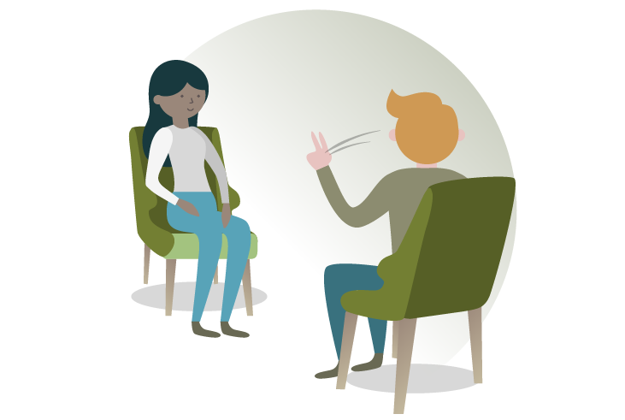
Eye Movement Desensitization and Reprocessing (EMDR)
Although there are limited studies on the use of EMDR with individuals with IDD, this mental health technique is considered a promising practice for use with people who have had traumatic experiences
This approach involves moving your eyes in a specific way while you process traumatic memories under the guidance of a trained EMDR practitioner.

Slide 41
Questions Self-Advocates Can Ask
What is the basis for the therapist recommending this approach?
What is the therapist’s experience in utilizing this approach with people with IDD (including if the therapist has received specific training/certification in the approach).
What changes can I expect to see based upon this approach?
How long might it take before I can see if this approach is effective for me?

Slide 42
Psychosocial Supports
And Behavioral Approaches

Slide 43
Positive Behavior Supports
Individual positive behavior support (PBS) combines evidence-based practices from Applied Behavior Analysis (ABA) and other disciplines to resolve behavioral challenges and improve independence, participation, and overall quality of life of individuals
Key features include lifestyle enhancement, collaboration with caregivers, tracking progress and comprehensive function-based interventions:
Engaging caregivers (staff and families) to take an active role in behavioral intervention
Designing interventions that work effectively within natural routines
Addressing lifestyle changes, as well as more discrete behavior changes
Creating strategies that are durable, reducing dependence on profession

Slide 44
Positive Psychology
An approach that is not based on looking at disability (developmental or mental health) as something to be cured or fixed but as something to be considered in terms of having a good and healthy life.
Values and strength-based approach.
Character Strengths and Virtues
Meaning and Purpose
Positive Relationships
Positive Emotions
Growth Mindset
Flow
Mindfulness
Hope

Slide 45
Behavioral Activation
Behavioral activation is an approach to mental health concerns that emphasizes increasing those adaptive behaviors that are likely to bring the individual into contact with positive environmental contingencies, with a corresponding improvement in mood, thoughts, and overall well-being such as scheduling activities that are fun or are those through which you have a sense of achievement (Lejuez et al., 2011)
Behavioral activation is particularly effective in the treatment of depression and based on the model that conceptualizes depression is caused by a lack of positive reinforcement. BA is an individualized and person-centered approach to treatment.

Slide 46
Pleasant Event Scheduling

Slide 47
How Activity Level Is Linked To Mood

Slide 48
Other Evidenced-Based Practices
There are five evidence-based practices that are easily incorporated into diverse settings and can increase the effectiveness of treatment for mental health problems in individuals with I/DD.
These techniques involve training but can be delivered at home, in program or residential settings:
Functional Behavior Assessment
Social Skills Training
Caregiver Training
Use of Visual Support
Use of Technology

Slide 49
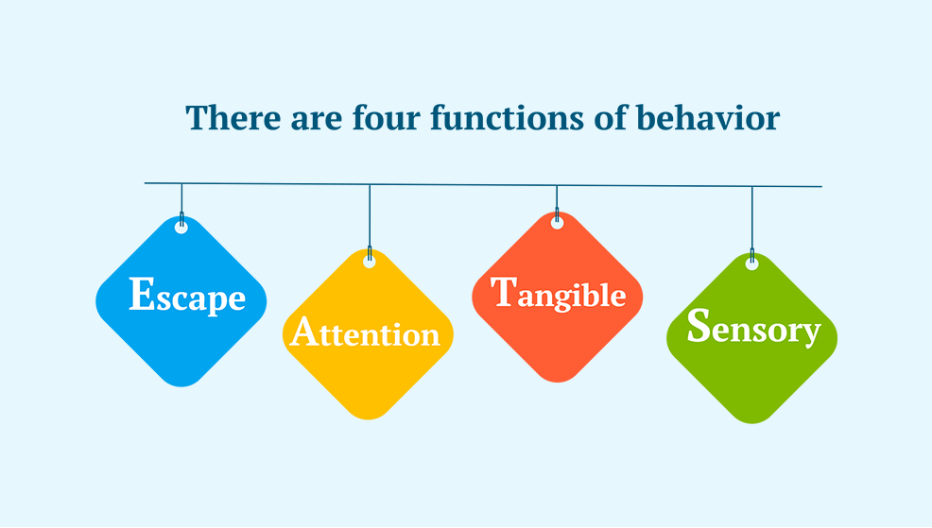
Functional Behavior Assessment
A Functional Behavior Assessment (FBA) helps determine the function of a problematic behavior, so that the therapist can develop strategies to address it.
The function of behavior may include attention, escape/avoidance, to obtain a tangible reward, to meet a sensory need.

Slide 50
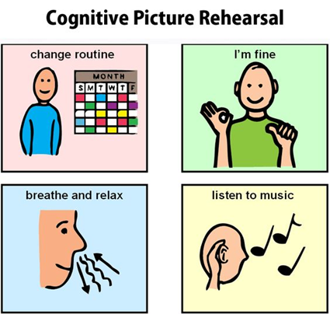
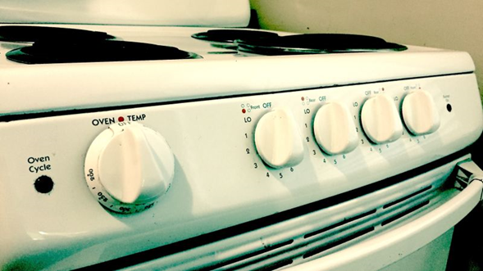
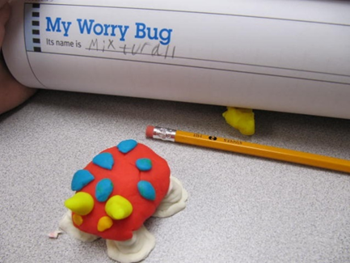
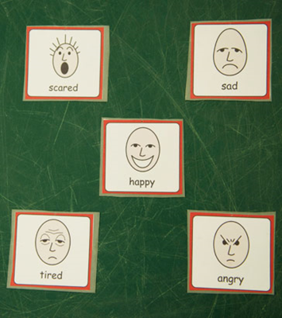
Interventions for Anxiety
Antecedent/prevention
Structure and visual supports
Picture Rehearsal (comic strip)
Skill development: social, coping, communication, relaxation
Label the Anxiety & Make it Concrete

Slide 51
Social Skills Training
When people have communication challenges, this may play a role in their mental health problems or keep them from getting the support they need from others.
They may have difficulty making eye contact, having back-and-forth conversations, making friends, or negotiating social problems.
Social Skills Training can help improve their communication with others through skill building and practice:
For example, a person who tends to have one-sided conversations, ignoring the comments of the other person can learn the steps for having a back-and-forth conversation (like turn-taking in a game), practice having two-way conversations (talk, listen, respond) in the session, and get immediate feedback on each step in their performance. This can be done individually or in groups.

Slide 52
Parent/Caregiver Training
Consider parent/caregiver training programs designed to help prevent or treat mental health problems and support caregiver wellbeing
Typically, 8 to 12 sessions lasting 90 minutes each
Focused on developing communication and social functioning skills in order to more effectively support the person with dual diagnosis (MI/DD)

Slide 53
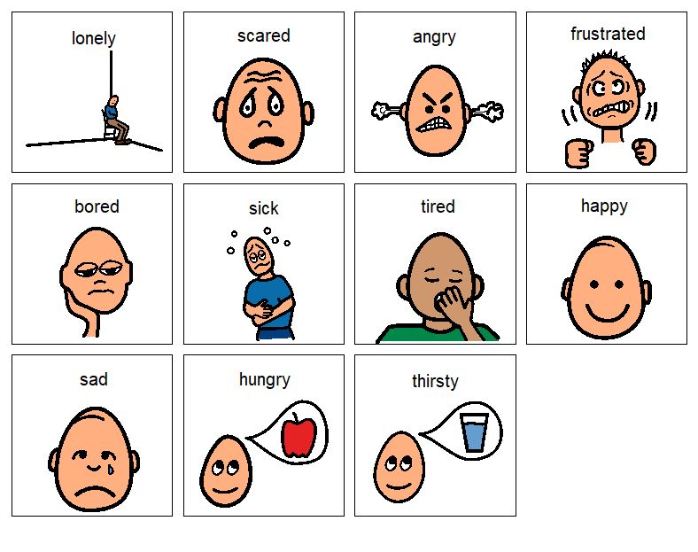
Visual Supports
Visual Supports (pictures, illustrations, objects, written words) can be used to explain a concept, aid memory, or support a person’s ability to communicate ideas. These supports are often used with individuals with I/DD who have limited spoken language.
Some examples include using pictures depicting emotion faces to help identify feelings, giving homework to-do lists, having physical boundary markers, posting images of calming techniques like blowing out a candle (deep breathing) or using objects in the room creatively (throwing away negative thoughts into the trash can).
These aids are also helpful to individuals who use spoken language when concepts are complex, or to when you want to prompt memory.

Slide 54
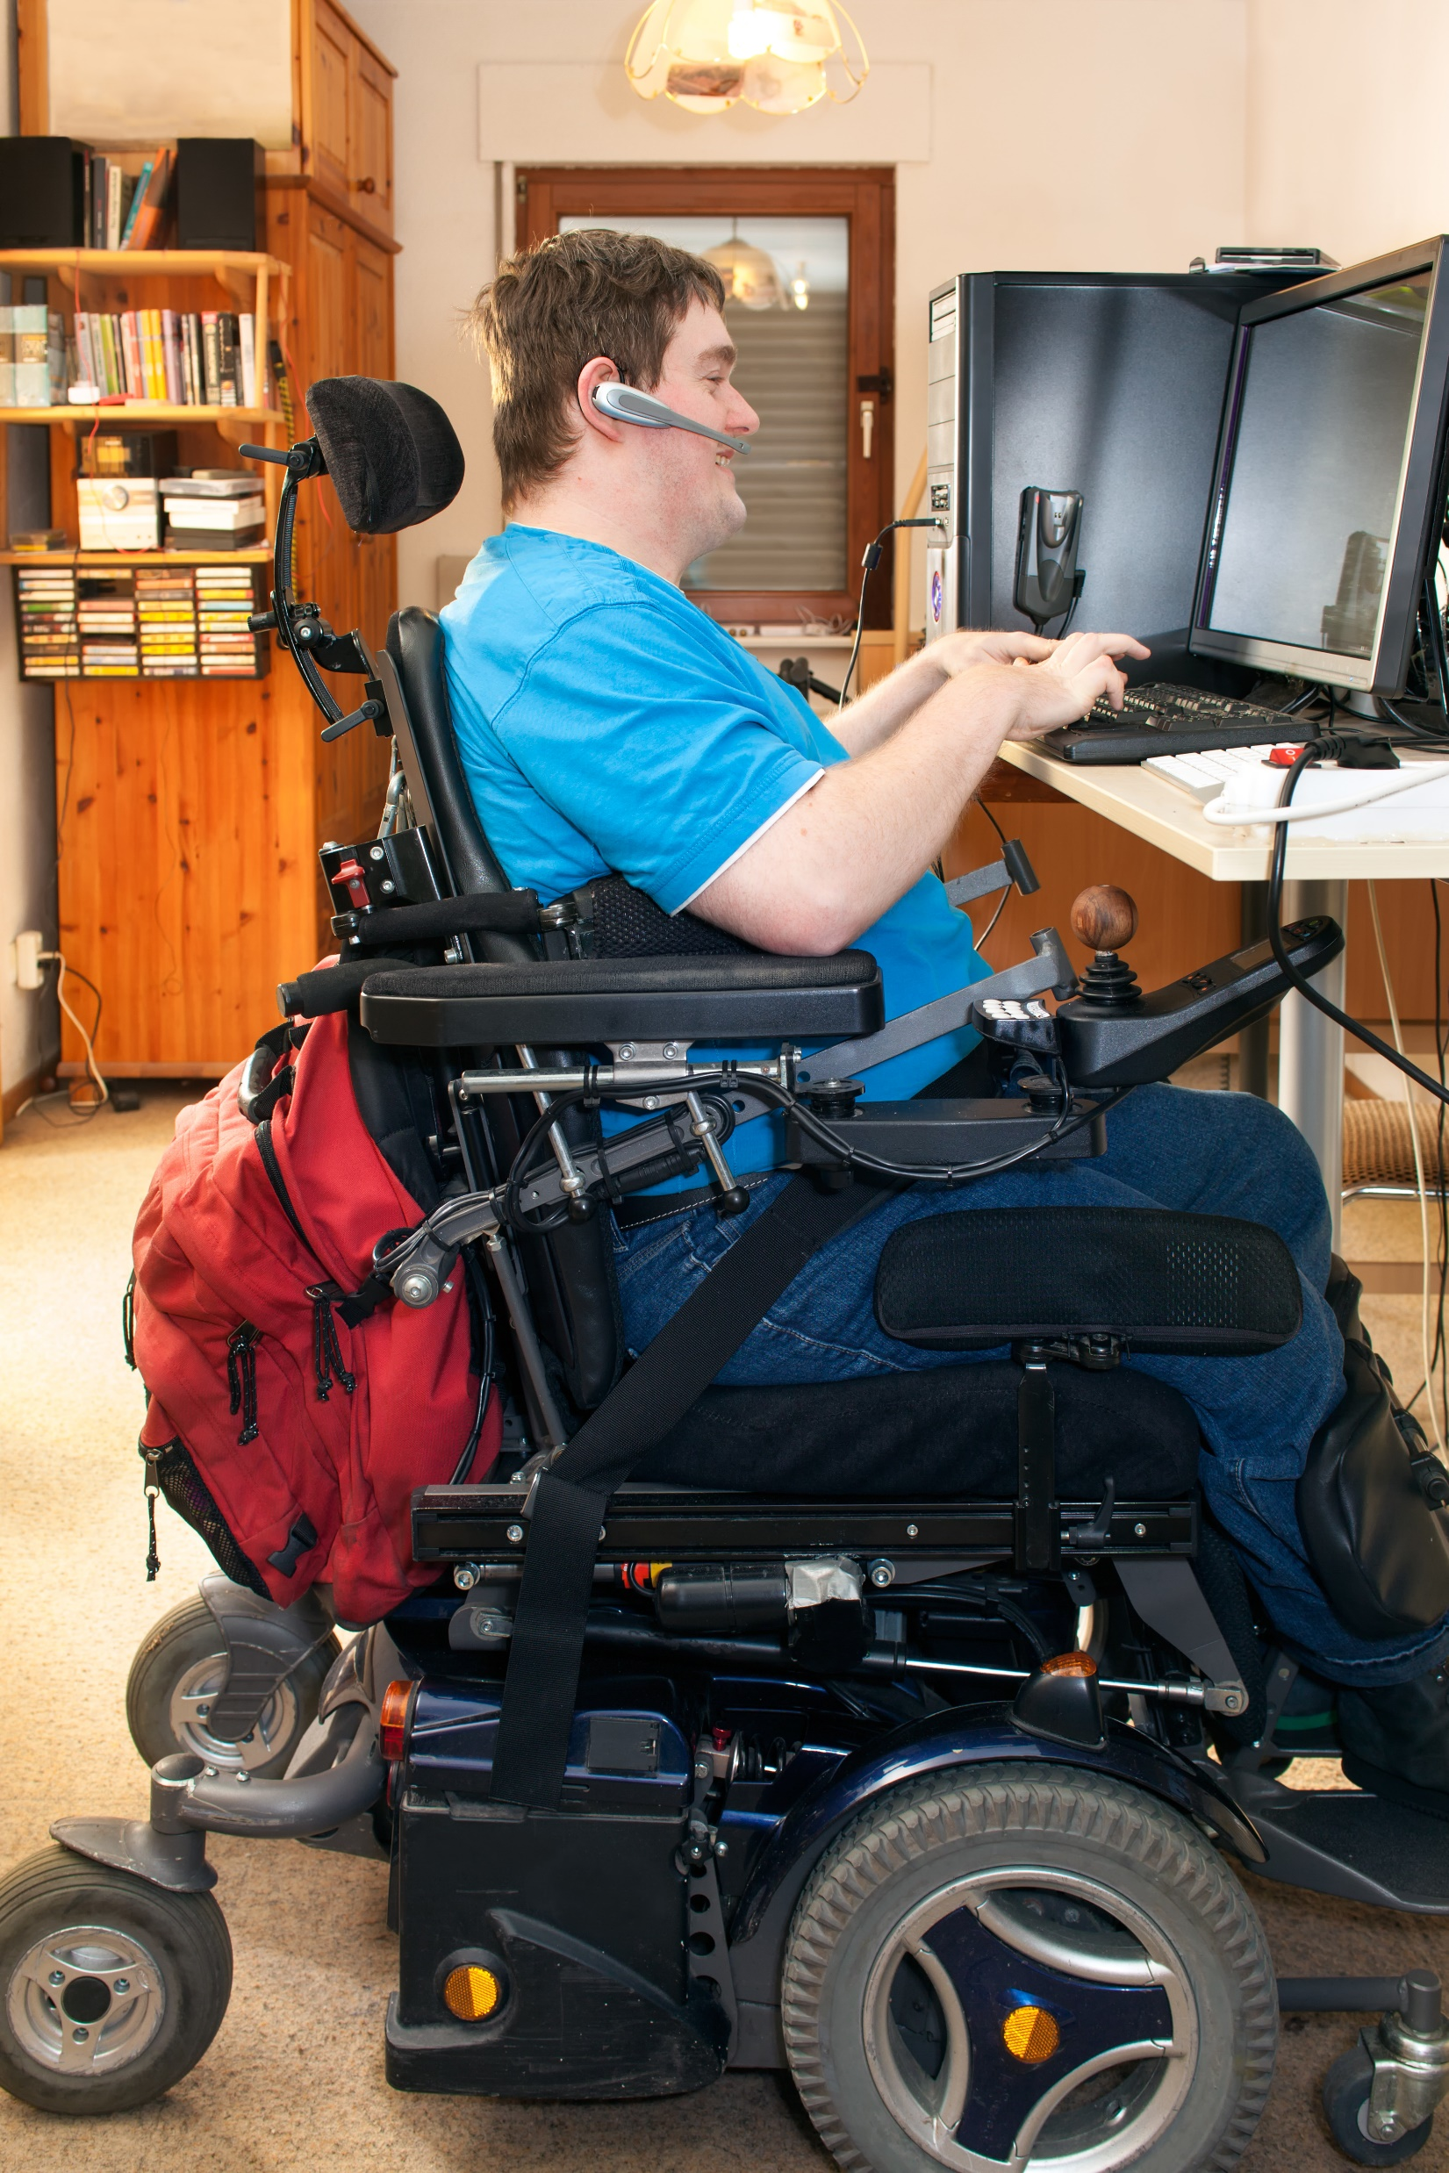
Technology
Technology can increase a person’s engagement in treatment sessions and motivate attendance.
Technology and videos can model behaviors for the client or help explain difficult concepts (for instance, how to complete a desired behavior). Video can be particularly helpful when goals include building social skills like group discussion, or particular behaviors, like brushing teeth.
Technology can be used to reinforce concepts or remind someone with difficulties in organization, such as phone apps to track tasks, or help with calming or distracting activities.
These technologies are also used as rewards: allowing the person to intermittently play a video or a song when they have engaged in part of their session

Slide 55
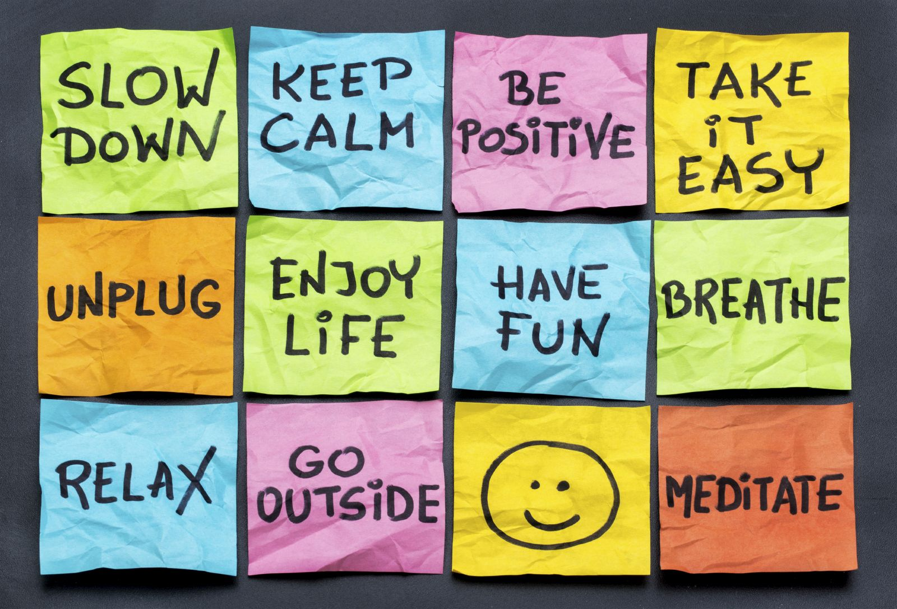
Coping Skills and Relaxation
American Institute of Stress (AIS)
https://www.stress.org/management-tips/
Deep Breathing
Visualization
Applied Progressive Relaxation
American Psychological Association (APA):
http://www.apa.org/topics/stress/index.aspx

Slide 56
Who Benefits From Relaxation Therapy?
Relaxation techniques are often incorporated in CBT, DBT and other forms of therapy. Most individuals can benefit from relaxation strategies.
However, for individuals with IDD, relaxation has been found particularly effective as a stand-alone treatment for anxiety and stress management
Relaxation strategies can be taught to staff who can work alongside individuals within residential or program settings. No special credentialing is required to use these strategies

Slide 57
4-Square Breathing

Slide 58
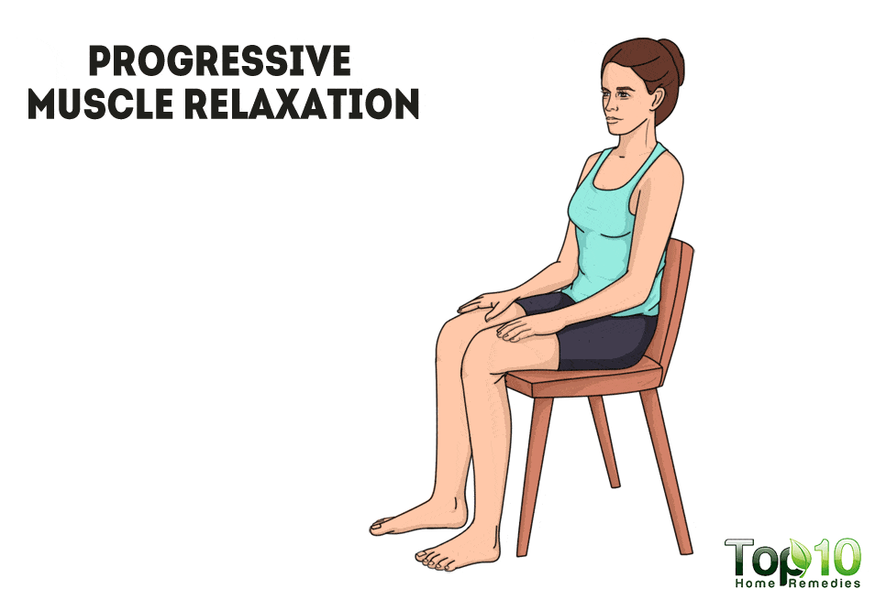
Progressive Muscle Relaxation
Tighten and release muscles one at a time, starting from toes and moving all the way up to the person’s scalp.
Only use the body parts that the person can understand.
For example, if a person doesn’t understand the concept of scalp muscles, stop with the face.
Please note that this should not be used with somebody who has muscle spasticity (tightness) who might find releasing too difficult.

Slide 59
Visual Meditation
Find a picture of something that the person finds calming.
You also can find a picture with some motion in it, if that works better for the person, such as a fireplace video or a waterfall video. These can be found for free on video-streaming websites.
Create a brief routine with the person in which you talk about all the things in that picture that are good. For example, with a picture of a cat, talk about all the things that are loved about a cat. As you talk through the things that are loved, involve other senses as well. Continuing with the cat example, talk about hearing the cat purr or how good the cat smells.

Slide 60
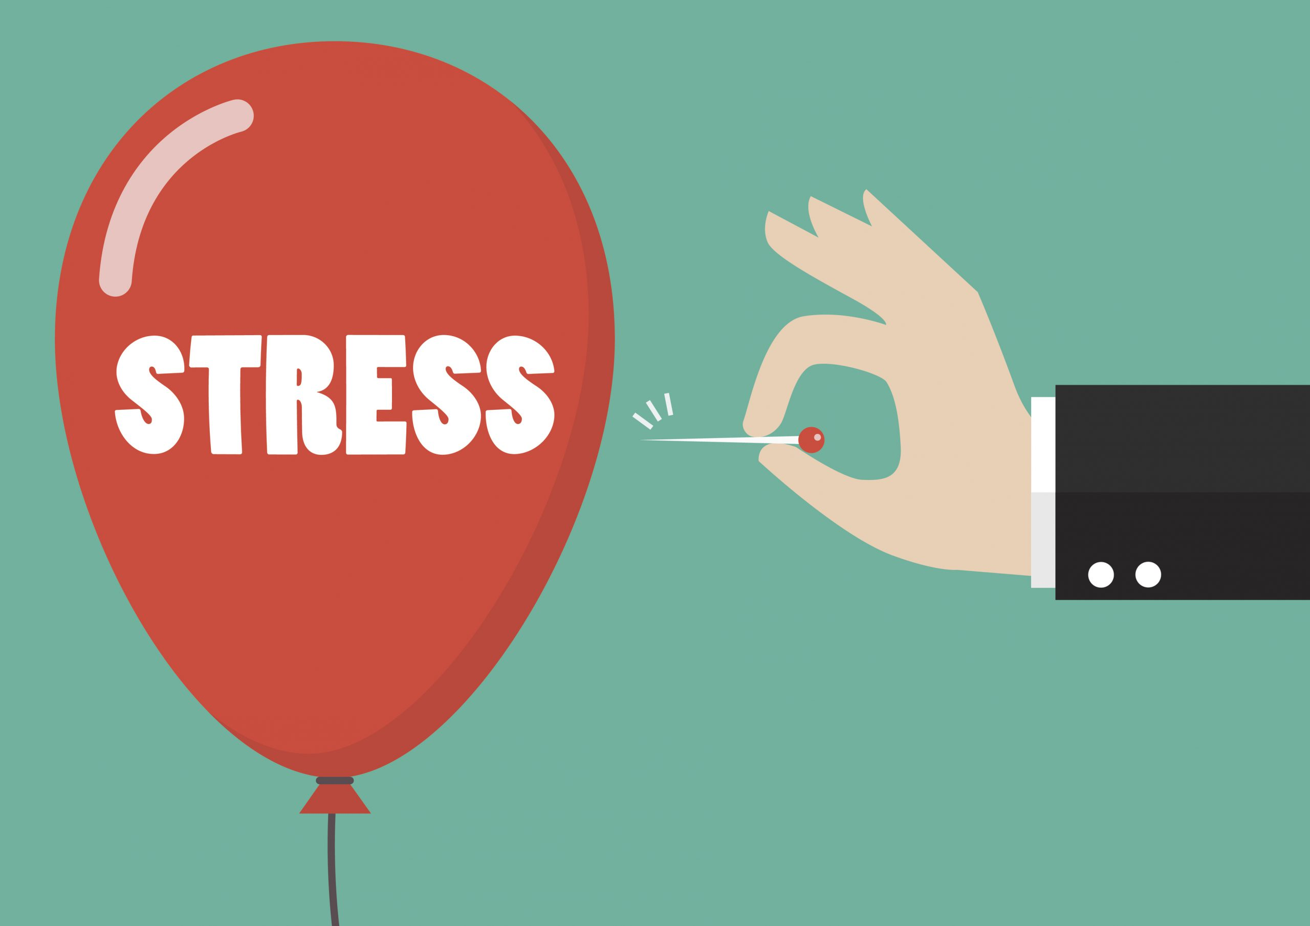
Stress Reduction Strategies
Teach relaxation exercises (breathing exercises, progressive relaxation exercises)
Help the individual learn self-regulation of mood and behavior through Zones of Regulation or the Incredible 5-point Scale
Help the individual develop a list of coping skills which might include:
a) taking a walk
b) taking a shower
c) developing a personal music play list
d) requesting to speak to a preferred staff, friend or family member

Slide 61
Anger Management

Slide 62
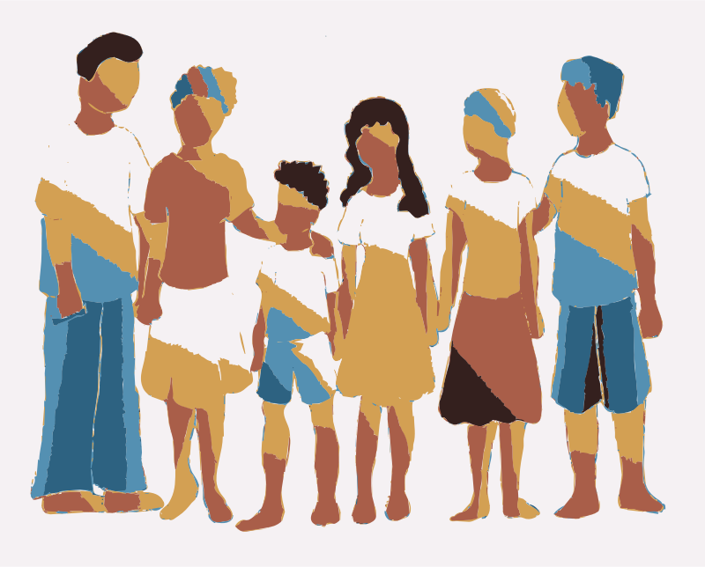
How Can Families Help?
Understand the nature of their relative’s mental health challenges including usual /prescribed medication that are effective in treating the specific mental illness
Encourage their relative to resume usual routine and expectations as soon as possible to the extent tolerated
Work alongside staff to provide supports, and opportunities to develop age appropriate social and emotional coping skills

Slide 63
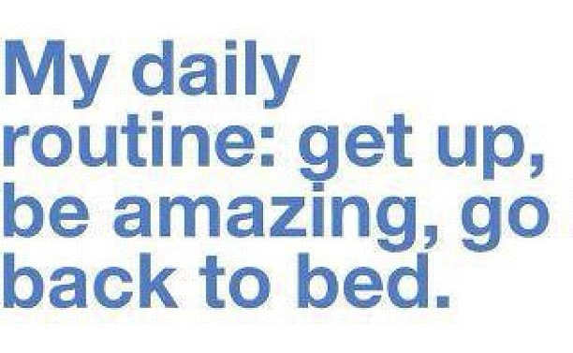
Positive Daily Routine
Morning routine to get the day started
Routines for transitioning from one activity to another or one area of the facility to another
Routine for afternoon activities
Routine for evening (include wind-down, leisure)
Routine for bed
When during the day or week is there time for physical activity?
When during the day or week is there time for social connection?
When during the day or week is there quite or private time?
When during the day or week is there time for recreation or leisure?
Where in the week is there time to learn and practice wellness tools?
When during the day or week is there time to connect with spiritual practice?

Slide 64
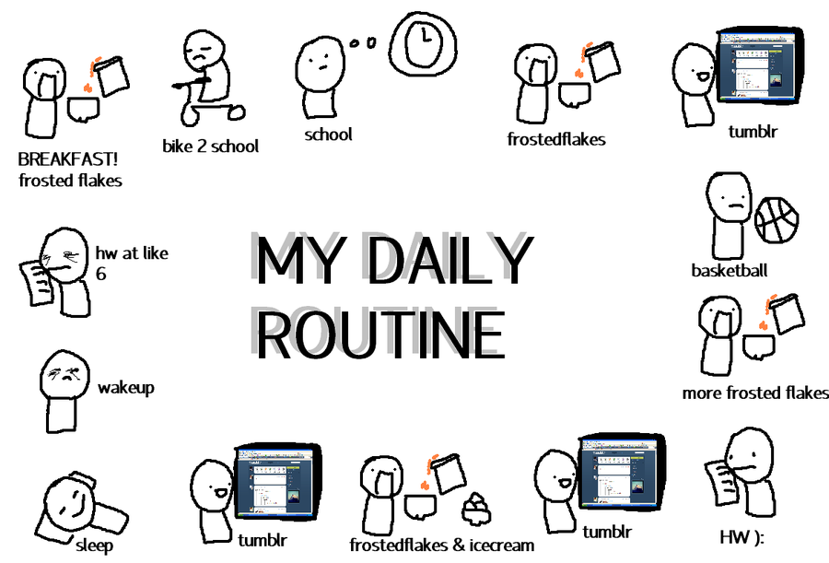
Provide Clear Expectations
Clear sequence of events
Clear expectations about behavior
Strategies about meeting those expectations
If using a rewards system, provide a clear link between behaviors and rewards or consequences
Predictability
Plan for times when there will be a break in routine
Provide the individual with positive practice suggestions
What can this individual do now to feel better?

Slide 65
Emergency Plan
Work with the family to develop an emergency plan:
How can everyone in the household remain safe?
When should the family physician/treating practitioner be notified?
When should the family bring the consumer to the Emergency Room?

Slide 66
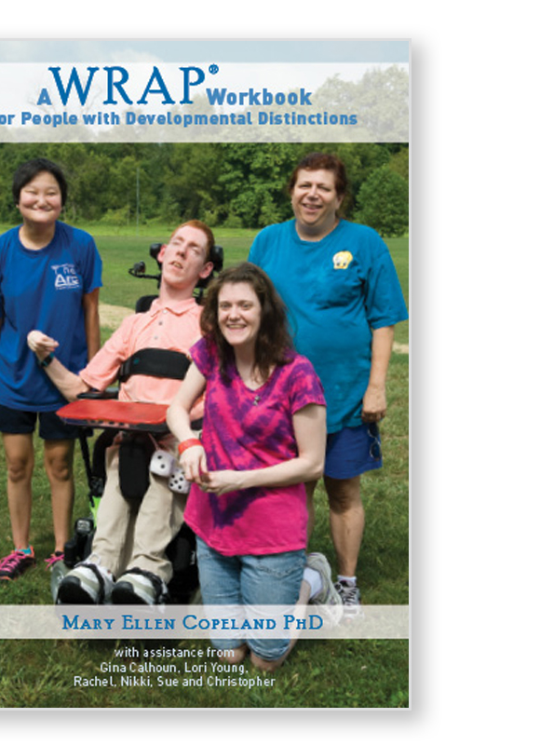
Wellness Recovery Action Plan (WRAP)
Can be likened to a Mental Health Individual Support Plan
Individuals develops a toolkit of coping resources
WRAP facilitators can work with individuals, families and staff to create a living document that reflects the strengths, evolving needs and capabilities of the person served

Slide 67
Mental health Supports for Families
CARES 1-888-393-3007
Intensive Family Support Services www.mhanj.org/intensive-family-support-services
Anyone who needs suicide or mental health-related crisis support, or who has a loved one in crisis, can connect with a trained counselor by calling, chatting, or texting 988
MoM2MoM 1-877-914-6662 (MOM2) ubhcrutgers.edu/call-center/peer
NAMI www.naminj.org 732-940-0991
County Mental health Associations www.mha+county
https://njcdd.org/wp-content/uploads/An-Enhanced-Family-Crisis-Handbook.-A-Behavioral-Health-and-Wellness-Toolkit-2022.09.22.pdf

Slide 68
https://njcdd.org/wp-content/uploads/An-Enhanced-Family-Crisis-Handbook.-A-Behavioral-Health-and-Wellness-Toolkit-2022.09.22.pdf

Slide 69
Take home message
Early identification of mental health issues
Delivery of relevant treatment, services and supports involve collaboration among multiple stakeholders: self-advocates, families, staff, health care providers
Seek medical evaluation to pursue medication management for individuals with mental health concerns
Seek non-medical interventions such as individual or group therapy for individuals who can benefit from psychotherapeutic approaches
The multi-disciplinary team can identify behavioral and programmatic supports and environmental interventions to assist the person with IDD and mental health concerns

Slide 70
!

