Slide 1
An Overview of Medicaid for Individuals with Intellectual and Developmental Disabilities (IDD)
Connor Griffin, MPH
Director, Health Care Advocacy
The Arc of New Jersey
December 5th, 2024
healthcareadvocacy@arcnj.org
To sign up for emails:
www.arcnj.org

Slide 2
The Arc of New Jersey
The state’s largest organization advocating for children and adults with intellectual and developmental disabilities (IDD) and their families.
Affiliated chapter of our national organization, The Arc.
Community-based, direct support services available statewide through our strong network of 20 local chapters across all 21 counties.
Primarily an advocacy organization, conducting public policy work, community outreach, and information and referral services.

Slide 3
The Arc of New Jersey
The Arc of NJ has many programs, including:
Project HIRE
Planning for Adult Life
The NJ Self-Advocacy Project
The Criminal Justice Advocacy Program
The Arc of NJ Family Institute
Children’s Advocacy
Health Care Advocacy
Training & Consultation Services
Visit arcnj.org

Slide 4
Common Acronyms
DDD – NJ Division of Developmental Disabilities
DAC – Disabled Adult Child
IDD – Intellectual and Developmental Disabilities
SSA – Social Security Administration
SSDI – Social Security Disability Income (based on work history)
SSI – Supplemental Security Income (not based on work history)
SNT – Special Needs Trust

Slide 5
Main Topics to be Discussed:
Applying for SSI
ABLE Accounts and Special Needs Trusts
Disabled Adult Child (DAC) Status
Appealing an SSI Denial
How to qualify for Medicaid, besides SSI?
Different Types of Medicaid Programs
NJ WorkAbility Medicaid
Medicaid Managed Care

Slide 6
Why Apply for SSI at 18?
When an individual with IDD is under 18 years old, the determination for Supplemental Security Income (SSI) is based on family income and resources.
When the individual is over 18, the determination is based on the individual’s income and resources.
Encouraged to apply after individual’s 18th birthday.
Resources must be under $2,000. This includes anything in their name, tied to the person’s Social Security number.
Relatives should not leave money to the individual, unless in a Special Needs Trust that the parents have set up.

Slide 7
To Receive Division of Developmental Disabilities (DDD) services at age 21, a person:
Why Apply for SSI at 18? (cont.)
Must be functionally eligible for DDD services and must have Medicaid.*
Best way to have Medicaid: Apply for SSI at age 18.
A person with SSI automatically gets Medicaid.
SSI is the cash benefit. Medicaid is the health insurance benefit and the gateway to DDD services.
*An exception being someone who qualifies as a “Non-DAC” through the DDD waiver unit. This is someone “over income” for SSI and other Medicaid programs.

Slide 8
Before Applying for SSI
Person with IDD can’t have more than $2,000 in their name (resources/assets).
“Spend-down” if the amount over $2,000 is small. Can document for spend-down: summer camp; class trip; therapies not covered by insurance.
No spend-down on food, clothing, shelter – considered the parent’s responsibilities.
If applicable, consider a Special Needs Trust and/or an ABLE account.

Slide 9
If Parents are Divorced
When parents are divorced, child support is viewed as the child’s “unearned income.”
Depending on the amount of child support, the adolescent may not be eligible for SSI or Medicaid, but there is a 1/3rd exclusion of child support income.
Example: if a child receives $1,000/month in child support, only $666 would be counted by Medicaid as “unearned income.”

Slide 10
ABLE Accounts
Achieving a Better Life Experience (ABLE) Act of 2014
Persons with IDD can deposit up to $18,000/year (2024) in an ABLE tax-exempt savings account.
Increasing to $19,000/year in 2025
Age of onset of disability must be before age 26
Must be receiving SSI or SSDI; or with medical documentation, can deposit money into ABLE as a spend-down before applying for SSI.
ABLE accounts won't affect continuing financial eligibility for SSI or Medicaid.
If the individual works, there is a higher annual contribution limit.

Slide 11
ABLE Accounts (cont.)
ABLE accounts available in NJ and other states.
May open an ABLE account in NJ online at https://savewithable.com/nj/home.html
Visit the ABLE National Resource Center at www.ablenrc.org, for state-specific information. Offer educational webinars and state-by-state comparisons.
Important: Upon the death of the beneficiary, the state in which the person lived may file a claim for a portion or all of the remaining funds in the ABLE account to recoup costs paid by the state while the beneficiary was receiving services through the state Medicaid program.

Slide 12
Special Needs Trust (SNT)
Unique type of trust that may be used to establish eligibility for SSI or Medicaid.
If setting up a SNT, be sure the attorney is very experienced with this type of trust for the SSI/Medicaid beneficiary.
If the SNT has been funded, Social Security/Medicaid will want to review the information.
Whenever there are expenditures from SNT, document and save all receipts.

Slide 13
Preparing to Apply for SSI
As you are getting ready to complete the application, start collecting:
Evaluations and assessments
Schools: Name, address, IEPs, and Progress Reports
Disabilities: names of conditions/diagnoses; onset date
Doctors and therapists: Name, address, phone, dates first and last seen, specialty, diagnosis
Medications: Name, prescribing physician, date, and dosage when started, as well as most recent date and dosage
Employment (if applicable): Name, address, phone, supervisor name, position held, date, pay when started, last date of work, and pay
Division of Vocational Rehabilitation Services information
Put together a folder and create electronic files, if possible.

Slide 14
SSA’s Decision
A disability diagnosis alone does not mean there is a severe impairment that entitles the applicant to SSDI or SSI benefits, and the burden of proof is on the applicant.
While the diagnosis may be very compelling, Social Security needs to know what the actual impact of the condition is on the applicant’s ability to do work-related activities and be self-supporting.

Slide 15
Starting the SSI Application
Information on applying for SSI: www.ssa.gov/ssi/text-apply-ussi.htm
Can start the disability application process online, for a first time SSI application.
SSA representative will follow up and schedule an appointment within 7-14 business days.
May also call Social Security at 1-800-772-1213 to make an appointment to apply for SSI benefits for your adult child with IDD.
With an appointment, you can apply for SSI on the phone or in person at your local Social Security office.

Slide 16
If SSI is Approved
Always respond quickly to official requests for information. SSI and Medicaid can be terminated for failure to respond.
If moving, be sure that Social Security and Medicaid have the new mailing address.
Keep copies of the SSI application and supporting documentation
Helpful to have this information for later when a parent collects Social Security retirement, disability, or passes away

Slide 17
When SSI Begins
Consider a representative payeeship for the SSI funds.
SSI cannot be deposited into the parent’s bank account!
SSI checks deposited electronically into this new account, set up for the representative payee, to manage the funds of the SSI beneficiary.
Do not exceed $2,000 in resources/assets!
If receiving a lump sum back payment, you have 9 months to spend down. After 9 months, assets cannot exceed $2,000 in the individual’s name.
Open an ABLE account or SNT, if needed.

Slide 18
SSI/Medicaid & Travel Abroad
If a person receives SSI and travels out of the U.S. for 30 consecutive days or more, they are not eligible for SSI (or Medicaid) during any month when they are outside the U.S.
An individual who was receiving SSI, and has traveled out of the U.S. for 30 days or longer, is not considered by SSA to be in the U.S. until they are in the U.S. for 30 consecutive days upon returning.

Slide 19
Why is it Helpful to have SSI?
When a parent retires, becomes disabled, or passes away:
If the adult child has SSI, they become eligible to receive Social Security Disability Insurance (SSDI) income on the parent’s work record, usually instead of SSI.
A loss of SSI results in a notice of termination from Medicaid.
Monthly SSDI often exceeds the ABD Medicaid income limit ($1,255/month for a single adult in 2024).
But, when the person with IDD had SSI, they are a “Disabled Adult Child” - a Section 1634 DAC,” as defined by the SSA.
Eligible to re-qualify for Medicaid, after they start receiving SSDI on a parent’s work record, even if SSDI exceeds $1,255/month.

Slide 20
Disabled Adult Child (DAC)
SSA definition of a DAC:
A person who was receiving SSI benefits (and Medicaid) and who meets the following:
Is at least 18 years of age;
Has blindness or a disability which began before the age of 22;
Has been receiving SSI based on blindness or disability; and
Has lost SSI due to the receipt of Social Security benefits on a parent’s record due to the retirement, death, or disability of a parent.
The person cannot have more than $2,000 in resources in their name (not including a SNT or an ABLE account).

Slide 21
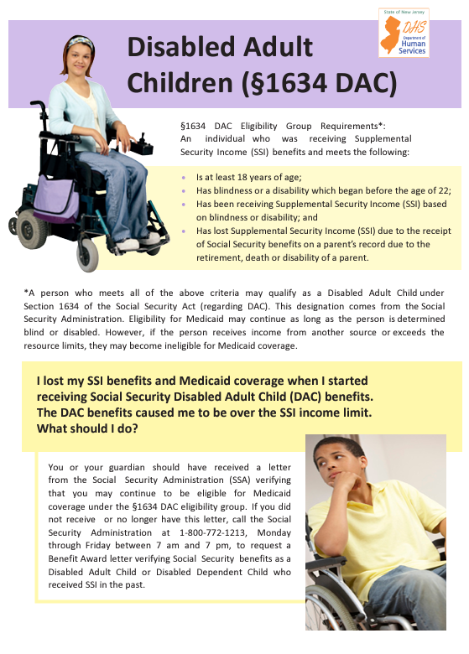
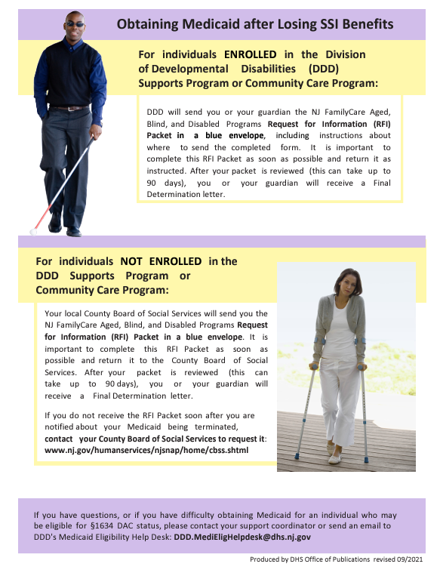
NJ DHS DAC Flyer

Slide 22
Medicaid as a DAC
For individuals NOT ENROLLED in the DDD Supports Program or Community Care Program:
Your local County Board of Social Services should send you the NJ FamilyCare Aged, Blind, and Disabled Programs Request for Information (RFI) Packet in a blue envelope.
Important to complete this RFI Packet as soon as possible and return it to the County Board of Social Services. After your packet is reviewed (may take up to 90 days), you will receive a Final Determination letter.
If you do not receive the RFI Packet from the County BOSS, contact the office to request it: www.nj.gov/humanservices/njsnap/home/cbss.shtml

Slide 23
Medicaid as a DAC - DDD
For individuals ENROLLED in the DDD Supports Program or Community Care Program:
DDD will send the NJ FamilyCare Aged, Blind, and Disabled Programs Request for Information (RFI) Packet in a blue envelope, which includes instructions about where to send the completed form.
Important to complete this RFI Packet as soon as possible and return it as instructed. After your packet is reviewed (may take up to 90 days), you will receive a Final Determination letter.
If you do not receive the RFI packet, notify your DDD support coordinator.

Slide 24
DDD Medicaid Letter for a DAC

Slide 25
If SSI is Denied
Appeal quickly! Must do so within 60 days.
Easiest way to appeal is online:
www.socialsecurity.gov/disability/appeal
Possible reasons for a denial of SSI:
Assets above $2,000
Special Needs Trust not done correctly
Medical documentation not sufficient to justify a severe disability, per SSA requirements.
Parents may want to contact an attorney to represent their son/daughter in the event of a hearing before an administrative law judge.

Slide 26
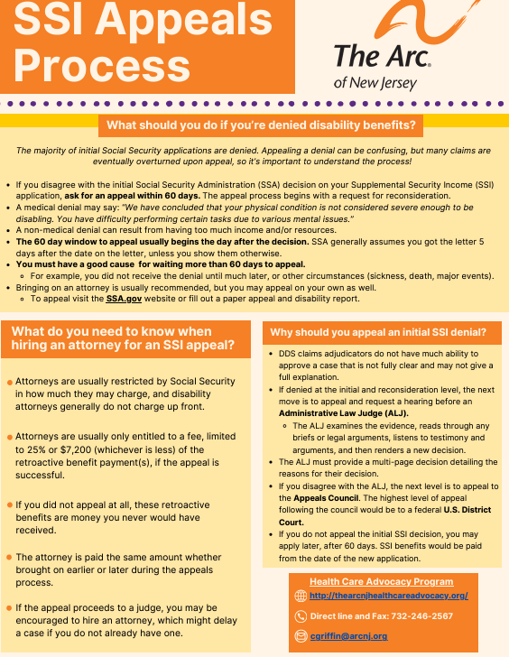
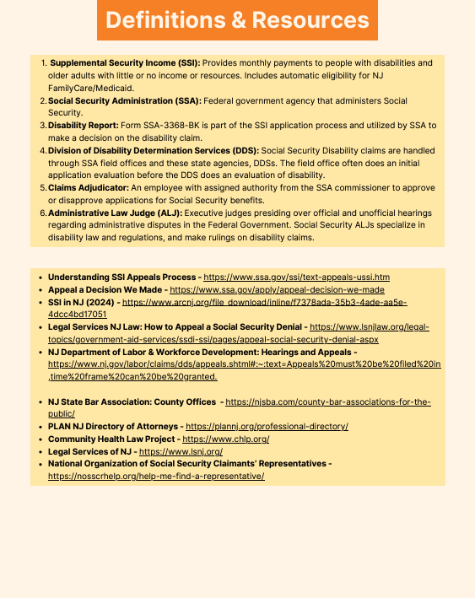
SSI Appeals Fact Sheet

Slide 27
SSI Denial & Medicaid
If SSI is denied because SSA determines the person to not be sufficiently disabled, per their requirements …
Would need to wait a year to apply for Aged, Blind, Disabled (ABD) Medicaid.
The state Medical Review Team (MRT) then makes an independent disability determination.
Some individuals may qualify for regular NJ FamilyCare Medicaid.
Only possible if the individual with IDD is not listed as a dependent on the parents’ tax return and does not have Medicare.
SSI approval, following an appeal, would provide Medicaid, but this is often a long process.

Slide 28
When SSI is Not Possible?
In some instances, a person with IDD cannot qualify for SSI because:
The applicant is receiving a Social Security benefit because their parent passed away, is retired, or is collecting SSDI themselves.
The applicant has high unearned income, such as from child support.
The applicant is employed and earns wages.
There are other ways to access Medicaid!
SSI is not required to receive Medicaid or be eligible for DDD services.

Slide 29
NJ FamilyCare/Medicaid
NJ FamilyCare is the NJ Medicaid program!
Main Types of Medicaid:
NJ FamilyCare Medicaid, covering children under 19, lower income adults, and pregnant women
Affordable Care Act (ACA) expansion Medicaid or “MAGI” (Modified Adjusted Gross Income) Medicaid.
Aged, Blind, Disabled (ABD) Medicaid, covering people 65 and older, and people determined blind or disabled by Social Security, or the state.
Most individuals with IDD have an ABD type of Medicaid.

Slide 30
ACA/MAGI Medicaid
Eligibility is based on income, not on an individual having a disability (no medical documentation needed).
No resource/asset limit
Maximum gross income of $1,732/month (2024) for a single adult
Not possible for an individual on Medicare or if the individual is listed as a dependent on parents’ tax return
ABD Medicaid is usually a better option if the individual has a disability and is financially eligible.

Slide 31
ABD Medicaid
Different ABD Medicaid Programs:
Supplemental Security Income (SSI) Medicaid
Medicaid Only
New Jersey Care … Special Medicaid Programs
NJ WorkAbility
Managed Long Term Services and Supports (MLTSS)
Only one ABD application, no matter the program.
2024 ABD Medicaid Programs Brochure

Slide 32
NJ Care Special Medicaid
Depending on their income, a person 18 years of age and older may apply for Medicaid.
Individuals with gross monthly income equal to or below 100% of the federal poverty level (FPL) may qualify for NJ Care Special Medicaid.
$1,255/month for a single individual (2024)
Resource maximum of $4,000
This type of Medicaid is fine for DDD services.
Social Security is not required.

Slide 33
Medicaid & the DDD Waiver Unit
If a person with IDD is not on SSI and receiving an SSDI benefit from the parent’s record work record - usually too much income to qualify for Medicaid.
Previously referred to as a “Non-DAC” - special eligibility through the DDD waiver unit, under their “Medicaid Only” program.
Income limit of $2,829/month (2024)
Resources must still be under $2,000.
Following DDD intake and, upon approval for services, the person is provided a Medicaid application.
Use The Arc of NJ Medicaid Eligibility Problem Form
https://www.arcnj.org/programs/health-care-advocacy/problem_forms.html

Slide 34
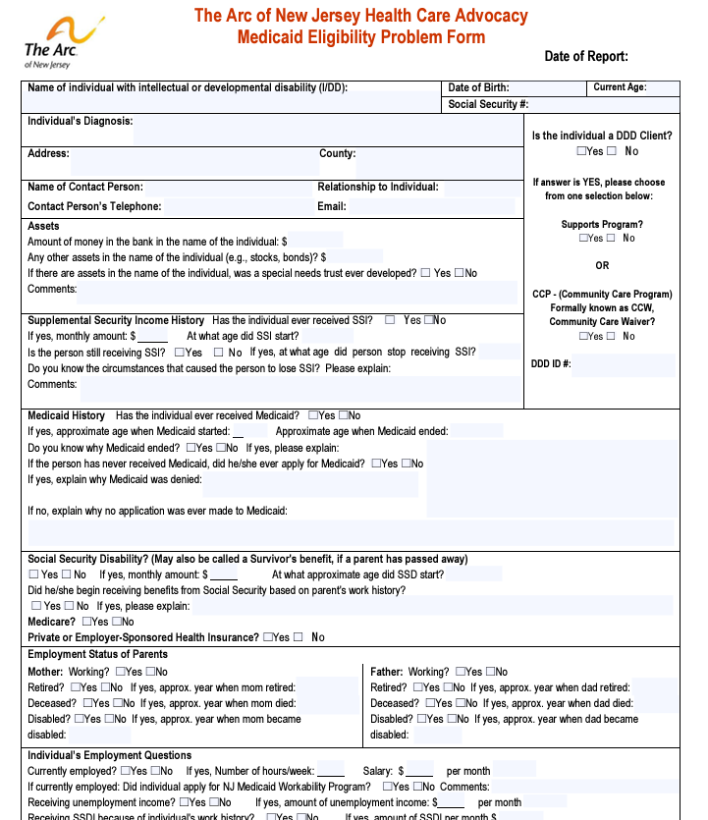
Medicaid Eligibility Problem Form

Slide 35
DDD & Medicaid (cont.)
Most notices say that Medicaid is required to receive DDD services.
But a person who has too much income for SSI and other Medicaid programs may qualify through the DDD Waiver Unit process.
We have a helpful “Non-DAC” fact sheet, available on our website under the Health Care Advocacy program.
https://www.arcnj.org/programs/health-care-advocacy/resources.html
Please note: Approval under the “Medicaid Only” program through the DDD Waiver Unit does not immediately provide Medicaid coverage. The person is provided a Medicaid application later, upon approval for DDD services.

Slide 36
NJ WorkAbility Medicaid
Offers full Medicaid coverage to working individuals with disabilities whose income/assets would otherwise make them ineligible.
Phase 1 - April 1st, 2023:
Allows for the continuation of NJ Workability for up to 12 months after a job loss (through no fault of the employee).
Resource/asset limits were eliminated.
Keep NJ WorkAbility after 65th birthday.
Removes consideration of spousal income.

Slide 37
NJ WorkAbility Medicaid (cont.)
Phase 2 - February 1st, 2024:
Open to people age 16+ with a disability determination
No longer counts spousal income when determining eligibility or premiums
No longer limits eligibility based on assets
No longer limits eligibility based on income.
People with countable income over 250% of the Federal Poverty Level must agree to pay a premium.
More information available on the DDS website:
https://www.nj.gov/humanservices/dds/programs/njworkability/

Slide 38
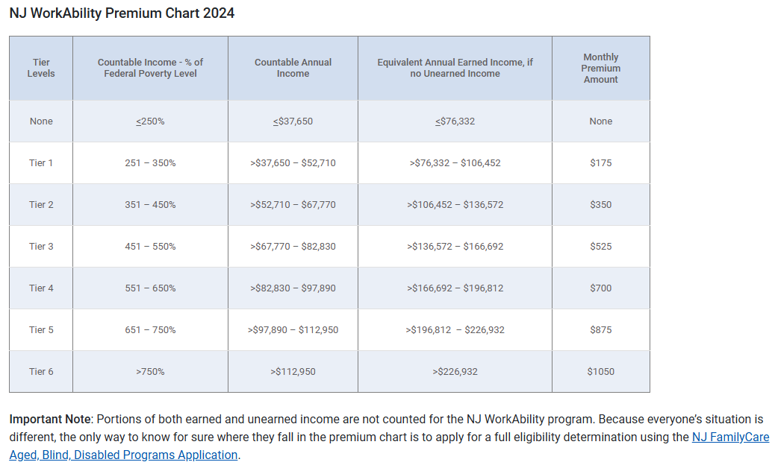
NJ WorkAbility Premium Chart
https://www.nj.gov/humanservices/dds/programs/njworkability/

Slide 39
Social Security & Employment
If an SSI/Medicaid beneficiary is working, must report wages to Social Security each month.
Substantial Gainful Activity (SGA) Limit - $1,550/month in work-related earnings (2024).
Increasing to $1,620/month in 2025.
Does not include a person’s SSDI benefit.
If receiving SSI and exceed SGA: expect a reduction in the amount of SSI.
If receiving SSDI and exceed SSDI: can result in a termination of SSDI and required to pay back the “overpayment.”

Slide 40
NJ WorkAbility & SSDI
Important to remember: NJ WorkAbility provides Medicaid coverage - as long as the individual remains employed.
While NJ WorkAbility Medicaid does not have an income or asset limit, a person on WorkAbility may also be receiving monthly SSDI.
If the person wants to keep their SSDI benefits, they must remember the Social Security monthly SGA limit.
Having WorkAbility does not protect against loss of SSDI, if a person continuously exceeds SGA.

Slide 41
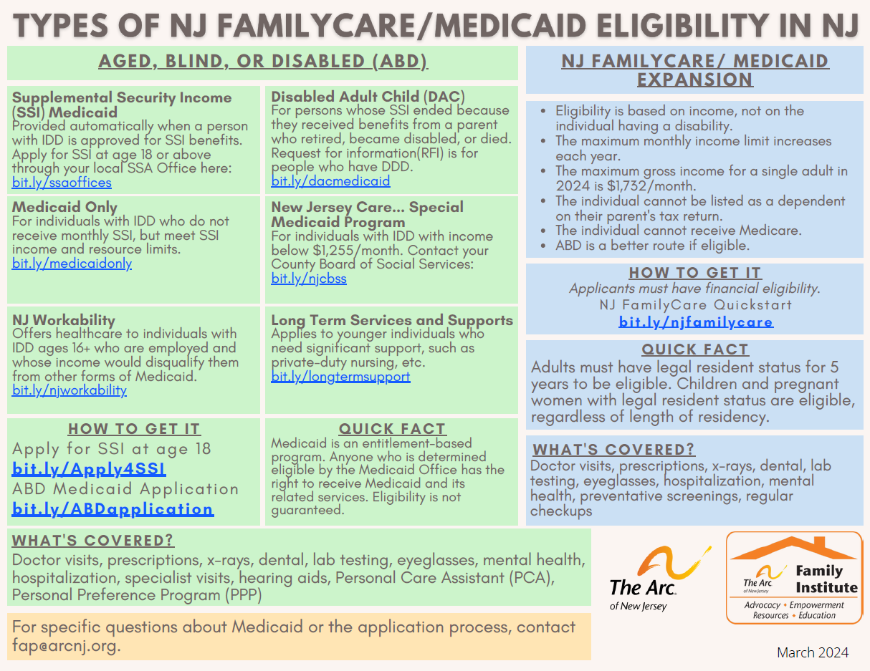

Slide 43
Medicaid Managed Care
A person enrolled in Medicaid must be enrolled in Medicaid managed care.
Can select a managed care organization (MCO), and switch at any time for “good cause.”
Health Benefits Coordinator for Medicaid questions: 1-800-701-0710
Care management available, upon request, from the MCO.
If person has private insurance, it is the primary payer and Medicaid is the “payer of last resort.”
Five Medicaid MCOs in NJ:
1. Horizon NJ Health
2. United Health Care Community Plan
3. Wellpoint (formerly Amerigroup)
4. Fidelis Care
5. Aetna Better Health

Slide 44
PCA & PPP
Personal Care Assistance (PCA) and the Personal Preference Program (PPP) are available for eligible Medicaid enrollees.
Must require assistance with activities of daily living (ADLs) such as bathing, feeding, dressing, grooming, toileting, etc.
PPP program allows someone to direct their own PCA services, such as through friends and family, without needing a home health care agency.
PCA and PPP are free, but require a doctor’s prescription and MCO nurse assessment to approve eligibility and determine the number of hours per week that Medicaid will cover.
Contact your MCO to begin the process.

Slide 45
Apply for Medicaid
Online via the NJ FamilyCare website
Apply here
In person at your local County Board of Social Services office
Find your local office
Print the application, fill in out, and mail it in
A pdf of the application
Call NJ FamilyCare at 1-800-701-0710 (TTY: 711) for assistance, if needed.

Slide 46
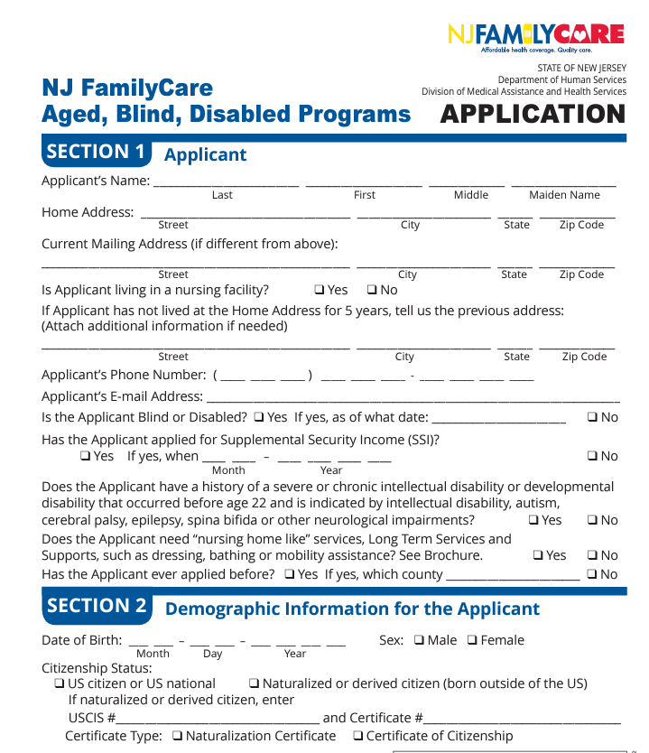
ABD Medicaid Application

Slide 47
Parent’s Insurance Beyond 26
All young adults can remain on a parent’s health insurance until age 26.
Adult children with IDD may remain on the parent’s plan beyond age 26, if not capable of self-sustaining employment.
At least a few months before the child’s 26th birthday the parent should contact employer’s Human Resources.
Possible to have private health insurance, Medicare, and Medicaid.
Medicaid is always the payer of last resort.
The Arc of NJ’s fact sheet on our website.
https://www.arcnj.org/programs/health-care-advocacy/resources.html

Slide 48
More information can be found at www.arcnj.org, under the Health Care Advocacy Program page.
Questions?
Connor Griffin, MPH
Director, Health Care Advocacy
The Arc of New Jersey
healthcareadvocacy@arcnj.org
To sign up for emails:
www.arcnj.org

